Slide 1
Silicon Valley Employers Forum (SVEF)
2022 US Benchmark Survey
Summary of Results | March 17, 2022

Slide 2
2022 US Benchmark Survey
Overview and Agenda
Participating Companies
Demographics, Headcount, Awards & Recognition, Accomplishments
Eligibility & Enrollment
Administration, Data, Vendors
HSA & Survivor Support
Cost
Priorities & Goals, New & Emerging, Trends
Time Off
Finances & Retirement
Survey Resources
2

Slide 3
64 Participating Companies
Data from ALL Companies are Included in Presentation
Adobe
Agilent
Airbnb
Alibaba
AMD
Apple
Applied Materials
Autodesk
Block
Cadence
Ciena
Cisco
Citrix
Dell
DocuSign
eBay
Electronic Arts
Google
Hewlett Packard Enterprise
Hitachi Vantara
HP Inc.
Intel
Intuit
Juniper Networks
Keysight
KLA Corporation
Lam Research
Lenovo
LinkedIn
Lumentum
Marvell
Meta
Micron Technology
Microsoft
NetApp
Netflix
NortonLifeLock
Nutanix
NVIDIA
NXP Semiconductors
Oracle
Palo Alto Networks
PayPal
Pinterest
Pure Storage
Qualcomm
Salesforce
Samsung Austin Semiconductor
Samsung Semiconductor Inc.
Seagate
ServiceNow
Sony Interactive Entertainment
Splunk
Stripe
Synopsys
Tencent
Tesla
Twitter
Veritas
Visa
VMware
Western Digital
Workday
Zendesk

Slide 4

Thank You To Our Survey Team
With Much Appreciation!!
Jennifer Anaba Regala Synopsys
Frank Banuelos Netflix
Matthew Chee Sony Interactive Entertainment
Lynn Erber Microsoft
Emer McCaul Veritas
Lauren Merluzzi AMD
Denise Morgan Citrix
Lisa Northup Splunk
Nicole Rickert Hewlett Packard Enterprise
Denise Rosa NVIDIA
Kathleen Rosenbaum Twitter
Tracy Uyeda Cadence
Linda Watson Samsung Electronics America
Julee Weller Intel

Slide 5

2022 US Benchmark Survey
Demographics | Headcount | Awards & Recognition | Accomplishments

Slide 6

Demographics
New for 2022
Employee Age
  Average: 41 Years
  High: 50 Years
  Low: 32 Years
Exempt/Non-Overtime Eligible (Average)
  Average: 84%
  High: 100%
  Low: 22%
N = 64

Slide 7
Demographics
Another 1% decrease this year in the average of male workers and no change to the average exempt workforce population
Average % Male Workforce: 69%
Average % Exempt Workforce: 84%
N = 64

Slide 8
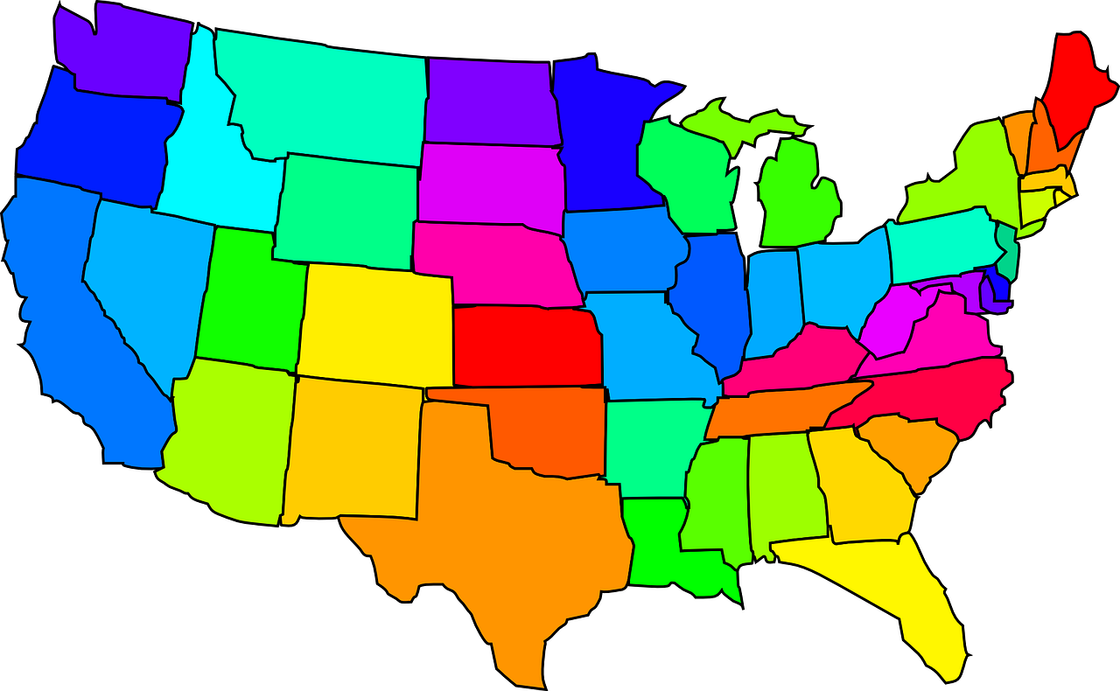
Headcount by State (Top 12)
All top 12 states had increases
4 states with increases of more than 20%:
  Illinois (22% overall, 13% 2021 cohorts)
  New York (22% overall, 18% 2021 cohorts)
  Virginia (22% overall, 20% 2021 cohorts)
  Texas (21% overall, 20% 2021 cohorts)
N = 64

Slide 9
Headcount
84% of Total Employees Reside in 12 States
N = 64

Slide 10





Awards & Recognition
Companies continue to focus on core awards instead of aiming for all possible awards
Overall award recognition increased by 4% this year
22 companies received other awards
9 companies did not receive any awards

Slide 11
2021 Accomplishments
Health, Behavioral Health & Time Off
Health
No increases to 2022 employee contributions
Time Off
Enhanced parental and military leaves
Behavioral Health
Launched global EAP
Increased number of EAP sessions
Unlimited surrogacy benefit
Added HDHP/HSA plans
Enhanced vision and dental benefits
Added Included Health for LGBTQ+ employees
Added Juneteenth holiday
Implemented NICU and pregnancy loss leaves
Bereavement leave enhancements
Education campaigns to encourage mental health
Behavioral Health & EAP RFPs/implementations
Company-paid wellness/recharge days
Expansion of fertility benefits and increased coverage

Slide 12
2021 Accomplishments
Perks, Retirement & Communications
Perks
Added/Enhanced wellbeing support & allowances
Retirement
Communications
Added after-tax contributions and Roth in-plan conversions
Held virtual benefits fairs
Added college admissions support
Implemented donation matching program
Introduced voluntary benefits and perks platform
Increased employer matching
Increased match true-up frequency
Changed to immediate vesting
Rebranded programs and communications
Consolidated and personalized communications
Updated open enrollment and benefits communications
COVID-19 communication campaigns

Slide 13

2022 US Benchmark Survey
Eligibility | Enrollment

Slide 14
Eligibility Requirements – Required Work Hours / Week
Less movement towards requiring the same minimum work requirements for both FT and PT workers
  22 companies have the same requirements for full-time and part-time workers (21 in 2021)
  41 companies have different minimum requirements for full-time and part-time workers
    22 companies define part-time eligibility as those working 20-29 hours per week
    2 companies define part-time eligibility as those working 30-39 hours per week
    The remaining companies have varying hour requirements for part-timers
N = 63

Slide 15
Dependent Eligibility
Verification Requirements and Domestic Partner Benefits
N = 64
N = 63
No change to current trends. Less than half of companies require dependent verification documentation, and companies typically provide the same coverage for same- and opposite-sex domestic partners.

Slide 16

Medial Plan Coverage Tiers
5 tiers continues to be most prevalent
Average family size = 2.7, with a range of 1.0 – 4.5
N = 64

Slide 17
Medical Plan Enrollment
Employee Only & Family with any child(ren) continue to have highest average enrollment
N = 64

Slide 18

2022 US Benchmark Survey
Administration | Data | Vendors

Slide 19
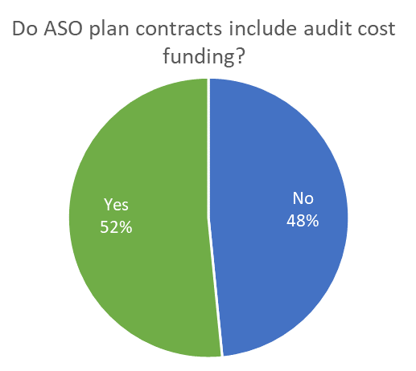
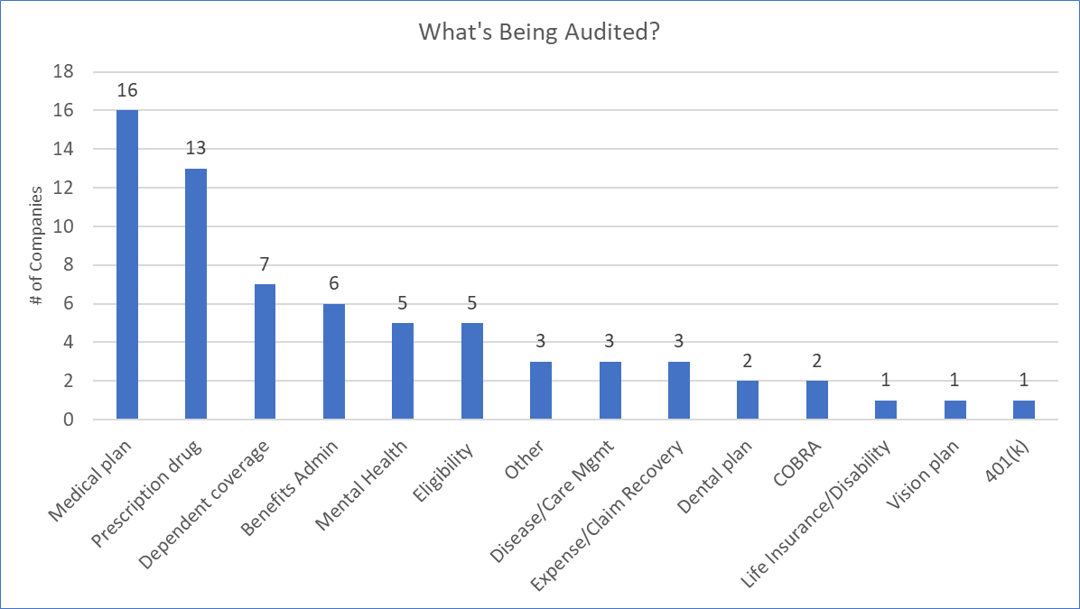
Administration – Audit Activity
56% of companies have an audit planned for 2022
What is driving the increase in planned audits?
What are the goals of these audits?
Which firms are doing the audits?
N = 64

Slide 20

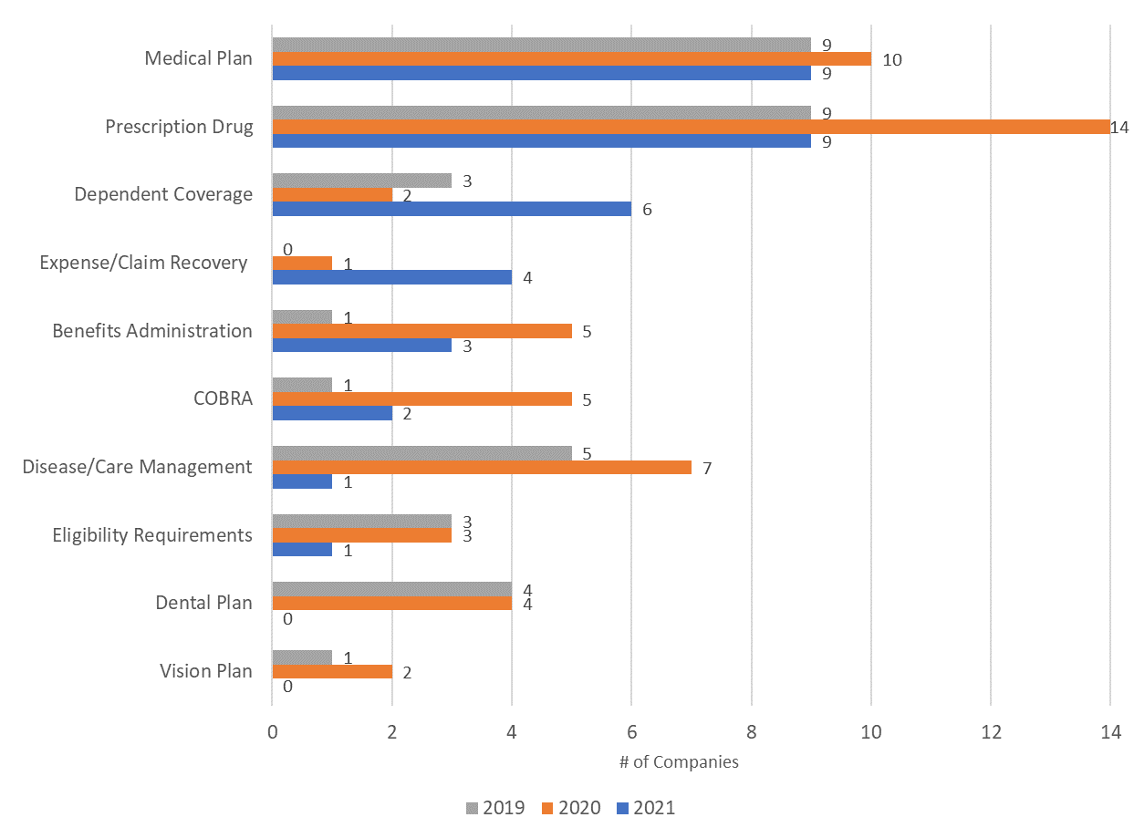
Administration – Prior Audit Activity
What were the key learnings?
Medical and Prescription Drug plans remain the most audited
Audit activity increased for Dependent Coverage and Expense/Claim Recovery
N = 64

Slide 21
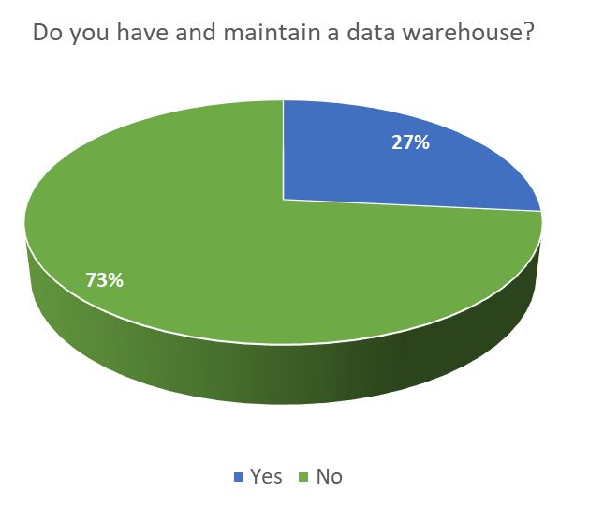

Administration – Data Warehouse
Just over one-quarter of members have their own data warehouse
What actions were taken utilizing the data warehouse?
N = 64

Slide 22
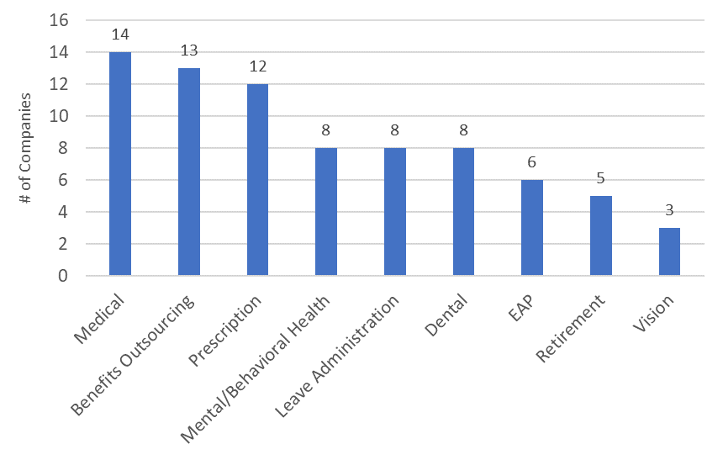
Planned RFPs in 2022
What is driving RFPs and termination of vendors?
34 companies terminated a vendor in 2021
23andMe
2nd.MD
ABD
A G Siebens
ADP (2)
Aetna (2)
Alight
Anthem (3)
BaySport (2)
Benefitexpress
BenePlace
Benz Communications (2)
Booster (2)
Care.com
Cigna
Collective Health (2)
Commuter Check Direct
Concern EAP
CorVel
Crossover Health (3)
Elite Cleaners
Empyrean
ESI (2)
GuideSpark (2)
Gukenheimer
Health Advocate
Health Equity/Wageworks (3)
Healthcare Bluebook
Kaiser (Mobile Health Vehicle)
Kindercare
LifeWorks
Livongo (2)
Lodo
Lyra
Mahalo
Matrix
meQuilibrium
Mercer
Mercer Health Advantage
MVP
Navia
Newport Group
Omada
Optum (2)
Oracle
Paragon
PeakOne
PeopleSoft
Plansource
Plus One
Premera
Purple Tie
Quantum Health
Quest
Rally
Real Appeal
Siteler Wash
Soothe
SOVOS
SurgeryPlus
T. Rowe
The Hartford
Transamerica
Tuition.io
Twic
United Healthcare (2)
Verity Point
YourCause
Wellness Corporate Solutions
Woodruff Sawyer
Workday
N = 64

Slide 23

2022 US Benchmark Survey
HSA & Survivor Support

Slide 24
HDHPs with Health Savings Accounts
95% of companies offer at least one HDHP with Health Savings Account (HSA)
  3 companies offer only HDHPs with HSAs for medical options
  95% of companies offering an HSA provide an employer contribution
    HDHP In-Network Deductible:
      Median: Per person = $1,500, Family = $3,000
      Average: Per person = $1,641, Family = $3,352
    Employer contribution to HSA:
      Median: Employee = $750, Family = $1,500
      Average: Employee = $799, Family = $1,604
  6 companies require employees to pay account maintenance fees. All other companies pay the fees or do not have them.
N = 64

Slide 25

Health Savings Account Employer Contribution Frequency and Proration
More companies are contributing every pay period
  All companies who contribute to HSAs annually do so at the beginning of the year
  One company does not provide a contribution to mid-year new hires
  86% of companies prorate contributions for qualified change of status events
  84% of companies prorate contributions for mid-year new hires
N = 58

Slide 26
HSA Employee Contributions and Retirement Savings
More than half of companies position the HSA as part of retirement savings
New for 2022
Of the six companies taking action if an employee does not contribute, all send follow-up communications, one resolicits for midyear enrollment, and one provides follow-up education
N = 59

Slide 27
HSA Investments
93% offer investment options other than cash-equivalents
New for 2022
More than half of companies (57%) require a minimum balance of $1,000 before an employee can invest their HSA
N = 55

Slide 28
Survivor Support
Just over half of companies provide support
New for 2022
N = 32
N = 64
Other:
Benefits continuation
Concierge and survivor outreach services
Free/Subsidized COBRA coverage

Slide 29
Survivor Support – Subsidized COBRA
The majority of companies providing survivor support fully subsidize COBRA
New for 2022
N = 32
N = 26
Of the 22 companies that fully subsidize COBRA, half do so for 12 months

Slide 30

2022 US Benchmark Survey
Cost

Slide 31
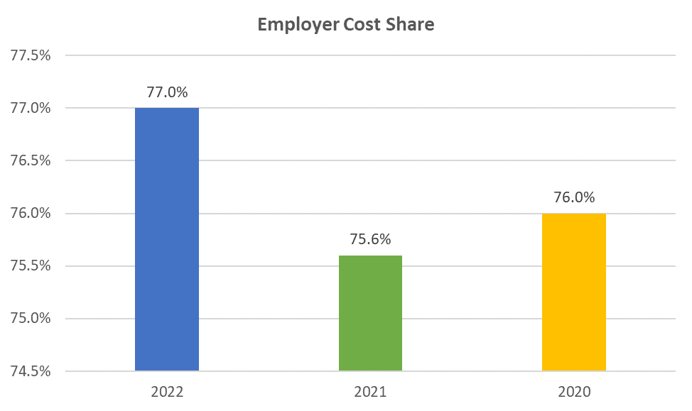

Benefits Cost Sharing
Overall, contribution strategies have remained essentially unchanged in 2022 but employers are paying slightly more for dental and vision coverage
N = 59

Slide 32
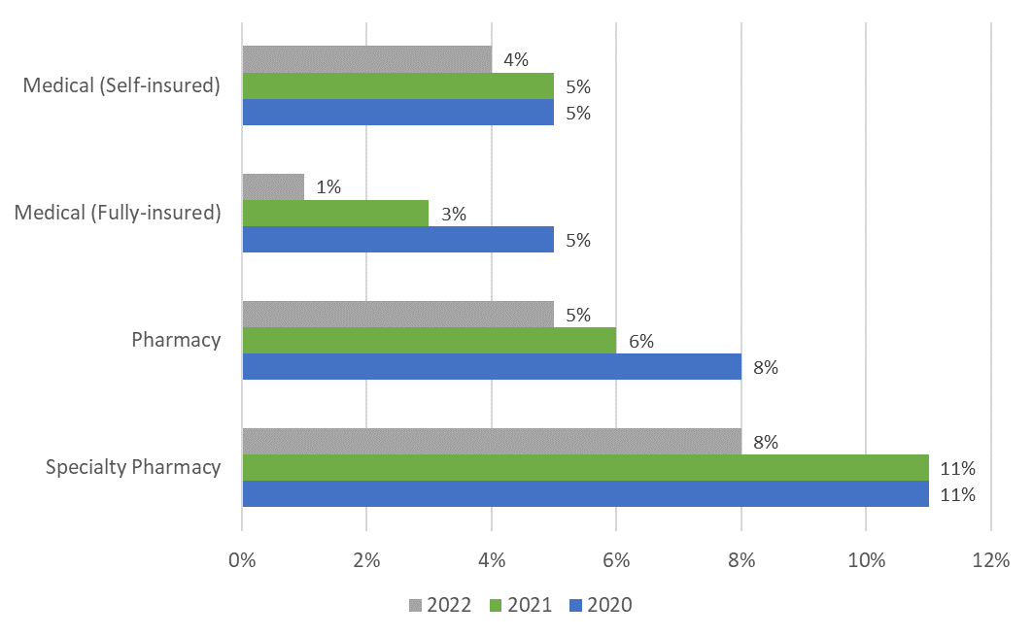

Cost – Projected Healthcare Trend
The overall projected healthcare trend is down for 2022
For 2022, overall reductions in healthcare costs are projected – is this due to COVID-19?
N = 52 for Self-insured Medical
N = 41 for Fully-insured Medical
N = 38 for Pharmacy
N = 29 for Specialty Pharmacy

Slide 33
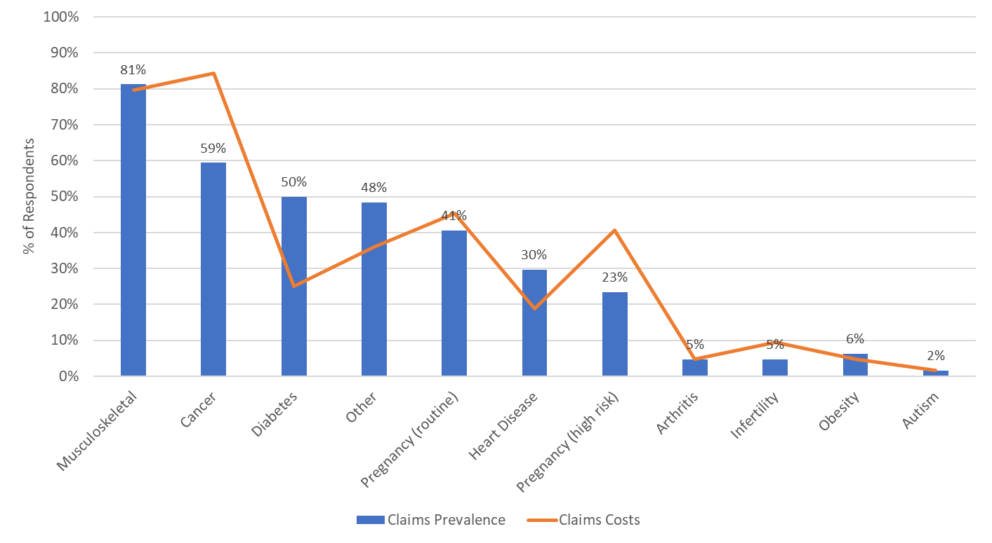
Medical Conditions with Highest Claims Prevalence and Cost
The top conditions remain the same as prior years (2017 – 2021) – Musculoskeletal, Cancer, Diabetes
How are disease management programs and/or point solutions supporting the conditions of your members?
N = 64

Slide 34
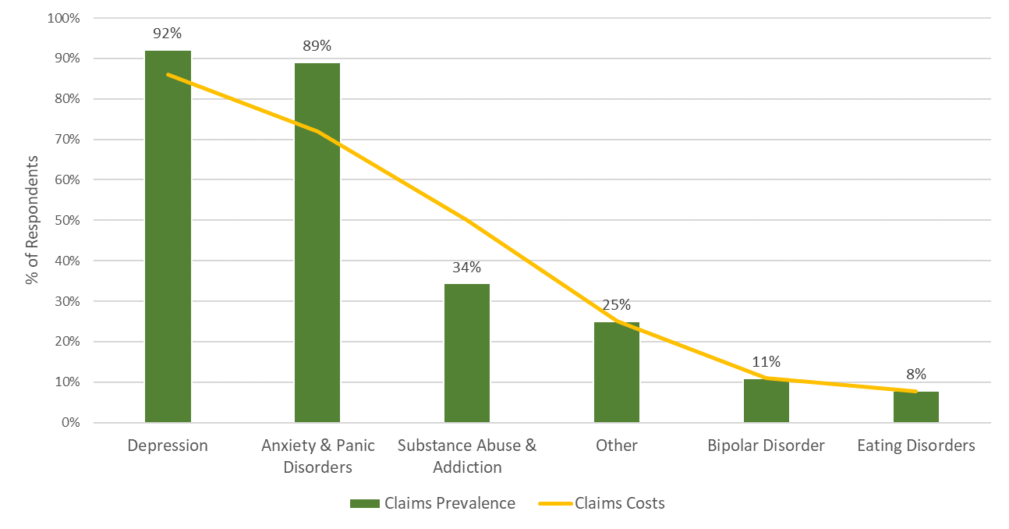

Mental Health Conditions with Highest Claims Prevalence and Cost
All conditions, except Substance Abuse & Addiction, increased in prevalence
Are increases in prevalence attributed to COVID-19?
Depression: +3%
Anxiety & Panic Disorders: +5%
Bipolar Disorder: +2%
Eating Disorders: +1%
-----------------------------------------------
Substance Abuse & Addiction: -10%
N = 64

Slide 35

2022 US Benchmark Survey
Priorities & Goals | New & Emerging | Trends

Slide 36

Themes for Member Priorities & Goals - 2022
Wellness
  Behavioral & mental health/wellbeing
  Financial wellbeing
  Increase engagement
  Build/increase resilience
Communications
  Educate/Promote to build awareness and engagement of benefit programs
  Simplify/Consolidate communications
  Promote/Enhance benefits portal/website
  Personalization of messaging
Compliance
  Healthcare price transparency
  COVID-19 legislation and support
  HIPAA
Other
  Diversity, equity, and inclusion initiatives
  Enhance employee experience
  Enhance family support benefits
Cost Containment
  Medical claims cost containment via wellness initiatives
  Prescription drugs
N = 61

Slide 37

New & Emerging Coverages & Services
  Health
  New programs and services (preventive cancer screening, diabetes support, genetic testing, MSK support, web-based wellness platform)
  Concierge/Navigation services (e.g., MyBind Health)
  Virtual care
  Implemented a mail order preventive care process (“VirtualCheckup”) through Catapult Health
  Advanced telehealth
  Maternity bundles with providers
  Life/Balance
  Transgender concierge services
  Implemented a caregiver solution to assist employees and their families who are caring for a loved one, providing assistance with locating and scheduling resources
  Mental Health
  Digital Mental Health counseling and coaching to increase access to employees and their families
  Mental Health concierge service
  Financial
  Student loan repayment services
  Other
  Benefits related to remote working
  Benefits based on diversity, inclusion and belonging

Slide 38

New and Emerging
Midwife Services & Doula Coverage
Eligible Providers Covered
Certified Nurse Midwives – 42 companies
Certified Midwives – 24 companies
Certified Professional Midwives – 22 companies
N = 64

Slide 39

New and Emerging
Stand-alone Birth Centers – 33 companies cover them
Of the 33 companies that now cover stand-alone birth centers:
4 are newer members
91% require that they be accredited
9% do not require accreditation
N = 63

Slide 40
Trends
Childcare, Backup Childcare & Eldercare: More companies are offering. Is this due to COVID-19?
Where company-sponsored childcare is offered
  On-site (3 companies)
  Off-site (7 companies)
  Considering (4 companies)
  Not offered (37 companies)
N = 64 (Childcare), 50 (Backup Childcare), 64 (Elder Care)

Slide 41
Trends
Companies continue to be more likely to offer a reimbursement or subsidy for backup childcare, and more companies are offering them in 2022
 | Maximum Annual Amounts
 | Childcare | Backup Childcare
Low | $ 500 | $ 25
High | $ 20,000 | $ 6,000
Average | $ 4,558 | $ 1,110
Median | $ 1,600 | $ 490
N = 50 (Childcare), 48 (Backup Childcare)

Slide 42
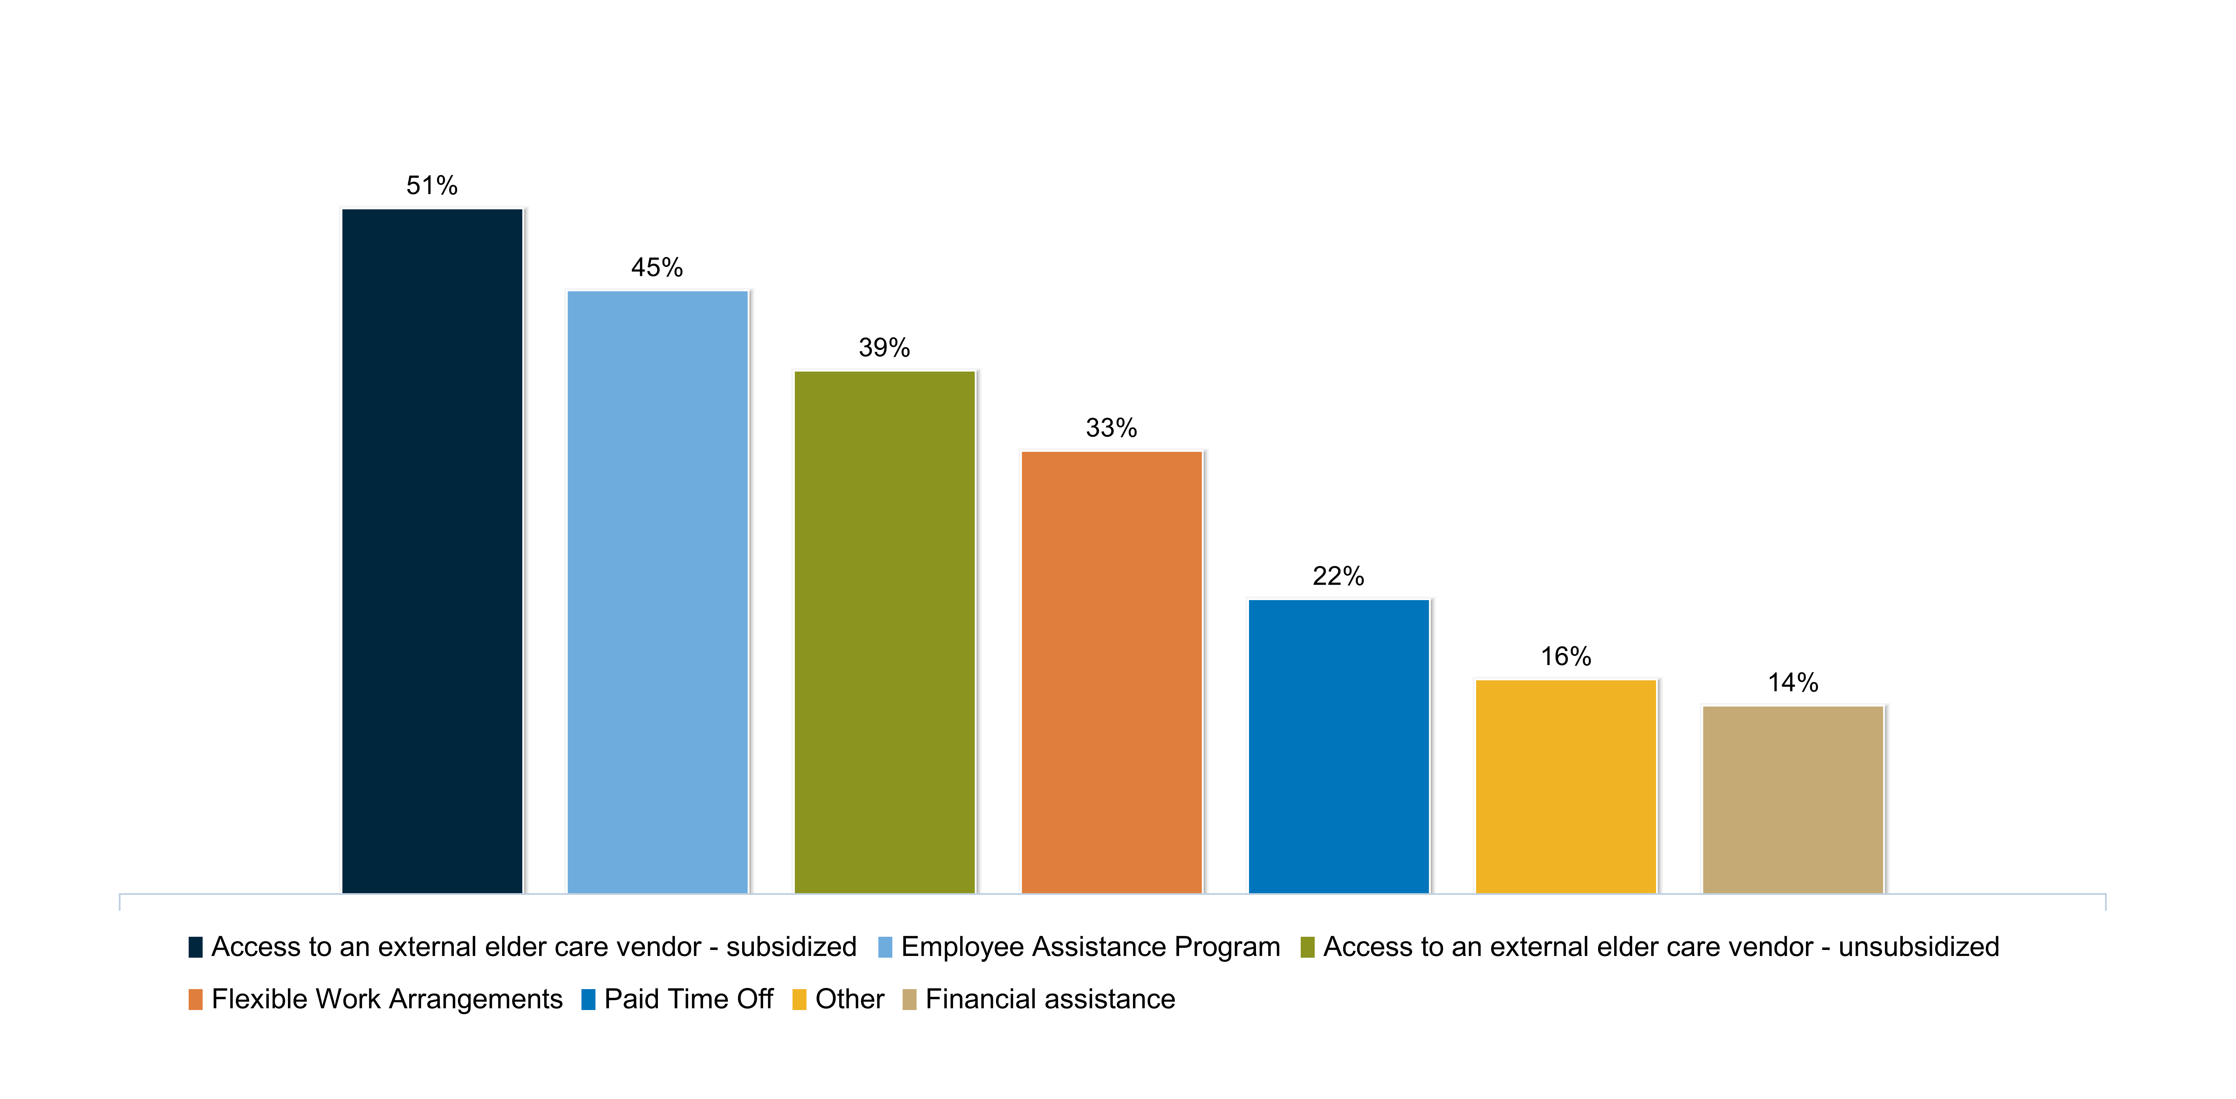
Trends
Elder Care Program Benefits – 26% increase in number of companies offering access to a vendor
Other benefits include
Navigation/Concierge services
Access to elder back-up care
Needs assessment
Resource library
N = 49

Slide 43

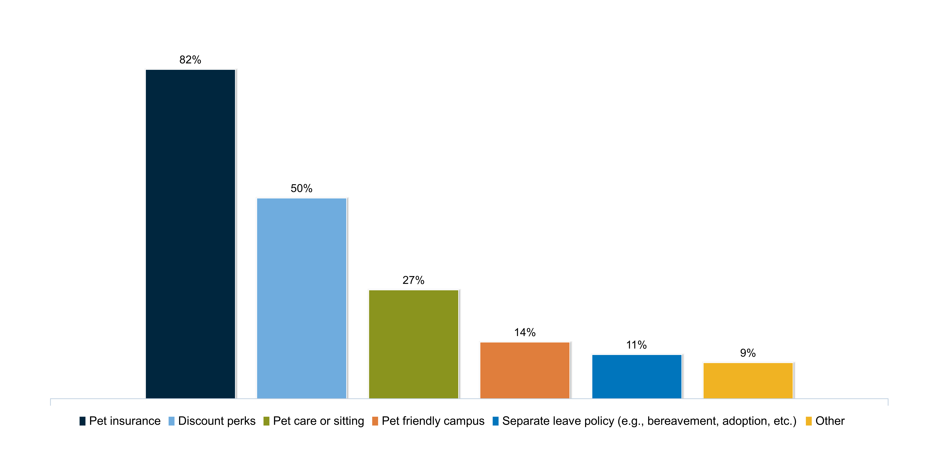
Trends
Pet Benefits Offered – 69% of companies offer them to employees
Other benefits include
Pet care locator through EAP
24/7 veterinary helpline
N = 44

Slide 44
Trends
Most companies match charitable contributions
Of those that offer a charitable match, 85% of companies extend the benefit to their PT employees
N = 64
Maximum Annual Amounts | Maximum Annual Amounts
Low | $ 100
High | $ 20,000
Average | $ 4,880
Median | $ 2,500
N = 45

Slide 45

Trends
4 out of 5 companies offer a formal Volunteer Work Program
N = 55
N = 39
Average number of days = 4

Slide 46

2022 US Benchmark Survey
Time Off

Slide 47

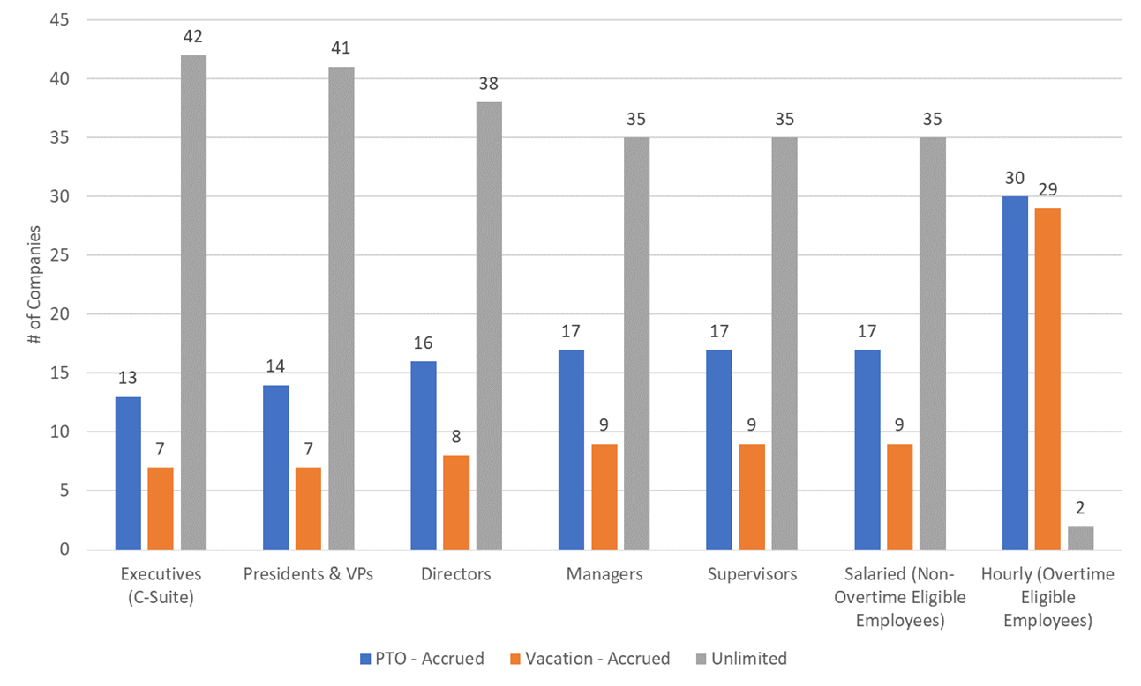
Paid Time Off & Vacation
“Unlimited time off” – are employees taking more or less time off under these policies?
68% of companies have unlimited time off for executives, presidents & vice-presidents
61% of companies offer unlimited time off for directors; 57% offer unlimited time off to managers and supervisors
For non-exempts, offering accrued PTO or accrued vacation continues to be most prevalent
N = 62 (Executives, Presidents & VPs, Directors)
N = 61 (Managers, Supervisors, Salaried, Hourly)

Slide 48

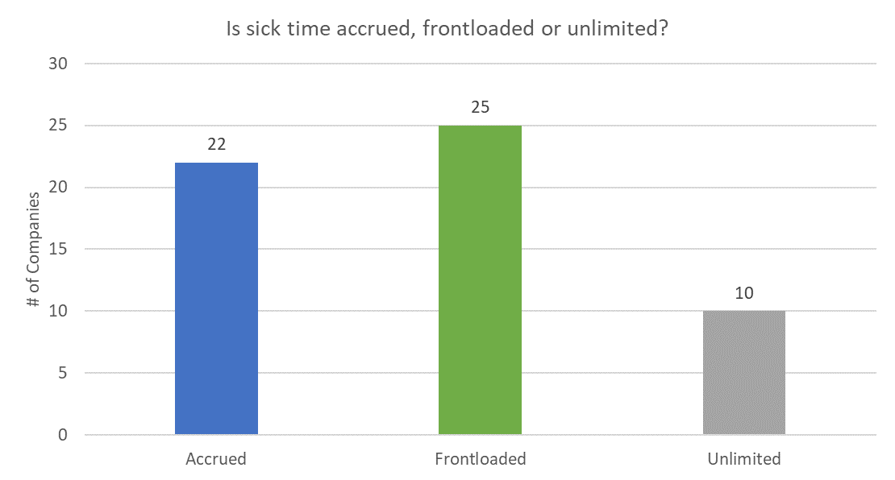
Sick Time
Companies are more likely to accrue or frontload sick time
Maximum sick hours per year for those that accrue or frontload
Low: 24 hours
High: 240 hours
Average: 85 hours
Median: 80 hours
N = 57

Slide 49
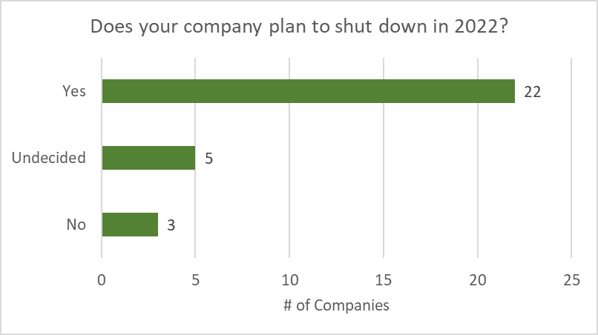
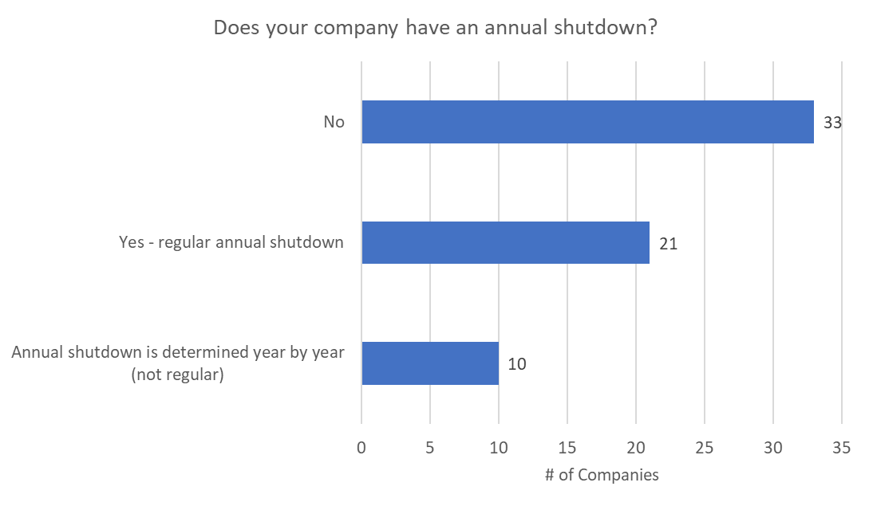
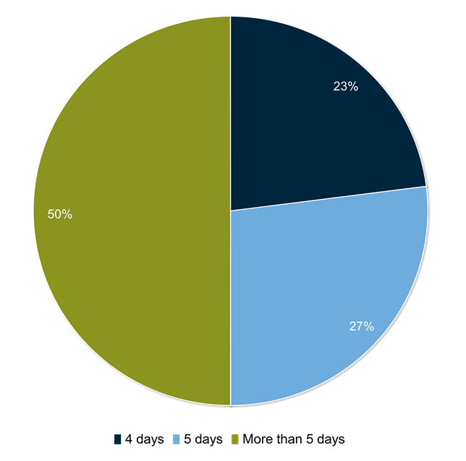
Paid Time Off
Shutdowns
N = 30
Number of company shutdown days in 2022
N = 64
11 more companies now have annual shutdowns
N = 22

Slide 50

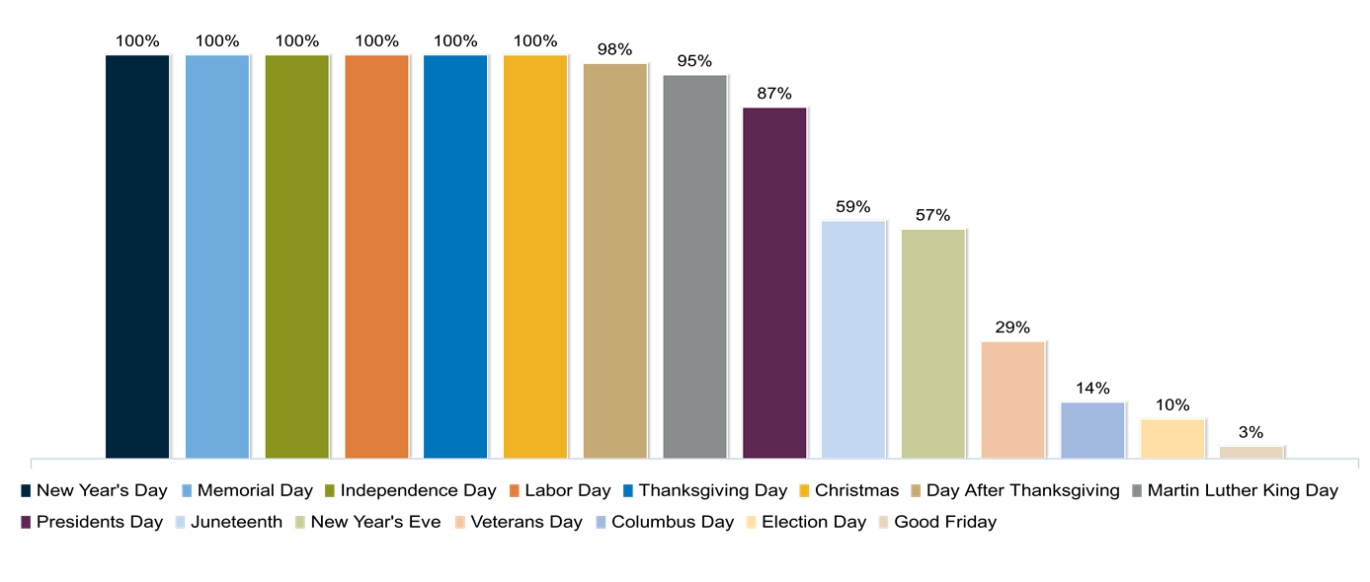
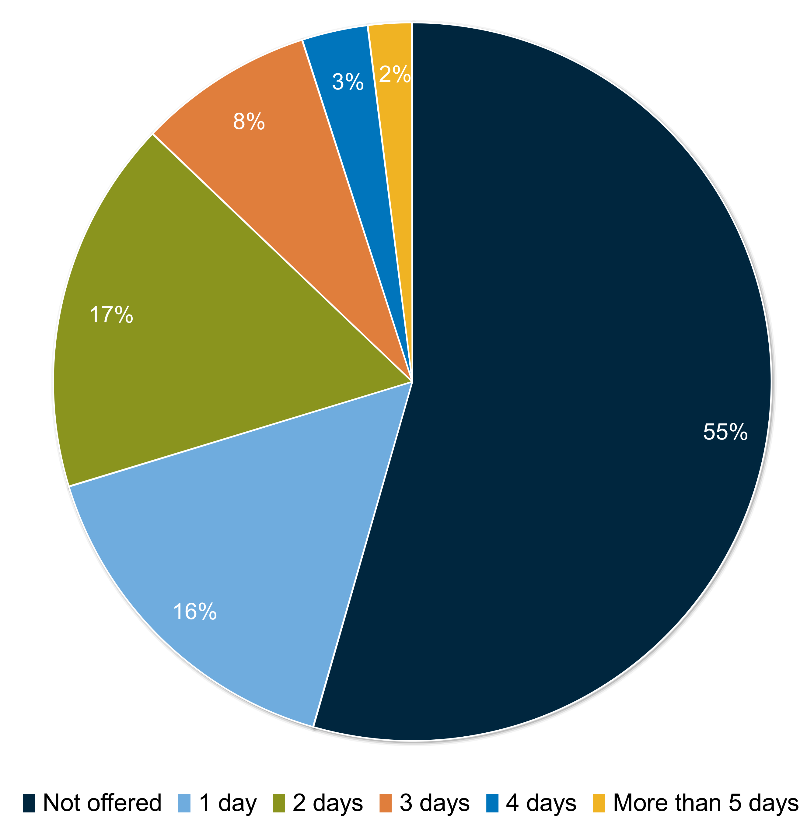
Paid Time Off
Holidays & Floating Holidays
Holidays provided to employees as paid days off
# of Floating Holidays Offered
N = 63
Holidays with the largest YOY change
Juneteenth – 37 companies (up from 10)
Columbus Day – 9 companies (up from 4)
N = 64

Slide 51
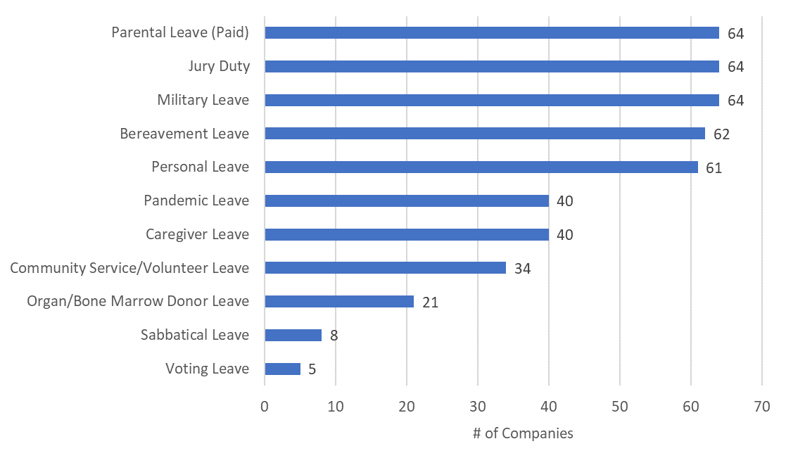

Types of Leaves Offered
Very little change year over year in the types of leaves offered
Several companies increased the number of weeks provided for Caregiver Leave with 17 companies now providing 12 weeks
41 companies offer the same number of bereavement days for all relationship types
Five companies now offer voting leave
N = 64

Slide 52


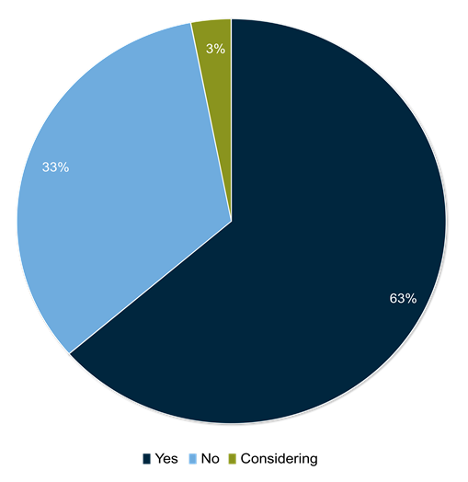
Pandemic Leave of Absence
Almost two-thirds of companies have a policy
Does your company have a pandemic leave policy in place?
Of those companies that have a pandemic leave policy in place:
37 provide full pay
2 provide partial pay
1 is unpaid
N = 63

Slide 53

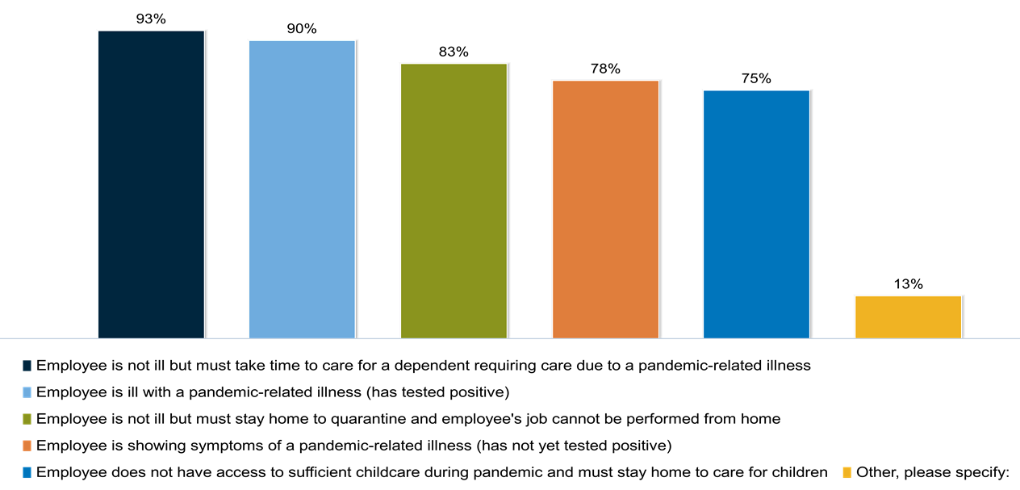
Pandemic Leave of Absence
Eligibility and Duration
Eligibility Requirements
Durations
48% provide 2 weeks
18% provide 4 weeks
8% provide 12 weeks
Remaining companies provide 1, 3, 6, 10, 14, 52 weeks or unlimited
N = 40

Slide 54

2022 US Benchmark Survey
Finances and Retirement

Slide 55
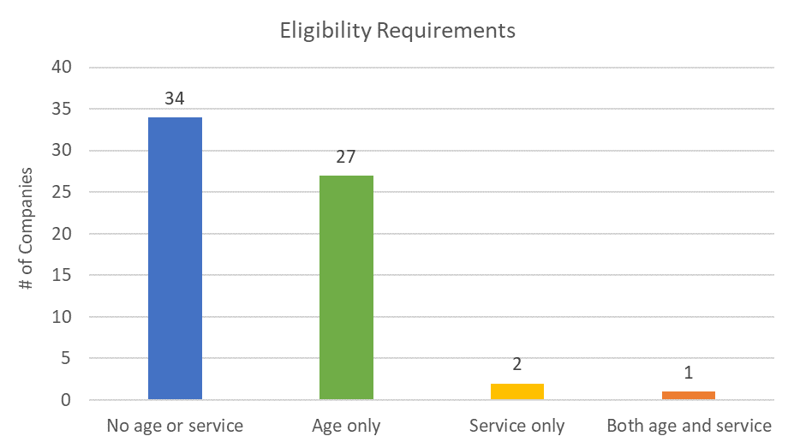
Finances – 401(k) Program Summary
100% of companies offer a 401(k) plan
Plan Highlights
53% do not have an age or service requirement
  42% have an age requirement
  2 companies have employment service requirements
  1 company has both age and service requirements
22 companies allow interns to participate, a slight increase from 2021
75% of companies offer auto enrollment and 2 companies are considering it
  54% of companies offering auto enrollment do so at 6% of base pay
81% offer automatic increases to employee contributions
  57% offer automatic increase as opt-out
  43% offer automatic increase as opt-in
Under M&A deals, 76% terminate the target company’s plan, 16% merge the plans, and 5% continue the plan
Roth
98% of companies offer Roth 401(k)
84% allow In-Plan Roth conversion
80% allow for non-Roth after-tax contributions and 6 companies are considering, with deferral maximums ranging from 10% - 100% and an average of 62%
N = 64

Slide 56

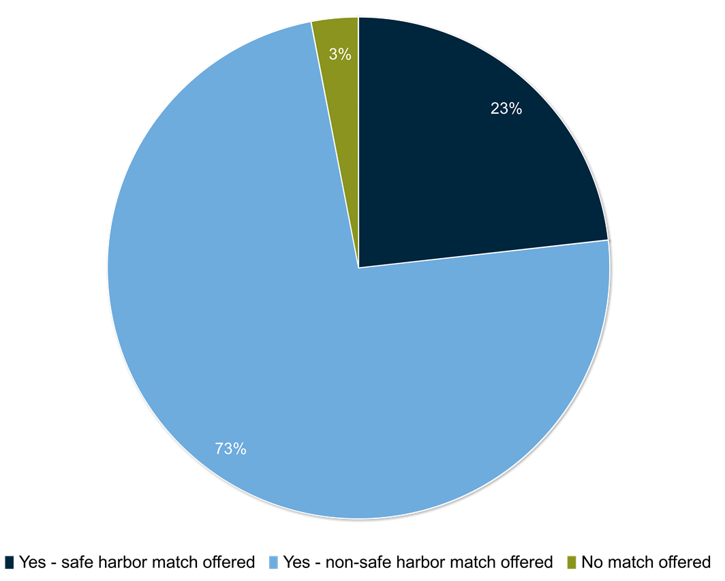
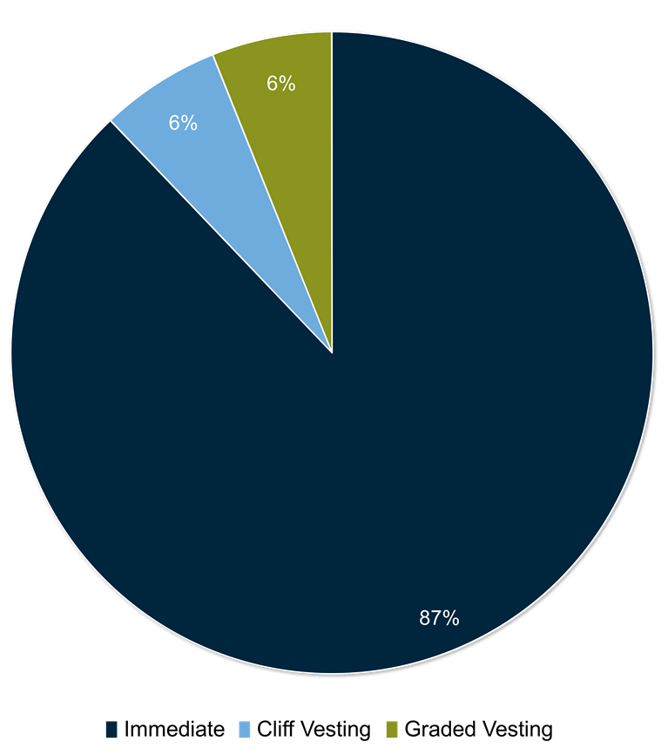
Finances
401(k) Matching and Vesting
Company Match
Vesting
N = 64
41 companies “true up” the company match
33 provide annually
4 provide every pay period
2 provide every pay period & annually
1 provides quarterly
1 provides quarterly & annually
N = 62

Slide 57
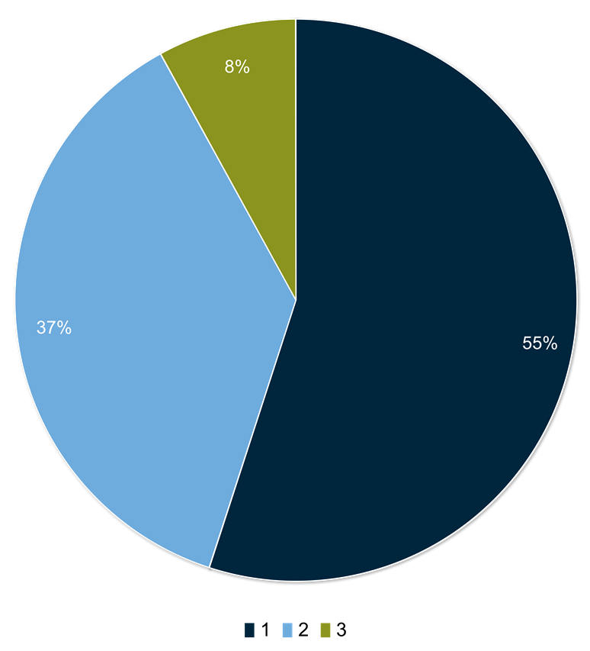
Finances
401(k) Loans: Any Companies Considering Reducing and/or Eliminating Loans?
Number of outstanding loans allowed
98% of companies allow a 401(k) loan
34 allow 1 loan
23 allow 2 loans
5 allow 3 loans
At termination, most companies (81%) allow employees to continue to pay the loan per the loan agreement
N = 62

Slide 58
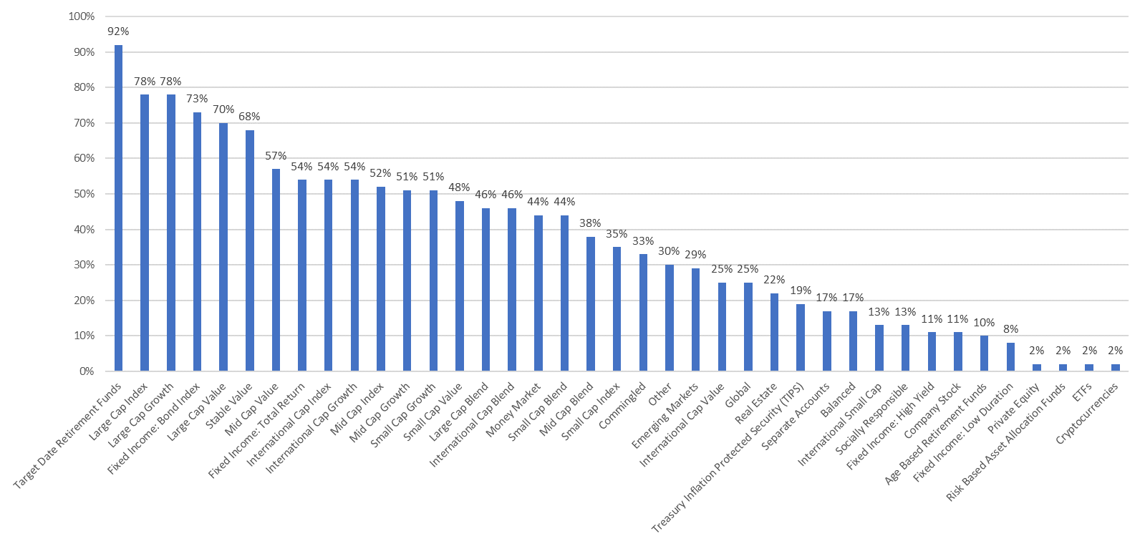
Finances
401(k) Asset Classes Offered: Most Companies Offer Target Date Funds
No change in companies offering company stock over the last three years
N = 63

Slide 59

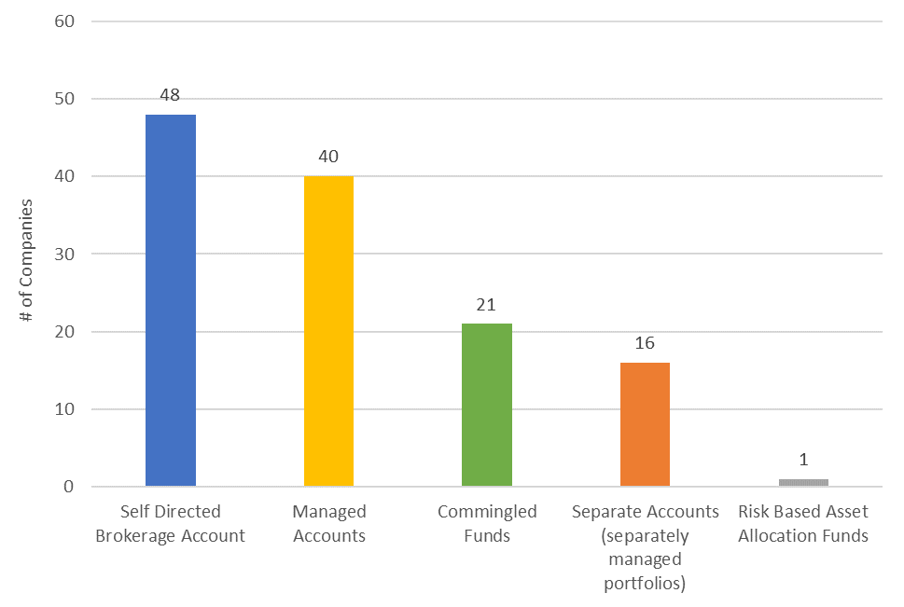
Finances
401(k) Investments: How engaged are employees in these accounts?
On average, companies offer 14 funds, ranging from 1 to 24
77% offer self-directed brokerage accounts, while 26% offer separate accounts
63% offer managed accounts, up 2% this year
45% of plans capture revenue share, 52% in 2021
Average fund expense ratio is 8%, down 1% this year
N = 64

Slide 60
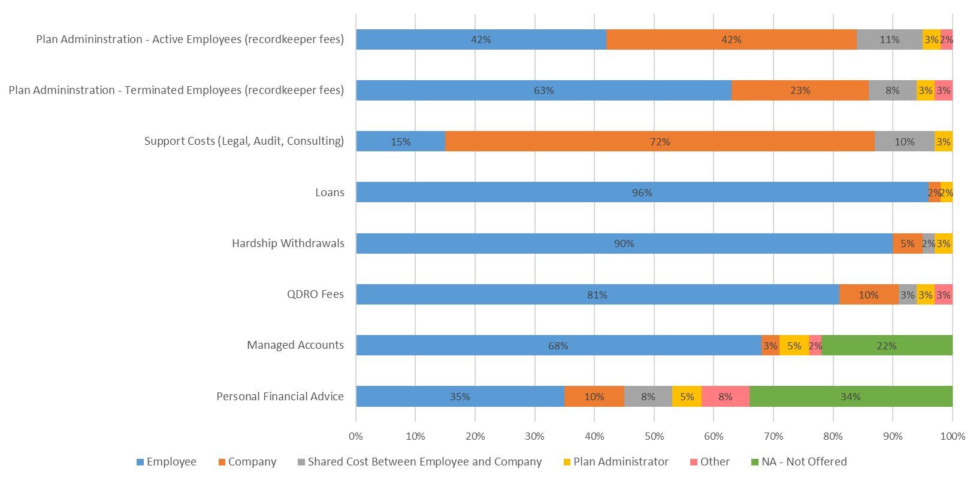
Finances
401(k) Costs – Who Pays
N = 64

Slide 61
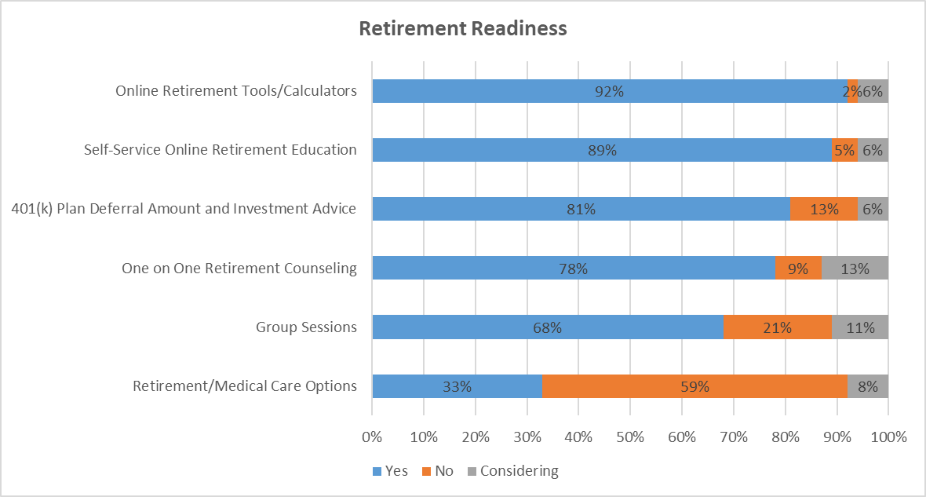
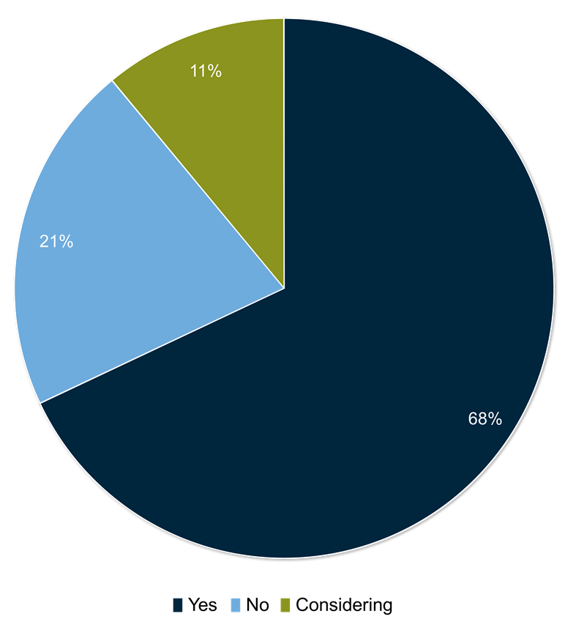
Finances
401(k) Retirement Readiness
Does your 401(k) offer personalized financial advice?
N = 63
Companies continue to support employees as they prepare for retirement
Most offer retirement readiness tools/calculators
Many offer online education, deferral and investment advice, 1:1 counseling, and/or group sessions
N = 62
Are you seeing results from the support provided?

Slide 62
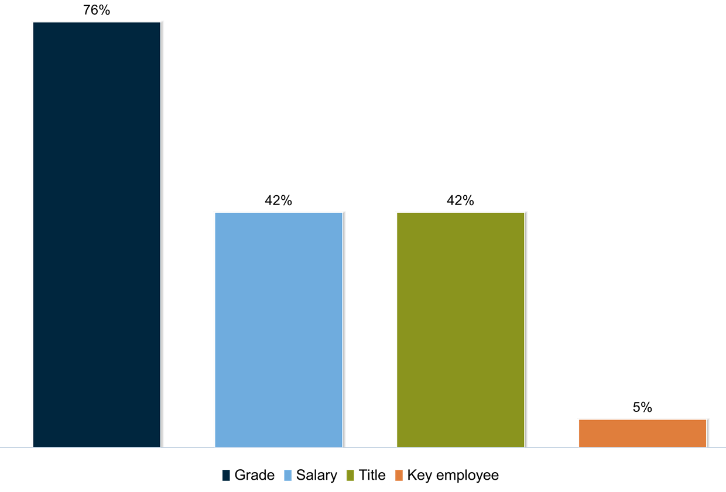
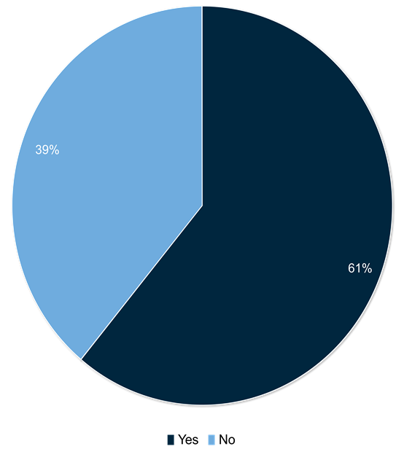
Finances
Non-Qualified Deferred Compensation (NQDC) Plans
Companies Offering a NQDC Plan
Eligibility Criteria
N = 64
N = 38
82% are a top-hat plan
8% are an excess plan
3 companies allow sign-on bonus deferrals (ranging from 50%, 90%, and 100% deferral)
Eligible Job Titles
C-Suite
President / Vice President
Senior Director / Director
Senior Manager / Manager

Slide 63

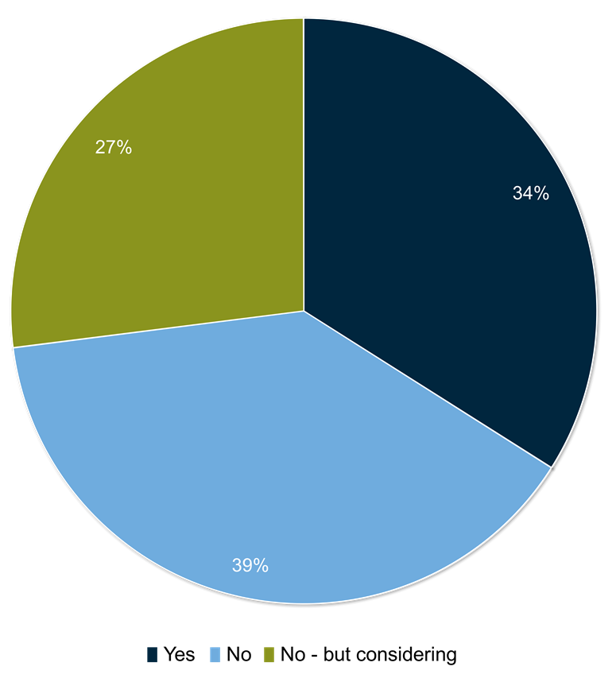
Finances
About one-third of companies offer student loan assistance
Student Loan Assistance Provided?
18 companies offer loan refinancing assistance (same as 2021)
16 companies offer company funded/subsidized loan payments (5 more than 2021)
No companies offer student loan assistance in lieu of company 401(k) matching contributions
N = 64

Slide 64
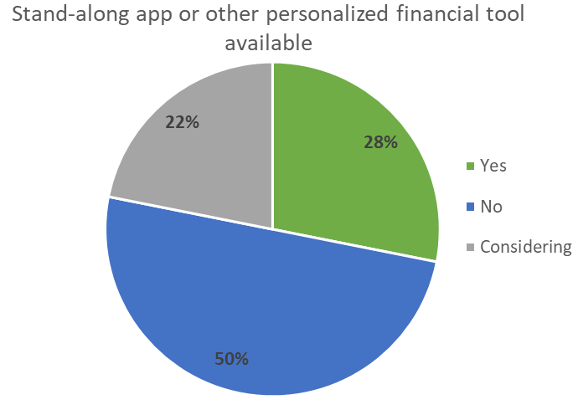
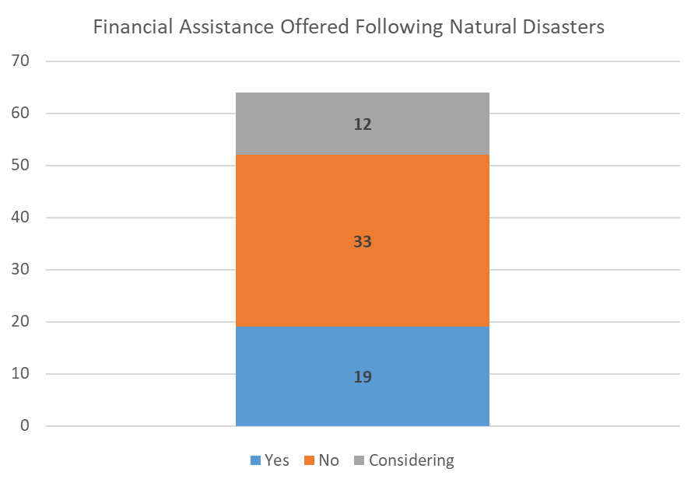
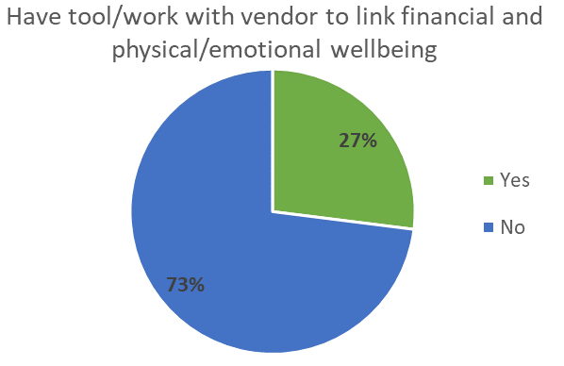
Finances
Other Financial Assistance
N = 64

Slide 65
Working Remotely Stipends/Reimbursements
More than half of companies offer them
New for 2022
N = 64
Maximum Annual Amounts | Maximum Annual Amounts
Low | $ 250
High | $ 1,996
Average | $ 733
Median | $ 600
N = 34

Slide 66
2022 US Benchmark Survey
Survey Resources

Slide 67

Benchmark Survey Resources Available to SVEF Members
Where to Find Them and How They are Used
Resources Available | Use
Summary Presentation Posted on sveforum.org | High-level overview of survey results
Excel File of Aggregate Data with Index File delivered via email Posted on sveforum.org | Detailed analysis using comprehensive data Index can be used to find specific information within the aggregate data
Excel File of Custom Cut Data with Index Files delivered via email | Detailed analysis of companies selected for your custom cut Index can be used to find specific information within the aggregate data
Dashboards Coming soon! | Online view of survey results Comparison of your company and all SVEF members Comparison of your company and selected SVEF members

Slide 68
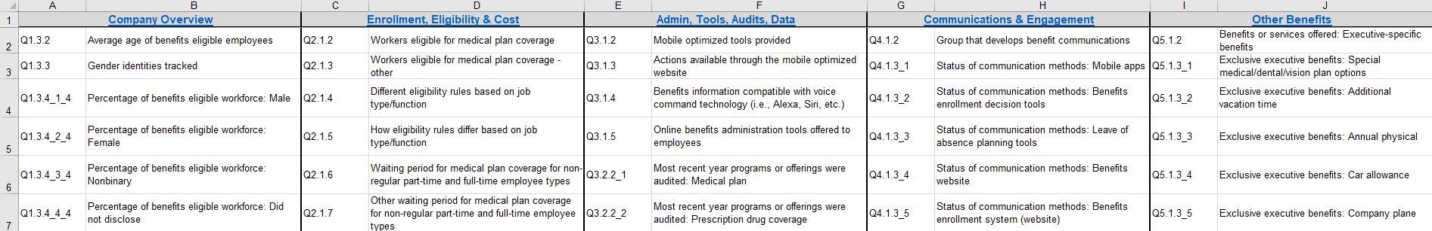
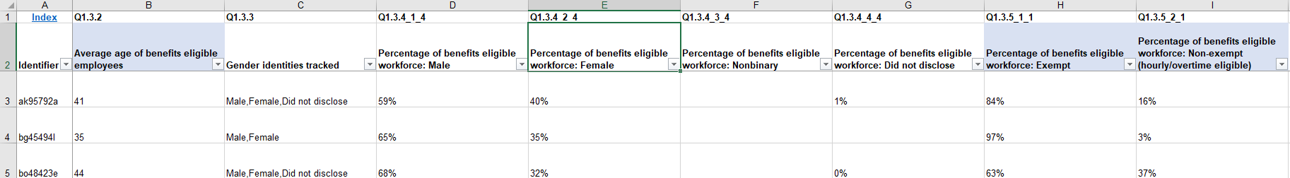
Benchmark Survey Resources Available to SVEF Members
Index Example
After finding the question you would like to review in the Index, click on the cell to be taken directly to this question in the master file

Slide 69


Slide 70
2022 US Benchmark Survey
Appendix

Slide 71
Critical Illness Insurance
More than half of companies now provide Critical Illness Insurance
28 out of 33 companies offering Critical Illness Insurance extend benefits to all dependents. The remaining five companies extend benefits only to spouses or domestic partners
All companies require employees to pay for 100% of the premium
Companies have employee participation rates ranging from 2% to 49%
  Mean = 22%
  Median = 18%
N = 64

Slide 72
Critical Illness Insurance
Covered Conditions
N = 32

