Slide 1
Silicon Valley Employers Forum (SVEF) 2021 United Kingdom (UK) Benchmark Survey
Summary of Results – 9 December 2021

Slide 2
2021 UK Benchmark Survey Overview and Agenda
Participating Companies
Medical, Dental, and Vision
Supplemental Life, Accident, and Critical Illness
Short-Term Disability and Income Protection
Retirement
Wellbeing Benefits
Employee Assistance Program (EAP)
Leaves
Voluntary Benefits
Perks & Allowances
Transportation
Survey Resources
Appendix
2

Slide 3
58 Participating Companies Data from all companies are included in presentation
Adobe
Airbnb
Alibaba
AMD
Apple
Applied Materials
Autodesk
Cadence
Ciena
Cisco
Citrix
Dell
DocuSign
eBay
Electronic Arts
Facebook
Google
Hewlett Packard Enterprise
Hitachi Vantara
HP
Intel
Intuit
Juniper Networks
Keysight
KLA
Lam Research
Lenovo
LinkedIn
Lumentum
Marvell
Micron
Microsoft
NetApp
Netflix
NortonLifeLock
NVIDIA
NXP
Oracle
Palo Alto Networks
PayPal
Pure Storage
Qualcomm
Salesforce
Seagate Technology
ServiceNow
Sony
Splunk
Square
Stripe
Synopsys
Tesla
Twitter
Veritas
Visa
VMware
Western Digital
Workday
Zendesk

Slide 4
Thank You to Our Survey Team With much appreciation!
Anthea Cassano VMware
Santiago Friedenthal Salesforce
Ian Grimshaw Microsoft
Nicky Jones Autodesk
Marcela Kopecka Hewlett Packard Enterprise
Andrew Miozga Salesforce
Dupe Olowokere Visa
Ray O’Sullivan Adobe
Karen Sancto Microsoft
Mirka Slater Meta
4

Slide 5
Benefits Summary Number of companies offering each benefit
N = 58

Slide 6
2021 UK Benchmark Survey
Medical, Dental, and Vision

Slide 7
Private Medical - Eligibility Most employees and dependants are eligible for private medical and do not have a choice for the level of cover
N = 57
N = 57

Slide 8
Private Medical – Dependant Eligibility and Coverage Most common practice is to include eligibility for spouse, domestic partner and children (no limit), and to provide the same medical cover as employees
N = 53
N = 54

Slide 9
Private Medical - Approach to Financing and Choice of Carriers Majority of companies insure private medical with an insurer
N = 56
N = 58

Slide 10
Private Medical – Who Pays for Coverage Most prevalent is for the company to pay all employee and dependant premiums…what is the rationale for these different contribution strategies?
N = 56
N = 58

Slide 11
Private Medical – Cover Provided Inpatient and outpatient mental health care, outpatient care, and digital GP are frequently provided in the majority of plans
N = 57

Slide 12
Private Medical - Maternity Most companies do not provide maternity cover in the medical plan design
N = 56
N = 6

Slide 13
Private Medical - Enhancements due to COVID-19 Most companies did not make changes to plan design due to COVID-19
N = 57
N = 21

Slide 14
Dental - Overview Most members provide some form of dental benefit and the majority use a carrier to insure
N = 58
N = 49

Slide 15
Dental - Employee Participation and Employee Cover Cost Sharing Most companies allow employees to choose to take out dental cover, and if they do so the company pays for the employee premiums
N = 50
N = 49

Slide 16
Dental – Dependant Cover Cost Sharing Just over half of employers pay for part or all of the premiums
N = 45
N = 45

Slide 17
Vision – Overview Vision benefit plan design is mainly aligned to health and safety requirements
N = 58
N = 43

Slide 18
2021 UK Benchmark Survey
Supplemental Life, Accident, and Critical Illness

Slide 19
Employee Supplemental Life Assurance – Overview
All companies surveyed (58) provide supplemental Life assurance to all employees
Six (6) companies allow employees to buy extra coverage through a Flex plan
Six (6) companies also provide Dependant coverage, mostly to Spouses and Domestic Partners
Only one company self insures its Life coverage, while the others use a carrier
The most common design is 4x Base Salary

Slide 20
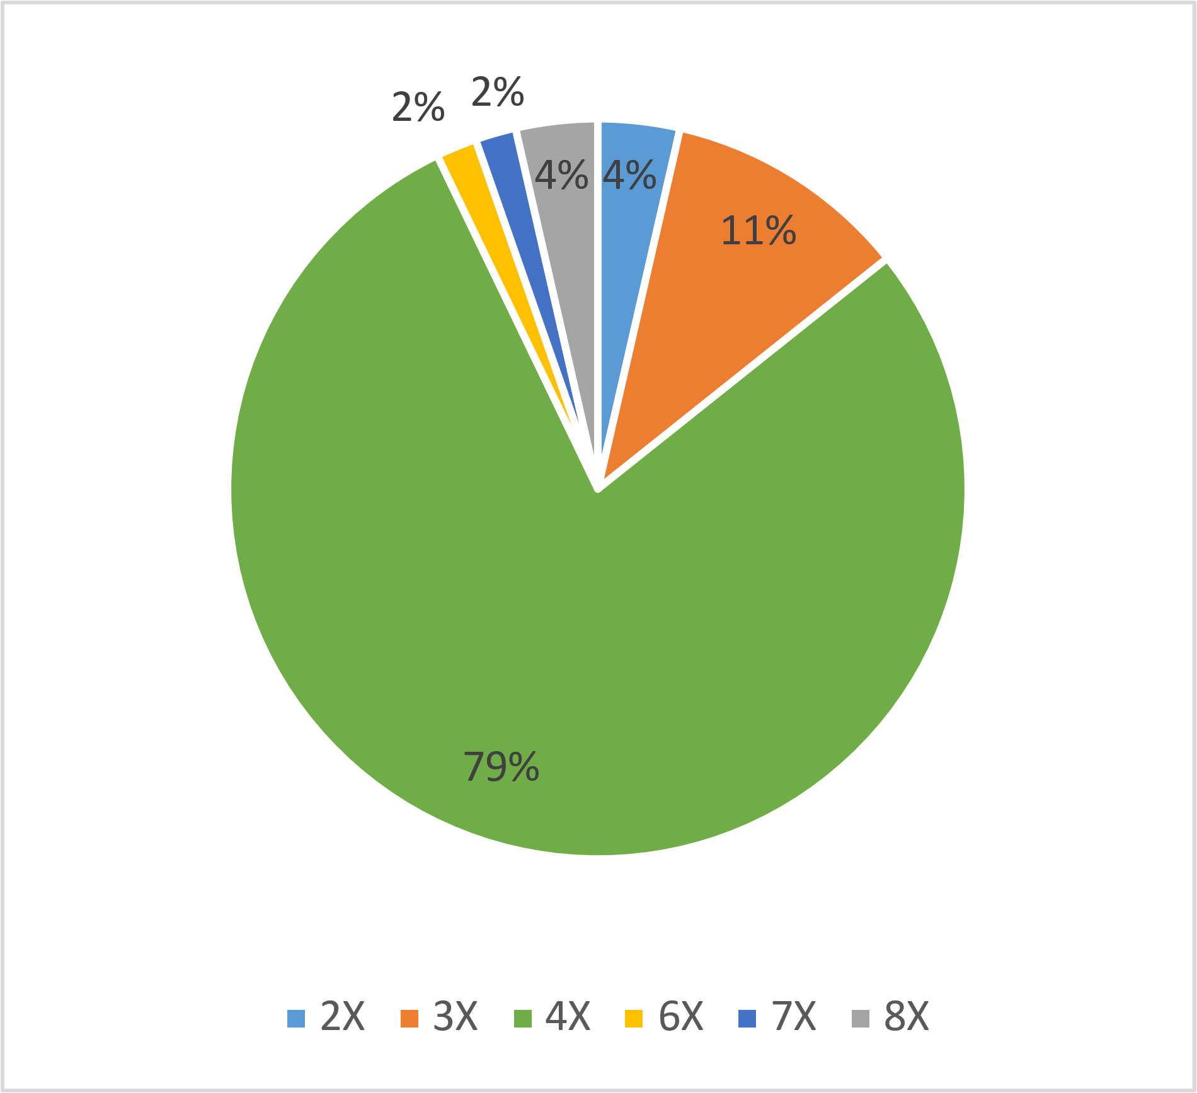
Employee Supplemental Life Assurance – Core Coverage 79% offer 4x eligible compensation
Two companies are not included because they offer a fixed benefit amount
8 companies offer below 4x while 2 offer twice as much (8x)
This excludes any additional coverage that employees can buy through Flex
25 companies cap the benefit; might want to check how many employees are currently impacted and expected to be
Min: GBP750,000
Max: GBP20,000,000
Average: GBP3,302,000
Median: GBP1,500,000
N = 56

Slide 21
Employee Supplemental Accident Assurance – Overview
26% (15 companies) currently provide supplemental Accident insurance, while one (1) is considering
Most companies who provide the benefit (12) pay for the full cost, while the others are fully employee paid
A benefit based on Base Salary only and covering Accidental Death and Disability is the most common coverage
67% of companies responded that they use a Stand Alone Policy for their Accident coverage

Slide 22
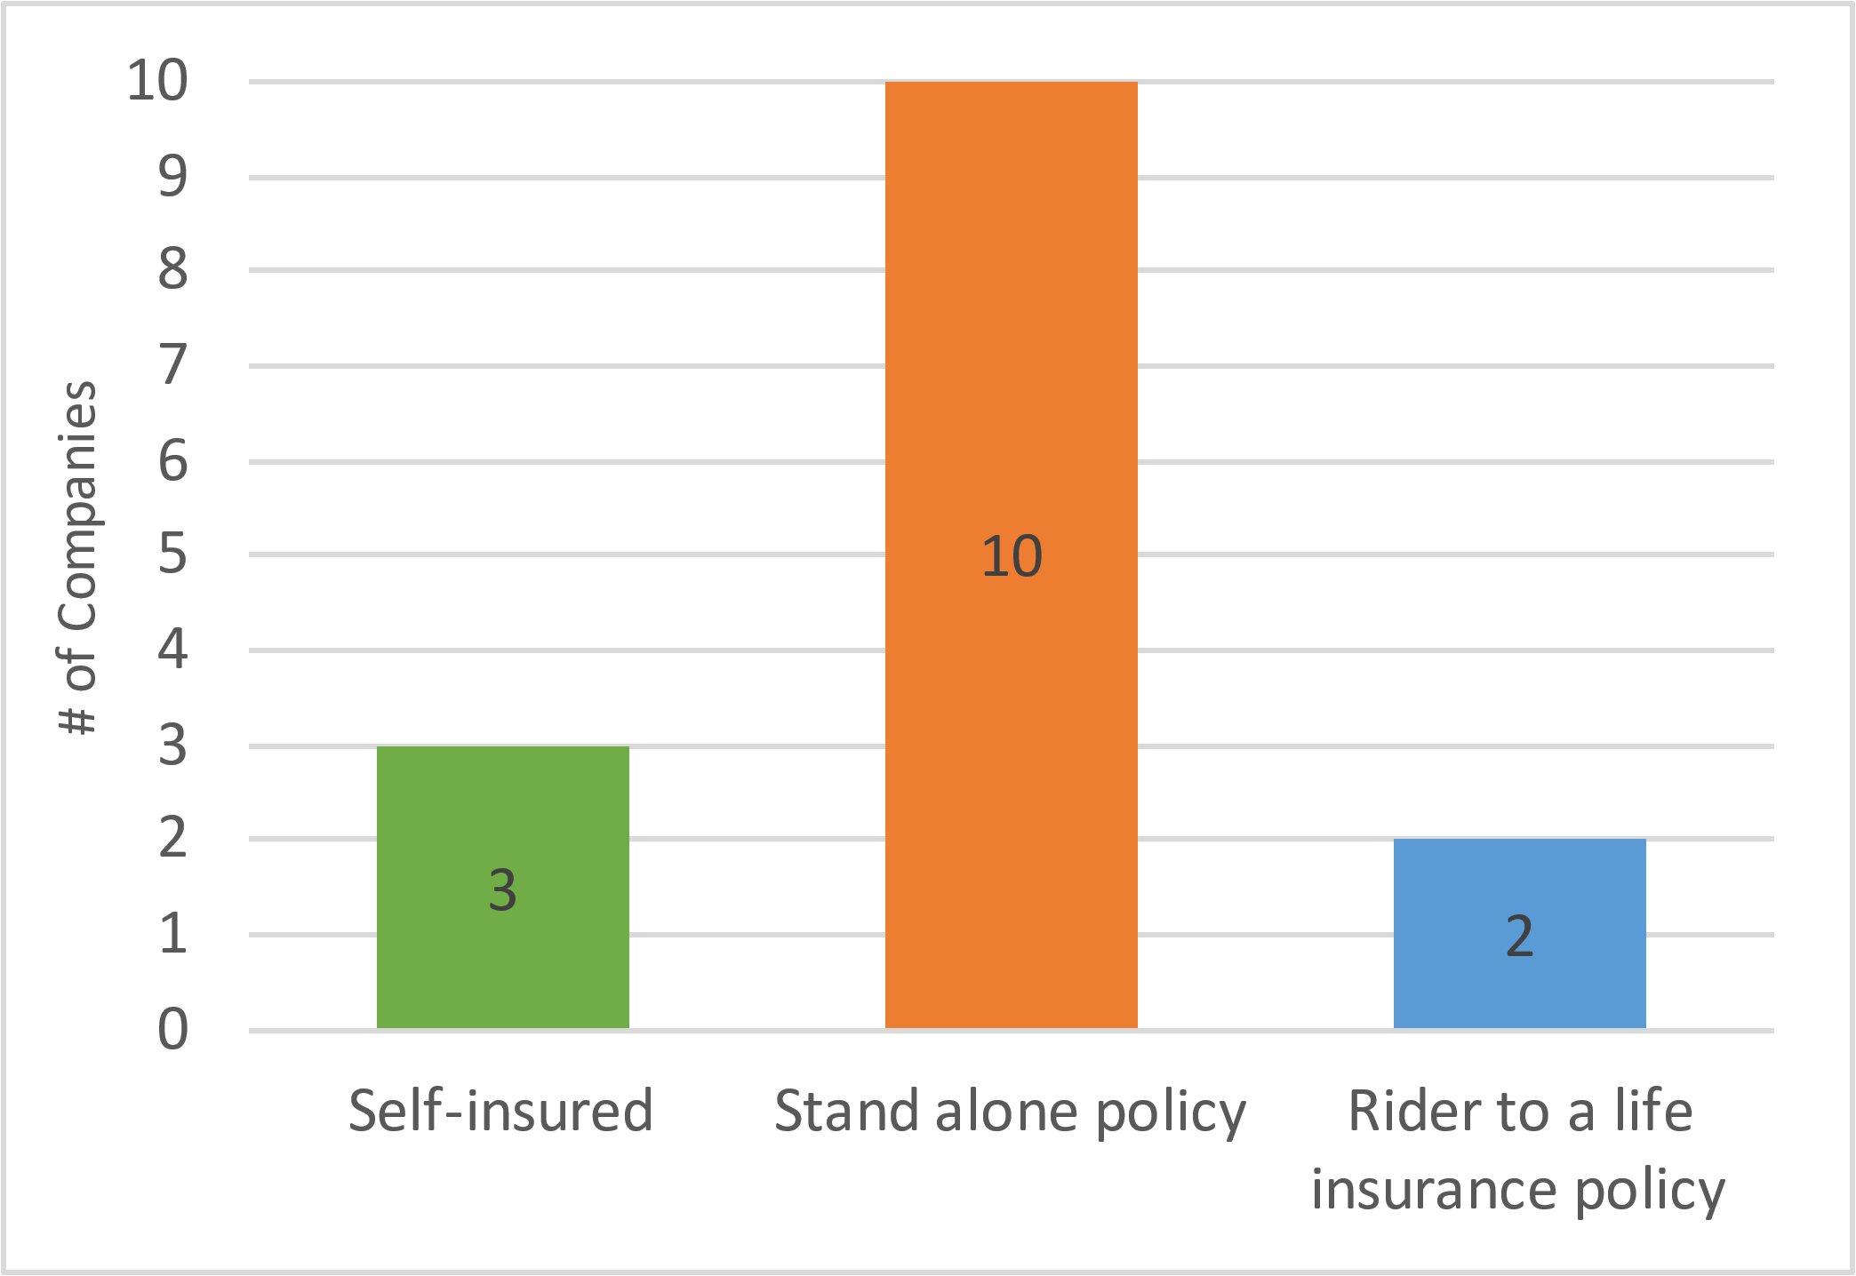
Employee Supplemental Accident Assurance Approach to insuring accident insurance
Companies surveyed uses a variety of insurers, with Chubb being slightly more popular
Accident coverage is typically not poolable in the UK
N = 15

Slide 23
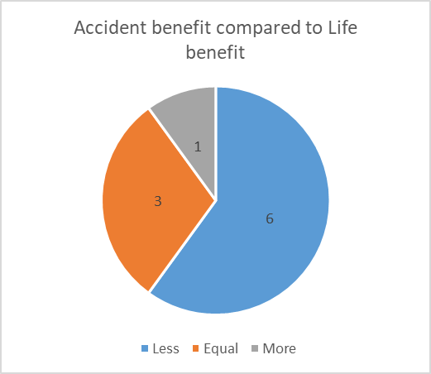
Employee Supplemental Accident Assurance – Coverage Core coverage levels for company paid benefits vary
No consistence in coverage levels paid by the company, with 2x and 4x being slightly more popular
Of the companies who provided information, 60% offer an Accident benefit less than the Life benefit
N = 10
N = 10

Slide 24
Employee Critical Illness Insurance – Overview
40% (23 companies) currently provide Critical Illness coverage, while one is considering
None of the companies surveyed provide the same level of Critical Illness benefit
About half of companies cover the full cost of the benefit
Overall, almost half the companies (12) provide a flat amount

Slide 25
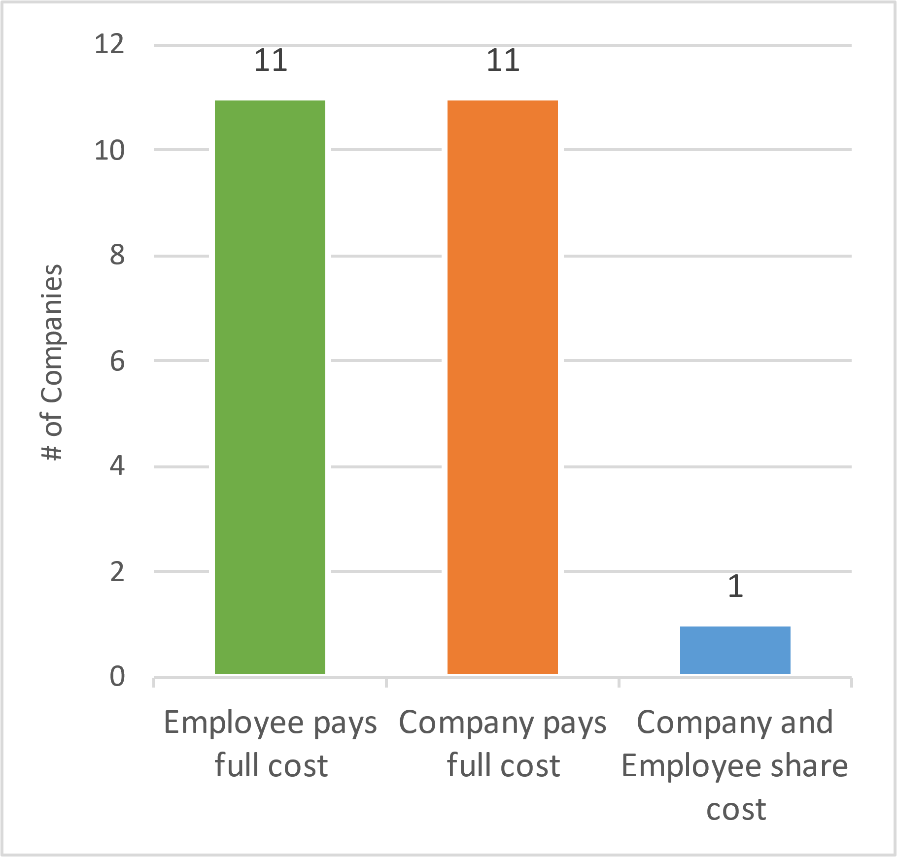
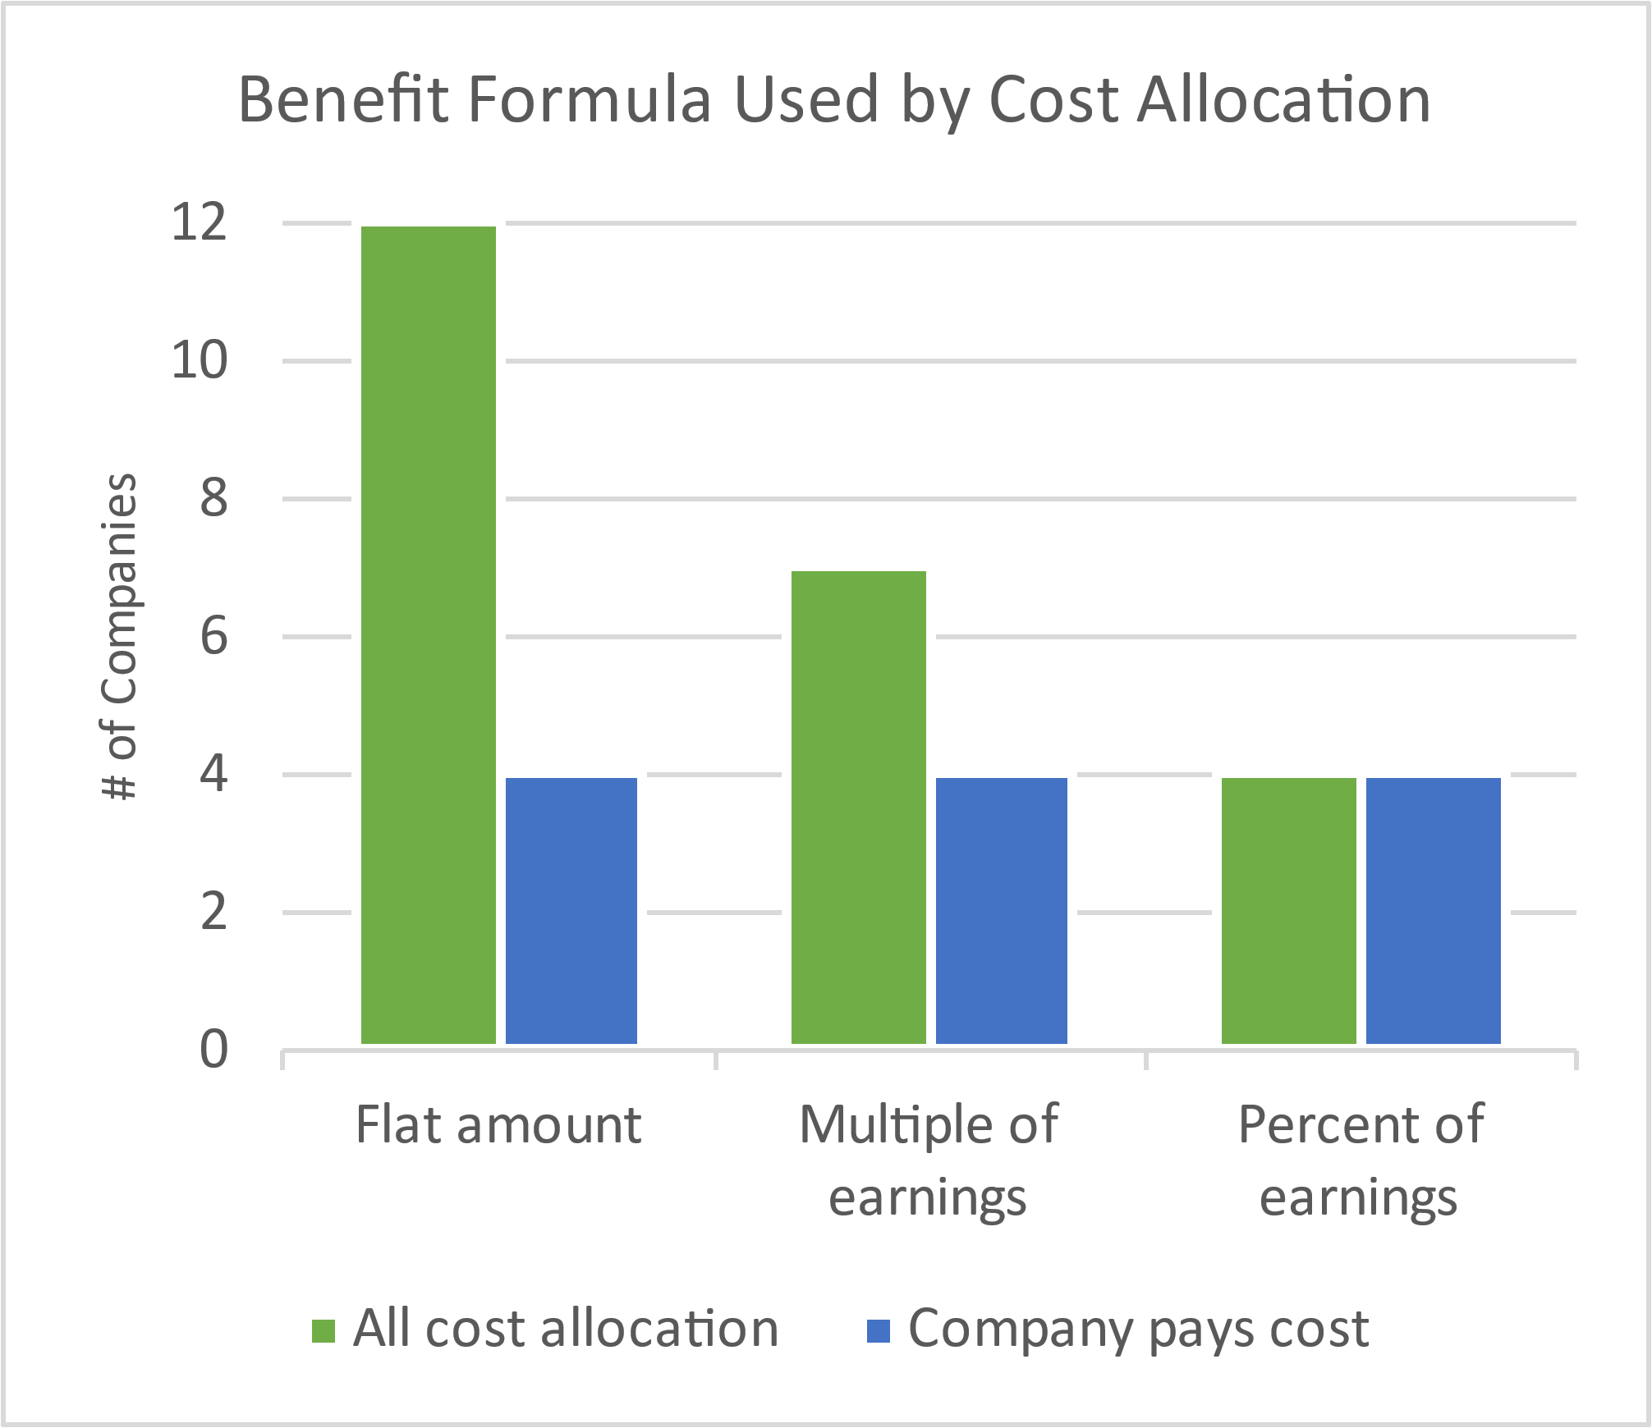
Employee Critical Illness Insurance Cost sharing & benefit formula
Just over half the companies offer a flat amount
However, when only looking at plans paid at least in part by the company, the split between flat amount, multiple of earnings and percent of earnings is the same
N = 23

Slide 26
2021 UK Benchmark Survey
Short Term Disability and Income Protection

Slide 27
Short Term Disability – Overview
57% (33 companies) currently provide Short Term Disability above Statutory Sick Pay (SSP), while one is considering
The most common design is to continue paying Base Pay for 180 days
About half of these companies (16) provide the benefit in addition to the minimum legally required, while the other half include it
Only one company uses an insured policy
Is Short Term Disability combined with supplemental sick pay or kept separate?
If combined, what learnings can you share?

Slide 28
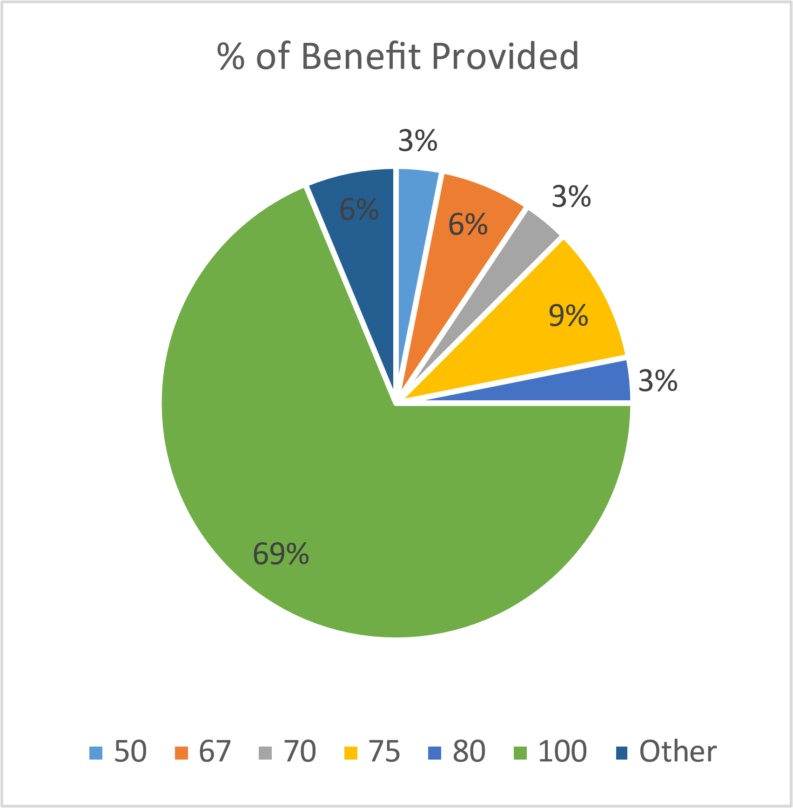
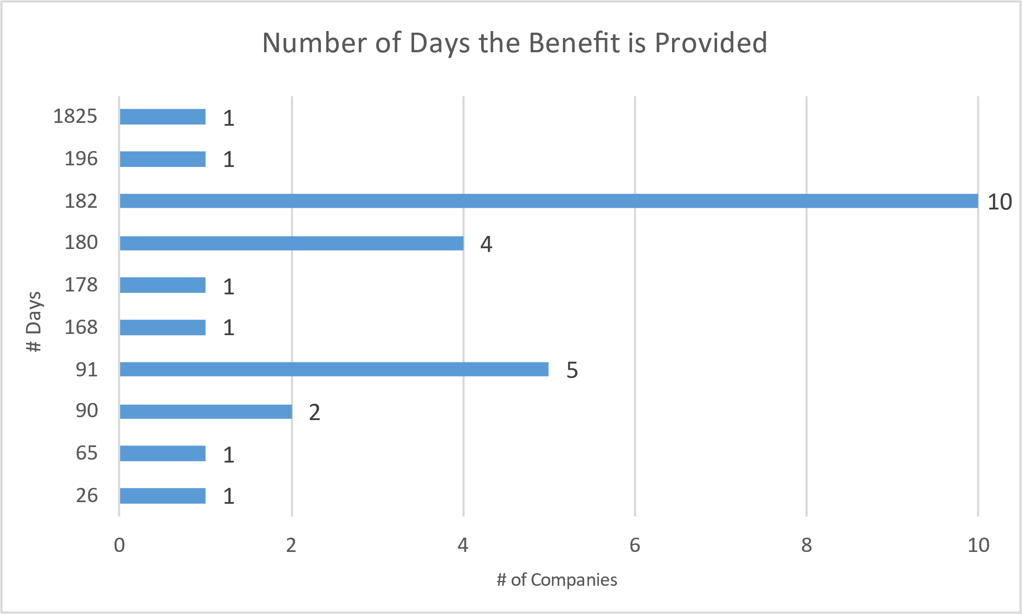
Short Term Sickness Absence/Company Sick Pay Core coverage levels – 69% provide 100% of earnings
Average Days: 209
Median Days: 180
N = 32
N = 27

Slide 29
Income Protection – Overview
The most common design is to provide 75% of Base Pay until Retirement Age, after a waiting period of 182 days, to employees who are unable to continue their own occupation
93% (54 companies) currently provide Income Protection benefits
Only one (1) company provides a Lump Sum benefit. Everyone else provides the benefit through Regular Payments.
72% of the companies who provide the benefit insure it on a Stand Alone basis

Slide 30
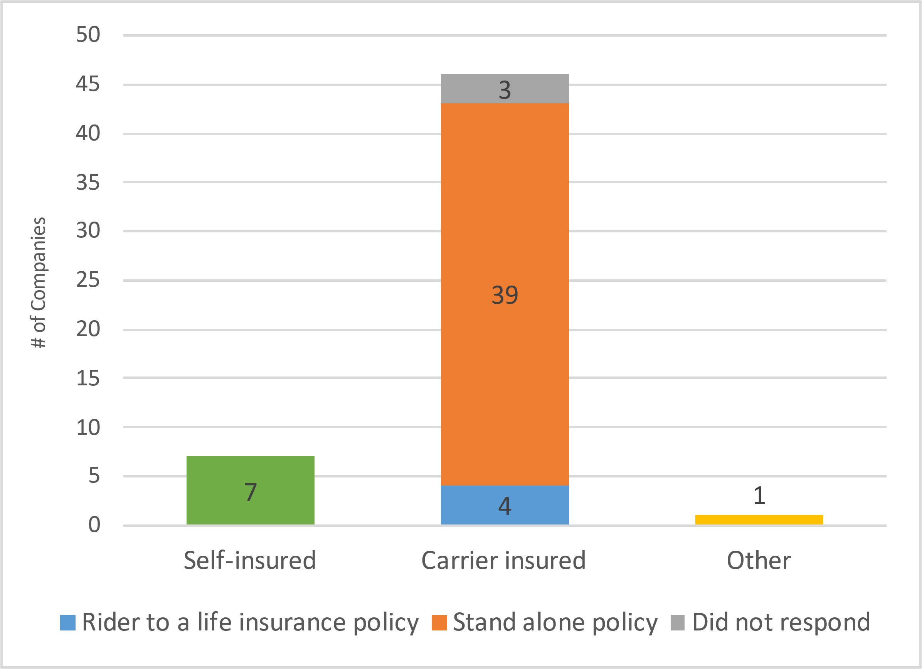
Income Protection – Approach to Insuring 85% use a carrier to insure income protection
All companies using self insurance provide the benefit as a regular payment; might consider looking into insurance to minimize cash flow and reserve management
N = 54

Slide 31
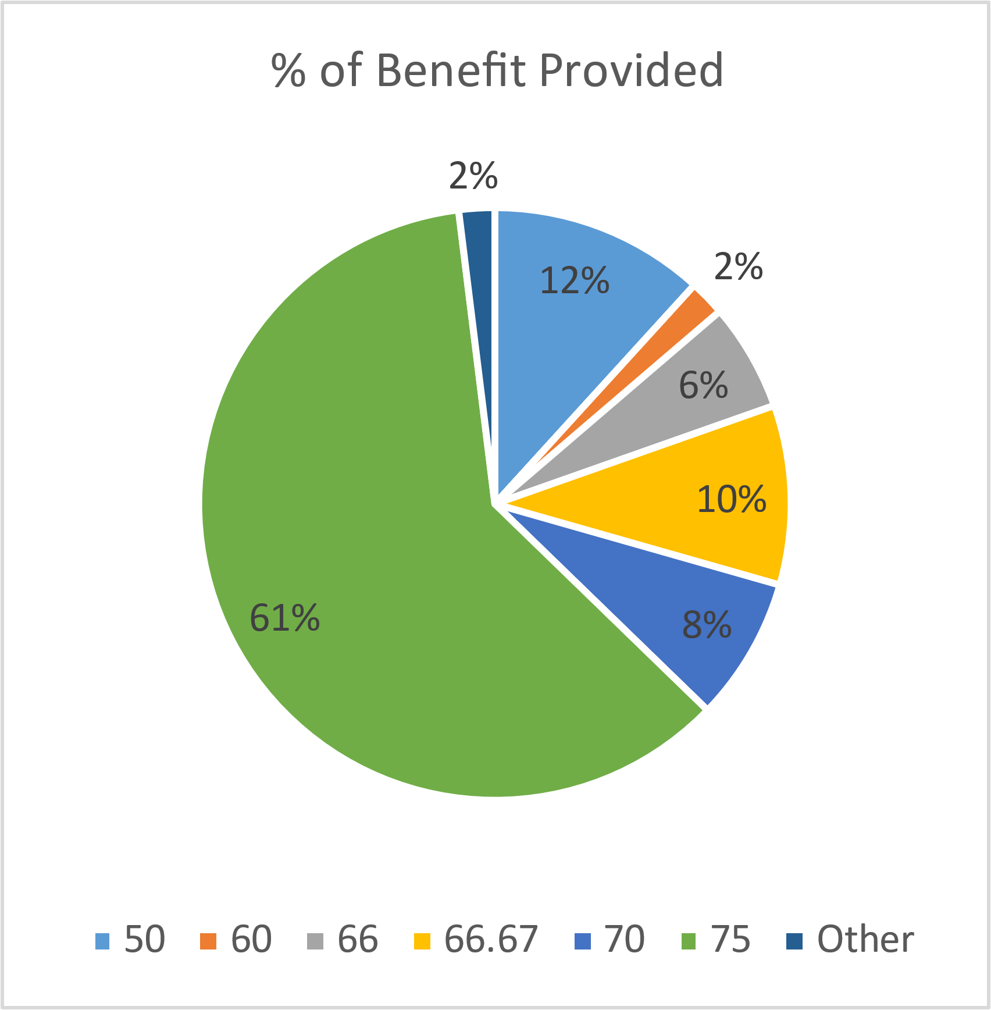
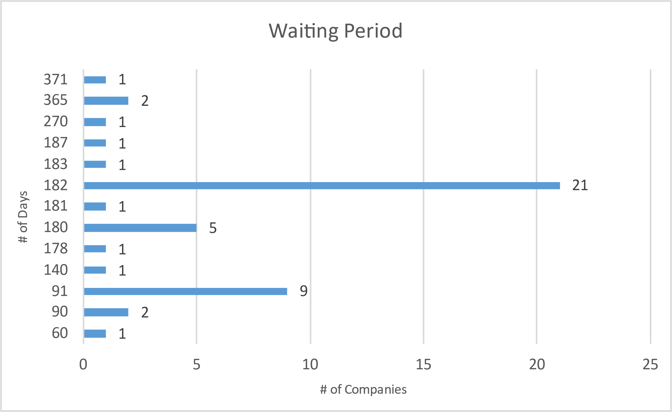
Income Protection – Core Coverage Levels 61% provide 75% of Earnings
Average Days: 171
Median Days: 182
N = 51
N = 47

Slide 32
Income Protection – Maximum Duration 76% continue the benefit until retirement
N = 50

Slide 33
2021 UK Benchmark Survey
Retirement

Slide 34
Retirement Benefits - Overview Defined contribution structure is the norm
For those with a master trust, what are the advantages of using one?
N = 53
N = 41
N=30

Slide 35
Defined Contribution Plan - Employer Contributions Companies contribute above legal minimum, but most require employee contributions to the pension plan
N = 41
N = 24

Slide 36
Defined Contribution Plan - Employee Contributions Most companies require employee contributions and match with a cap
N = 36
N = 20

Slide 37
Alternative Provisions for Annual Allowance Tapering Nearly half of respondents provide an alternative pension benefit
N = 52
N = 21

Slide 38
2021 UK Benchmark Survey
Wellbeing Benefits

Slide 39
Wellbeing – Overview
81% (43 companies) indicated that perceptions of mental illness greatly or somewhat affects Wellness program utilization
60% (35 companies) have a Financial Wellbeing program in place
Retirement planning tools and calculators (77%) are the most popular Financial Wellbeing benefit
Flexible Work Policies (81%) and Work/Life Balance Support (74%) are the most popular Wellbeing programs offered
32% (18 companies) have a local Wellness Committee, and 7% (4 companies) are considering establishing one. HR and the Benefits Team are typically involved.
Companies surveyed offer on average eight (8) different Wellbeing programs

Slide 40
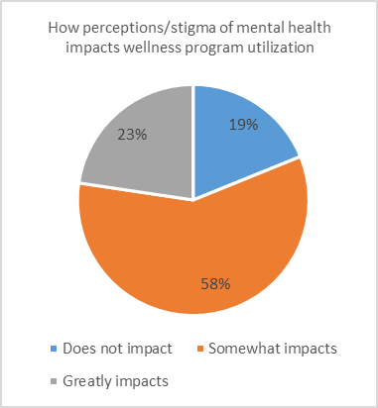
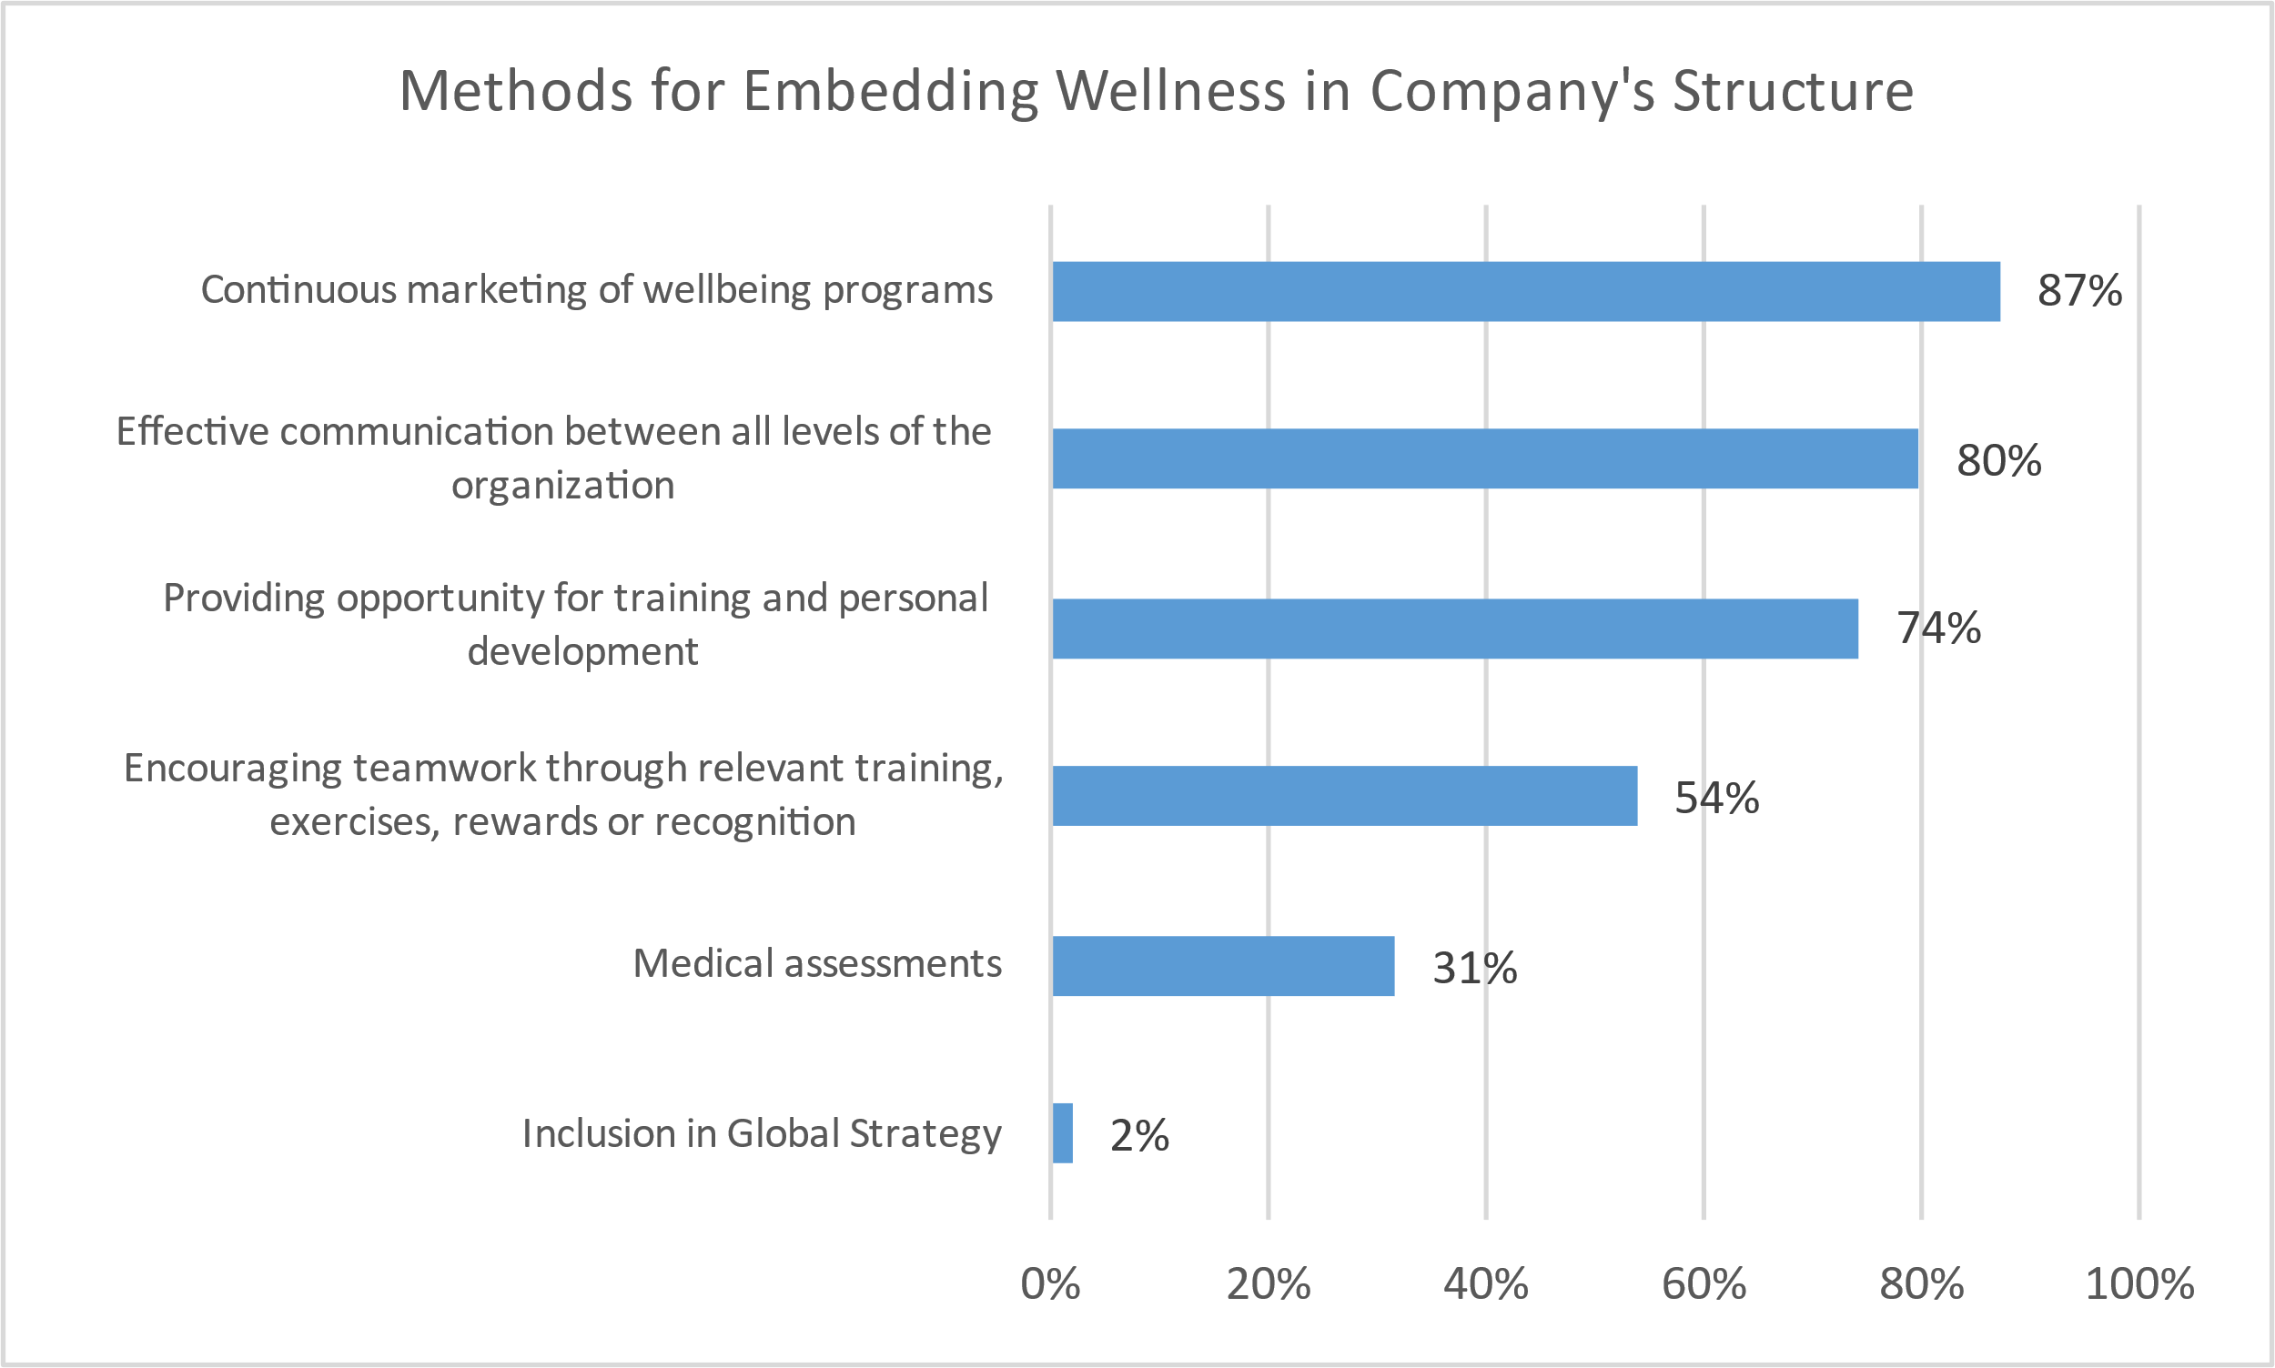
Wellbeing – Utilization Perceptions of mental health greatly impact wellness program utilization
N = 53
N = 54

Slide 41
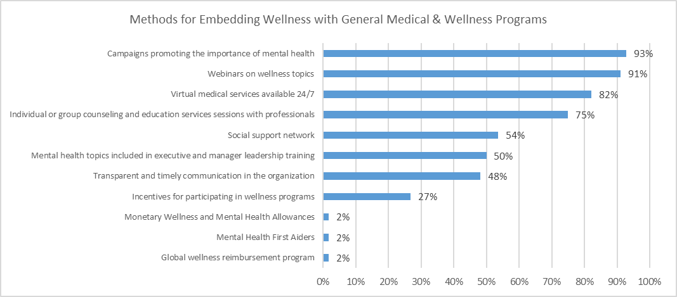
Wellbeing – Methods to Embed with other Programs Campaigns and webinars are widely used
On average, companies use 5 different methods to embed Wellbeing with Medical and Wellness programs
N = 56

Slide 42
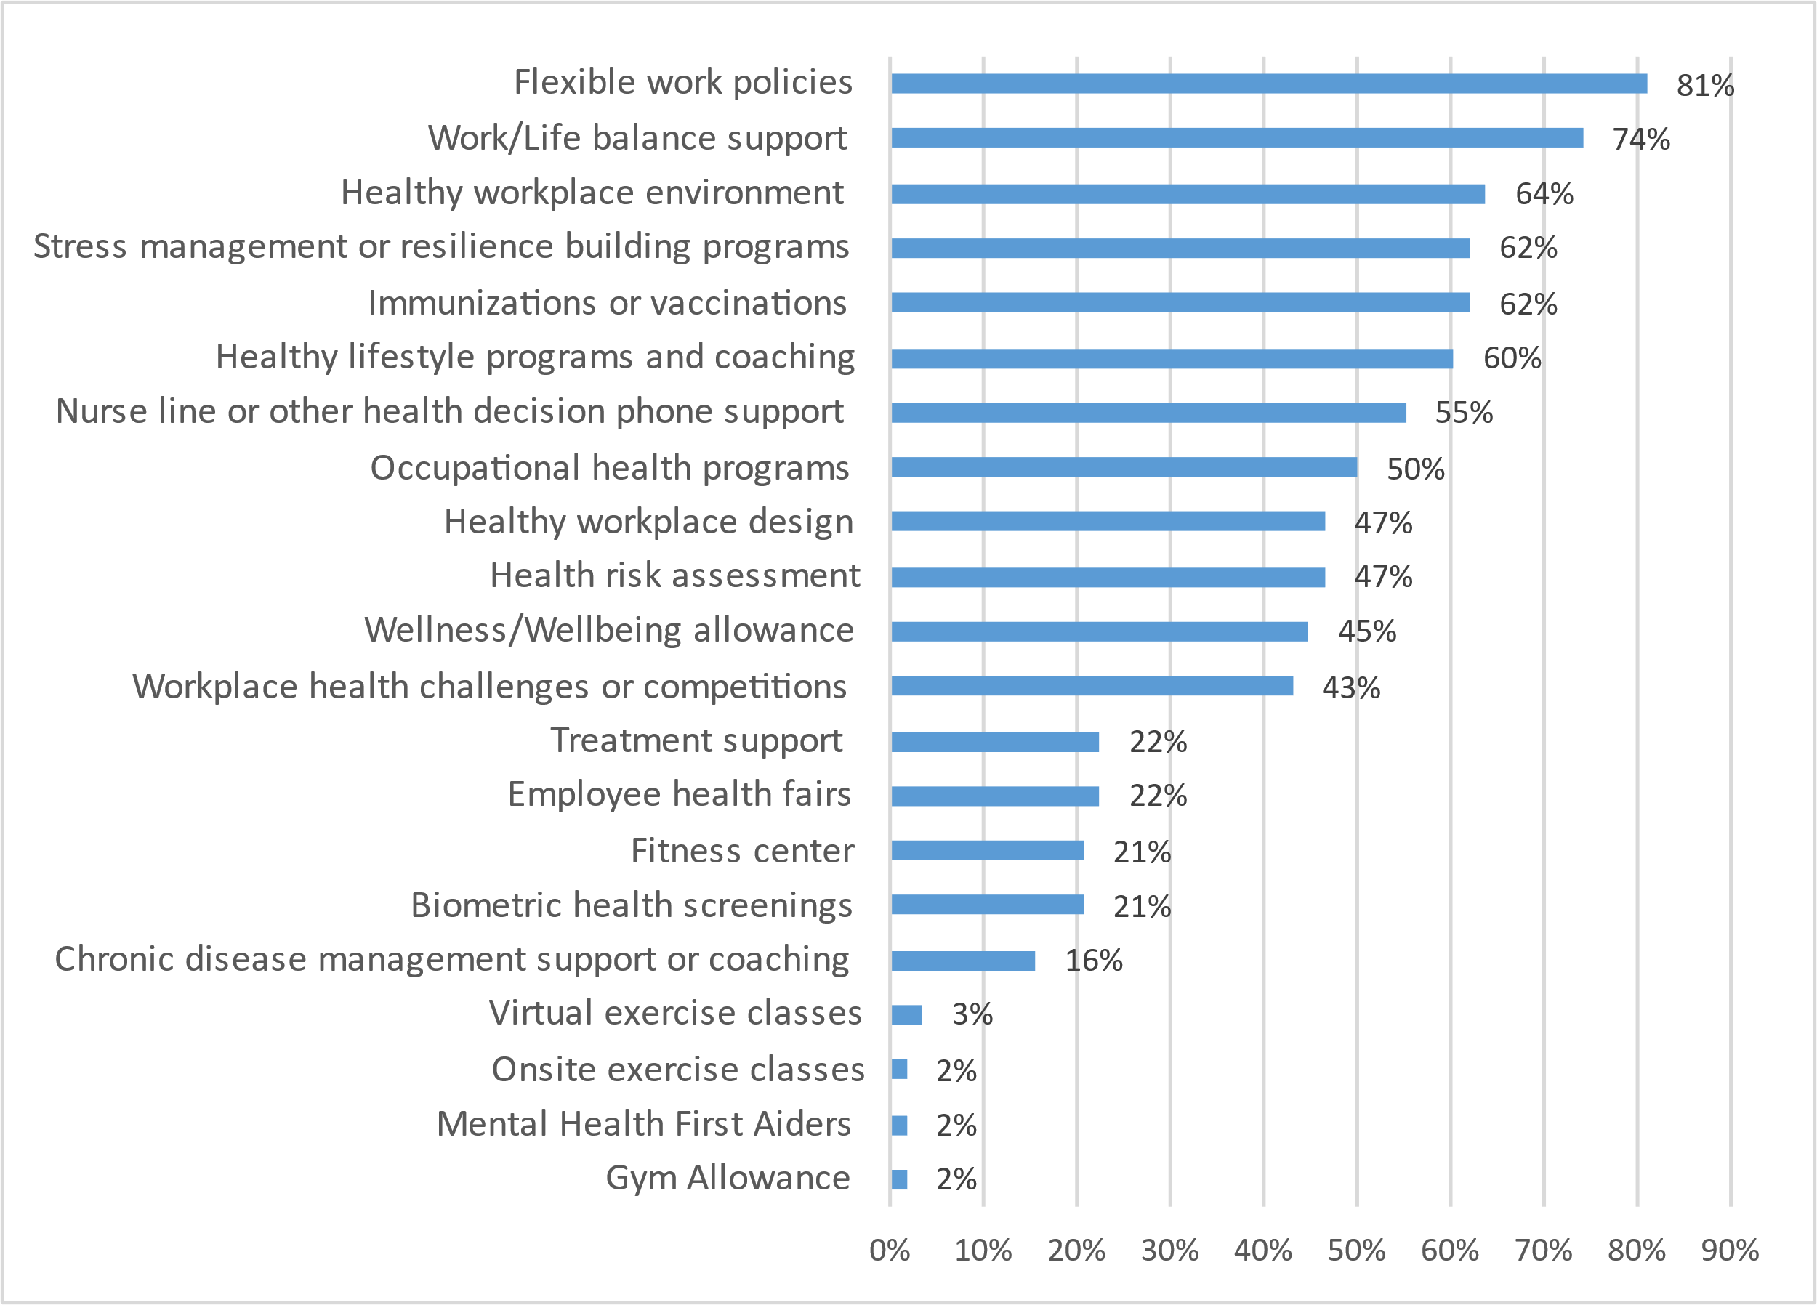
Wellbeing – Type of Programs Offered All companies offer some type of wellbeing program
On average, companies provide 8 different programs, with the maximum being 16 and the minimum being 1
Might want to examine utilization to achieve a balance between choice, value to employees and manageable number of programs
N = 58

Slide 43
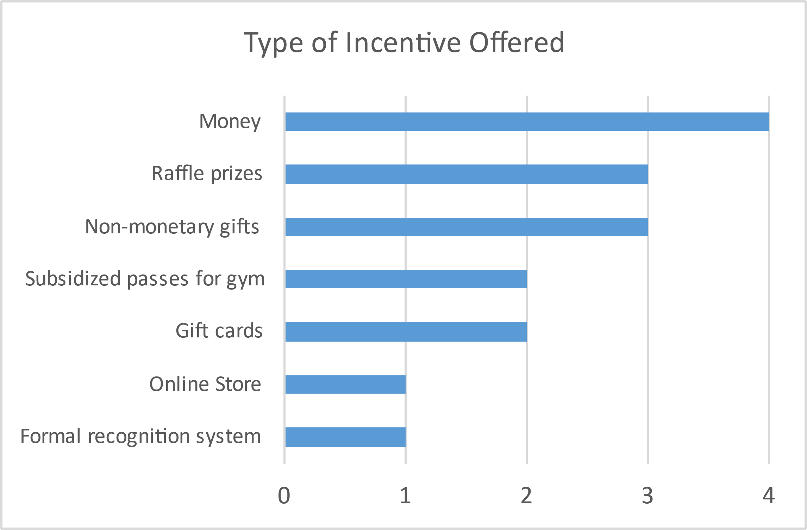
Wellbeing – Incentive for Participating Most companies do not offer incentives for participating in a well-being program
Only 8 companies offer incentive to participate in the well-being program, while 2 are considering
When provided, 2 incentives are offered on average, with a maximum of 4 and a minimum of 1
N = 8

Slide 44
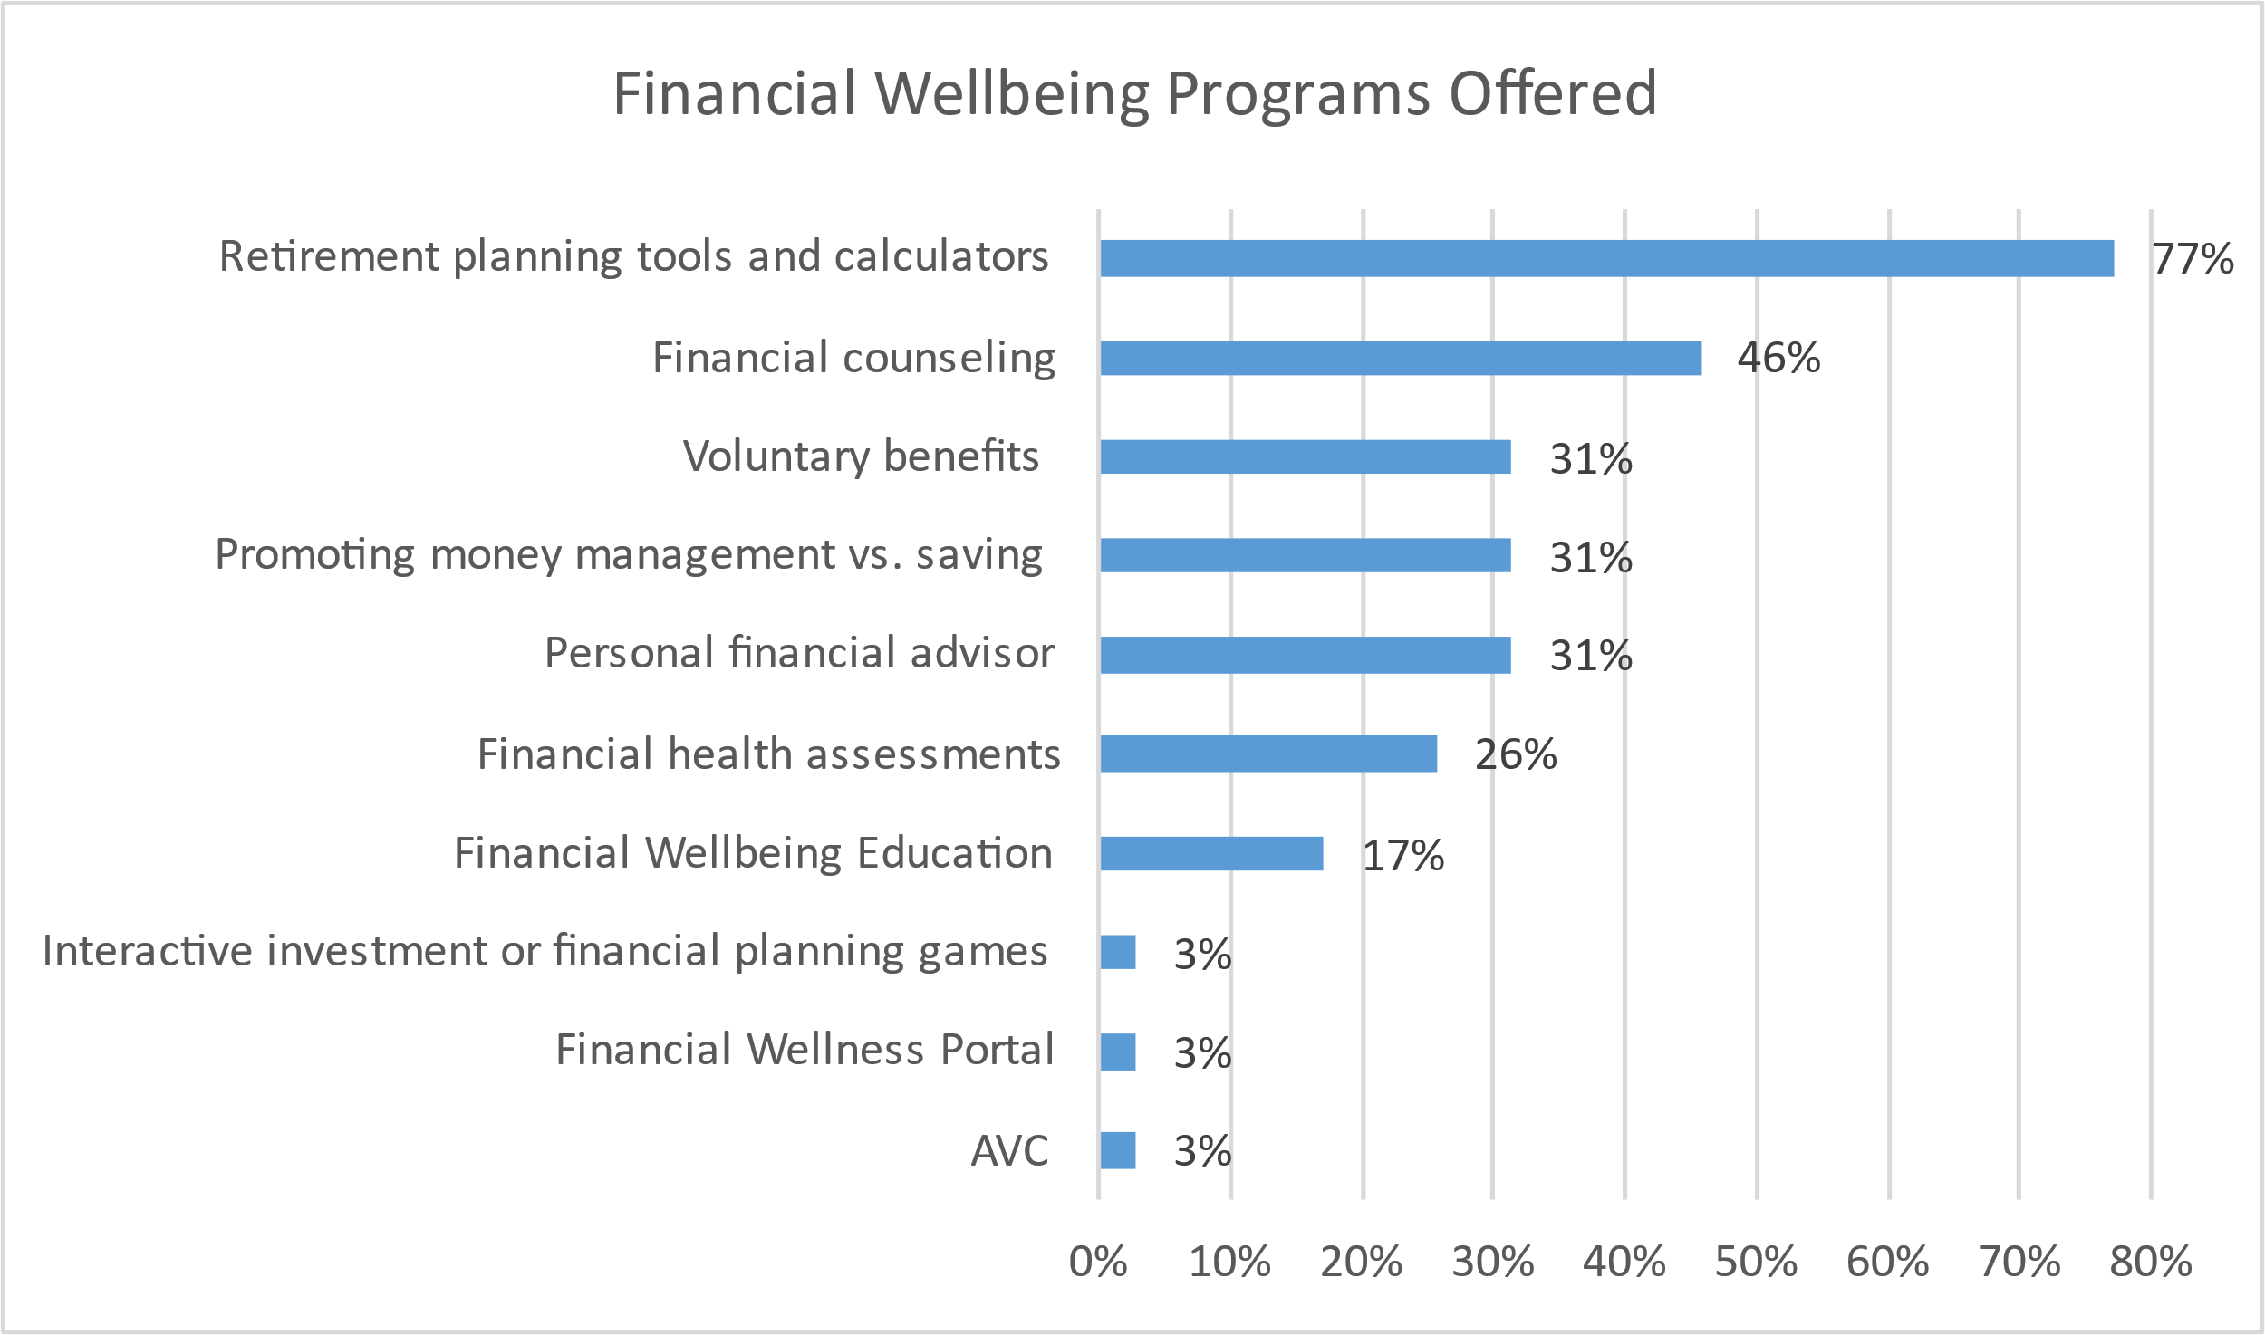
Wellbeing – Financial Retirement planning tools & calculators is the most prevalent program
35 of the companies surveyed currently offer a financial wellbeing program, while 2 are considering
When provided, 3 programs are offered on average, with a maximum of 6 and a minimum of 1
The most popular Financial Well-Being program (retirement planning tools and calculators) is 30% more popular than the 2nd one (financial counseling)
N = 34

Slide 45
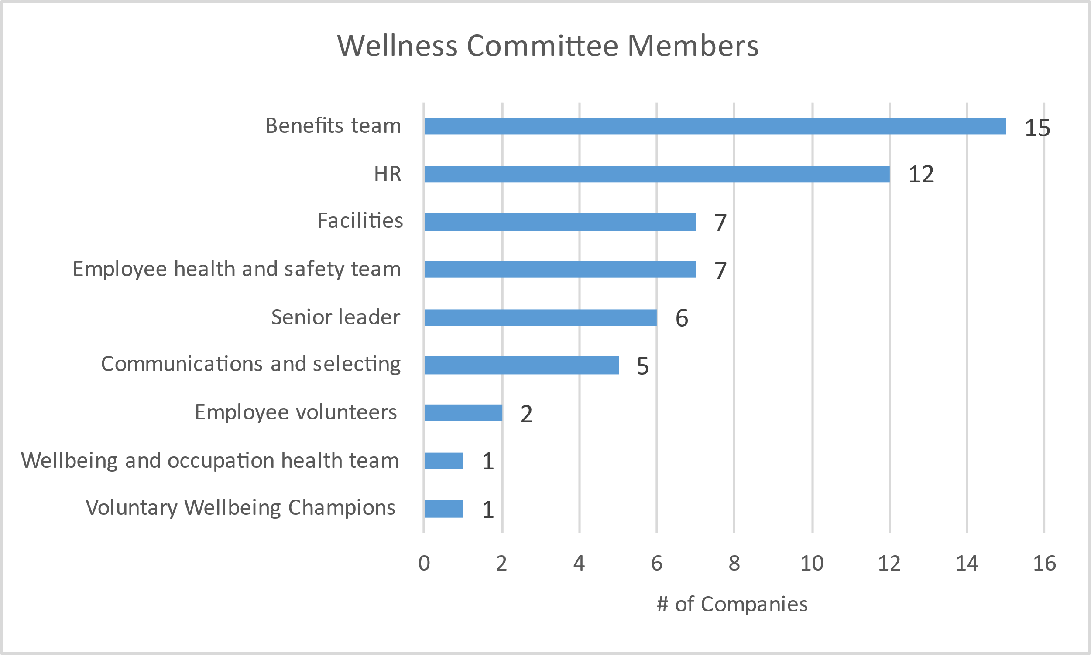
Wellbeing – Committee Few companies have established a wellness committee. Why?
18 companies have a local Wellness Committee, and 4 are considering establishing one
Benefits Team and HR are typically involved
On average, 3 different groups take part in the Wellness Committee
Cross functional teams can help bring a diverse perspective and innovative solutions
N = 17

Slide 46
2021 UK Benchmark Survey
Employee Assistance Program (EAP)

Slide 47
EAP – Overview
All but one company provide EAP, and that company is considering implementing
Although there is a wide range of sessions provided, six (6) sessions is the most common
53% (30 companies) use “per Incident” as the approach to determining the number of EAP sessions, while the rest (27 companies) use “per Year”
Utilization is generally low (1% - 5%), mostly because it’s not part of the culture and it’s not properly communicated

Slide 48
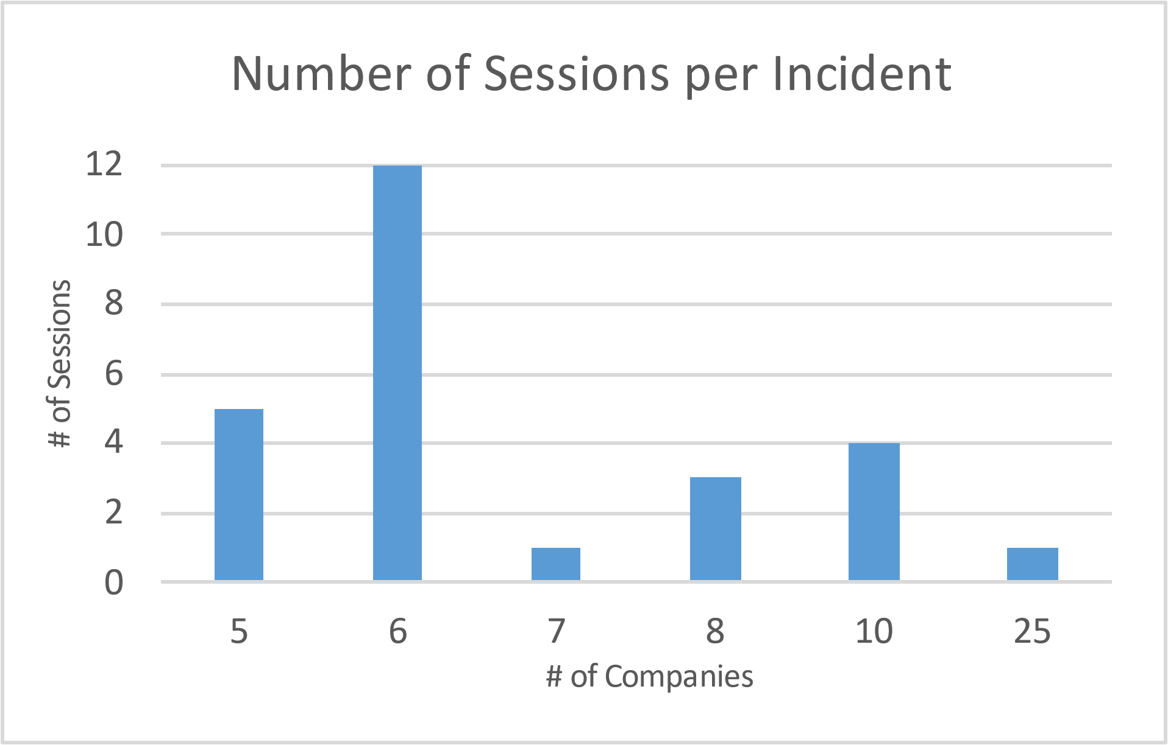
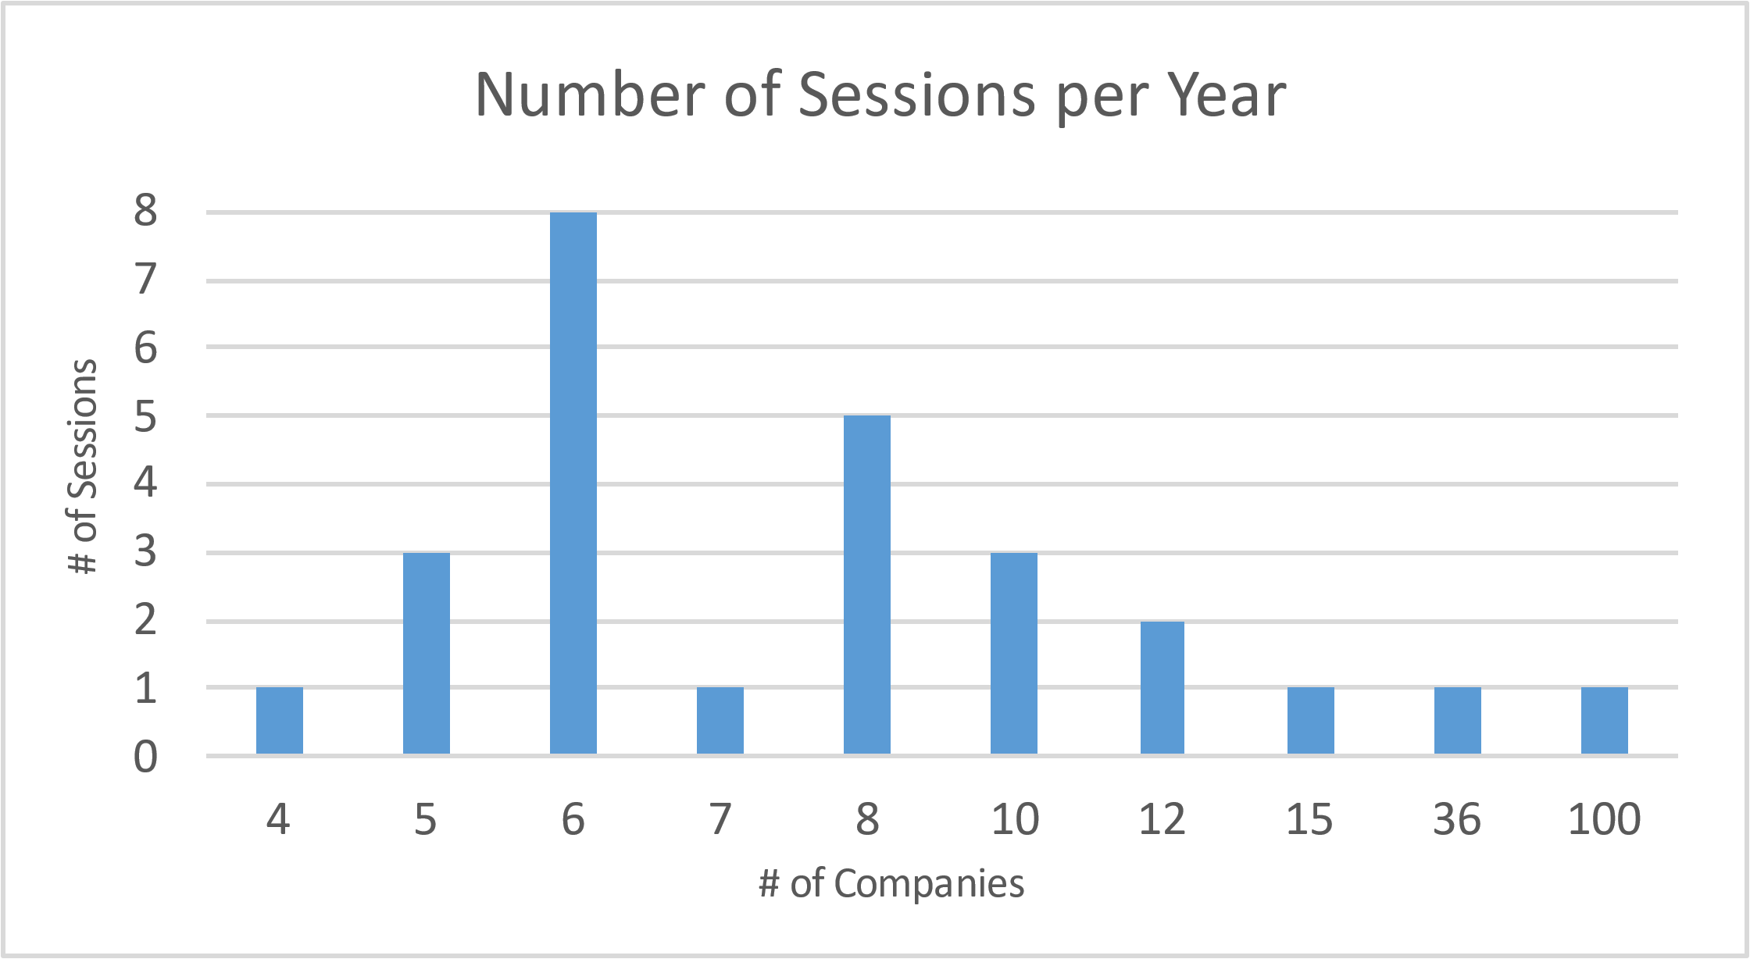
EAP – Number of Sessions 6 is the most prevalent, irrespective of the approach
As expected, companies using “per Year” allow on average a higher number of sessions
Might want to look at utilization to check if most people using the benefit max out of the number of sessions
Average sessions: 7
Median sessions: 6
Average sessions: 13
Median sessions: 8
N = 26
N = 26

Slide 49
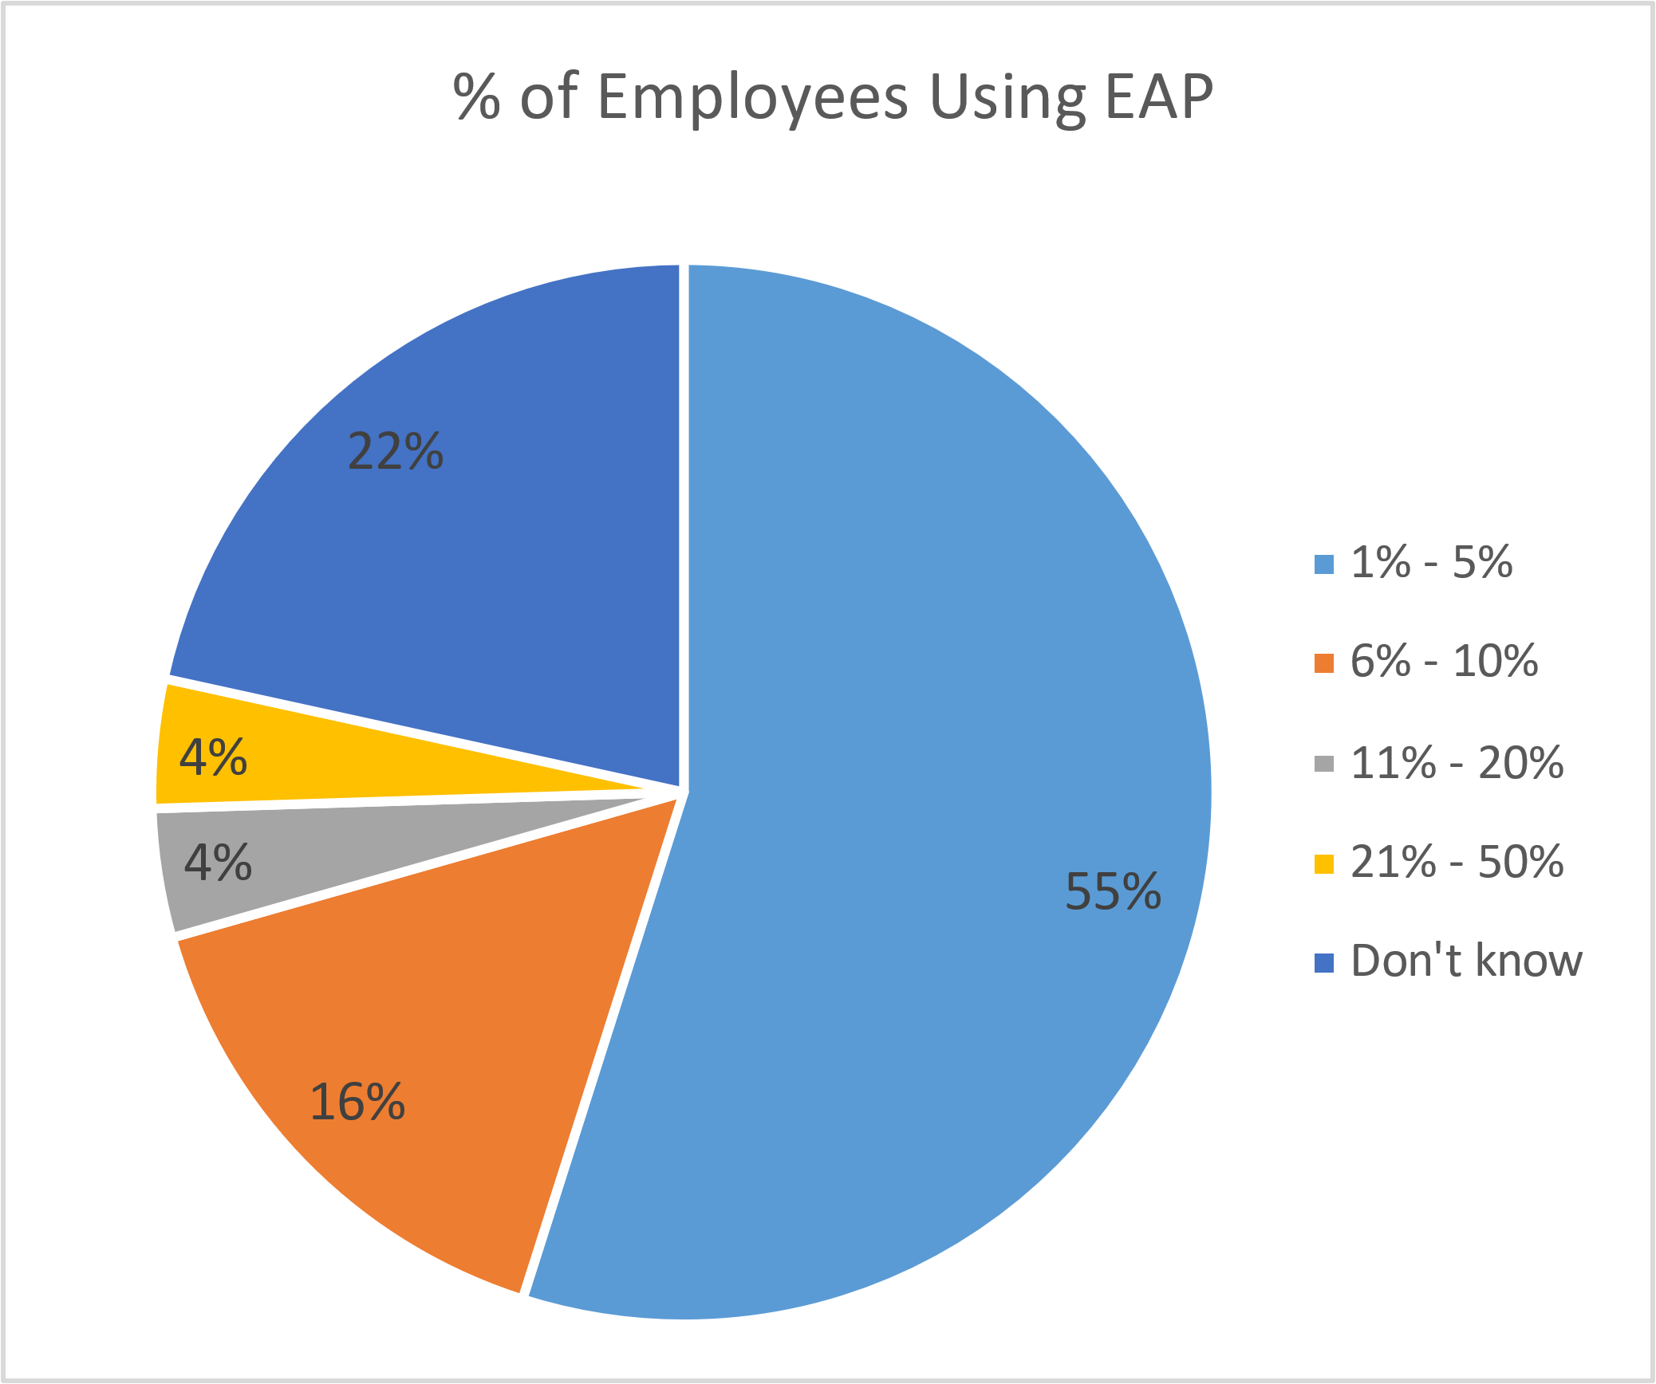
EAP – Utilization 93% receive a utilization report from their vendor. What steps/success stories can you share about increasing EAP usage?
Despite receiving a utilization report, 11 companies don’t know the percentage of employees using the EAP benefit
Only 4 companies have a utilization above 10%
The main reasons mentioned for the low utilization are that it’s not part of the culture and it’s not properly communicated
N = 51

Slide 50
EAP Services outside of EAP
Only 13 companies provide services outside of EAP, while 2 are considering
Example of other outside EAP services offered: some form of counseling and consultation, mental health first aiders, cash allowance
In most cases, these outside services are offered either through the Life and Income protection insurer, or through a specialized vendor (Happify, Modern Health, Sanvello and Spring Health)

Slide 51
2021 UK Benchmark Survey
Leaves

Slide 52
Leaves – Types Offered Most companies supplement 5 different leave types
Other leave types include:
Pandemic
First Year Child Leave
Domestic Abuse, Sexual Assault, and Crime Victim Leave
N = 57

Slide 53
Annual Leave - Entitlements and Duration Most common approach is to provide 5 weeks per year of annual leave with no increase for tenure
N = 41
N = 40

Slide 54
Annual Leave - Buying Most companies do not allow employees to buy additional annual leave
N = 42
N = 12

Slide 55
Annual Leave – Selling Selling of annual leave is not a common plan design
N = 42
N = 9

Slide 56
Sickness Absence - Overview Majority of SVEF members maintain sick pay for up to and including 26 weeks or 180 days
N = 44

Slide 57
Ordinary Maternity Leave Most companies maintain full pay for the full duration of Ordinary Maternity Leave (OML)
N = 55

Slide 58
Additional Maternity Leave Most members do not maintain full pay for Additional Maternity Leave
N = 48

Slide 59
Enhanced Paternity Leave Most companies provide leave duration above statutory amounts
N = 41

Slide 60
Parental Leave – Paid vs. Unpaid Most members do not pay for parental leave
N = 42

Slide 61
Shared Parental Leave Most apply only statutory shared parental leave pay (SPL)
N = 37

Slide 62
Adoption Leave - Duration Most companies pay adoption leave up to 26 weeks
N = 47

Slide 63
Other Time Away
Bereavement
98% of respondents provide paid bereavement leave, with a median leave duration of 10 days and up to a maximum of 28 days (N=53)
Carers leave
74% of respondents provide full pay for carers leave for a median duration of 4 weeks (N=23)
Jury Duty
Out of 41 companies responding, 95% provide full pay

Slide 64
2021 UK Benchmark Survey
Voluntary Benefits

Slide 65
Voluntary Benefits Cycle to work and health screenings most frequently reported voluntary benefits
Are Voluntary Benefits included in the flex benefits plan?
N = 57
N = 36

Slide 66
2021 UK Benchmark Survey
Perks & Allowances

Slide 67
Perks & Allowances – Overview
91% (53 companies) offer some type of Perks & Allowances (excluding EAP)
Companies surveyed offer on average 5 different Perks & Allowances, with the maximum being 12 and the minimum being 1
Employee Share Plan (ESPP) (66%) and Service Awards (51%) are the most popular
Rewards, Technology & Home Office, and Health are the Top 3 categories

Slide 68
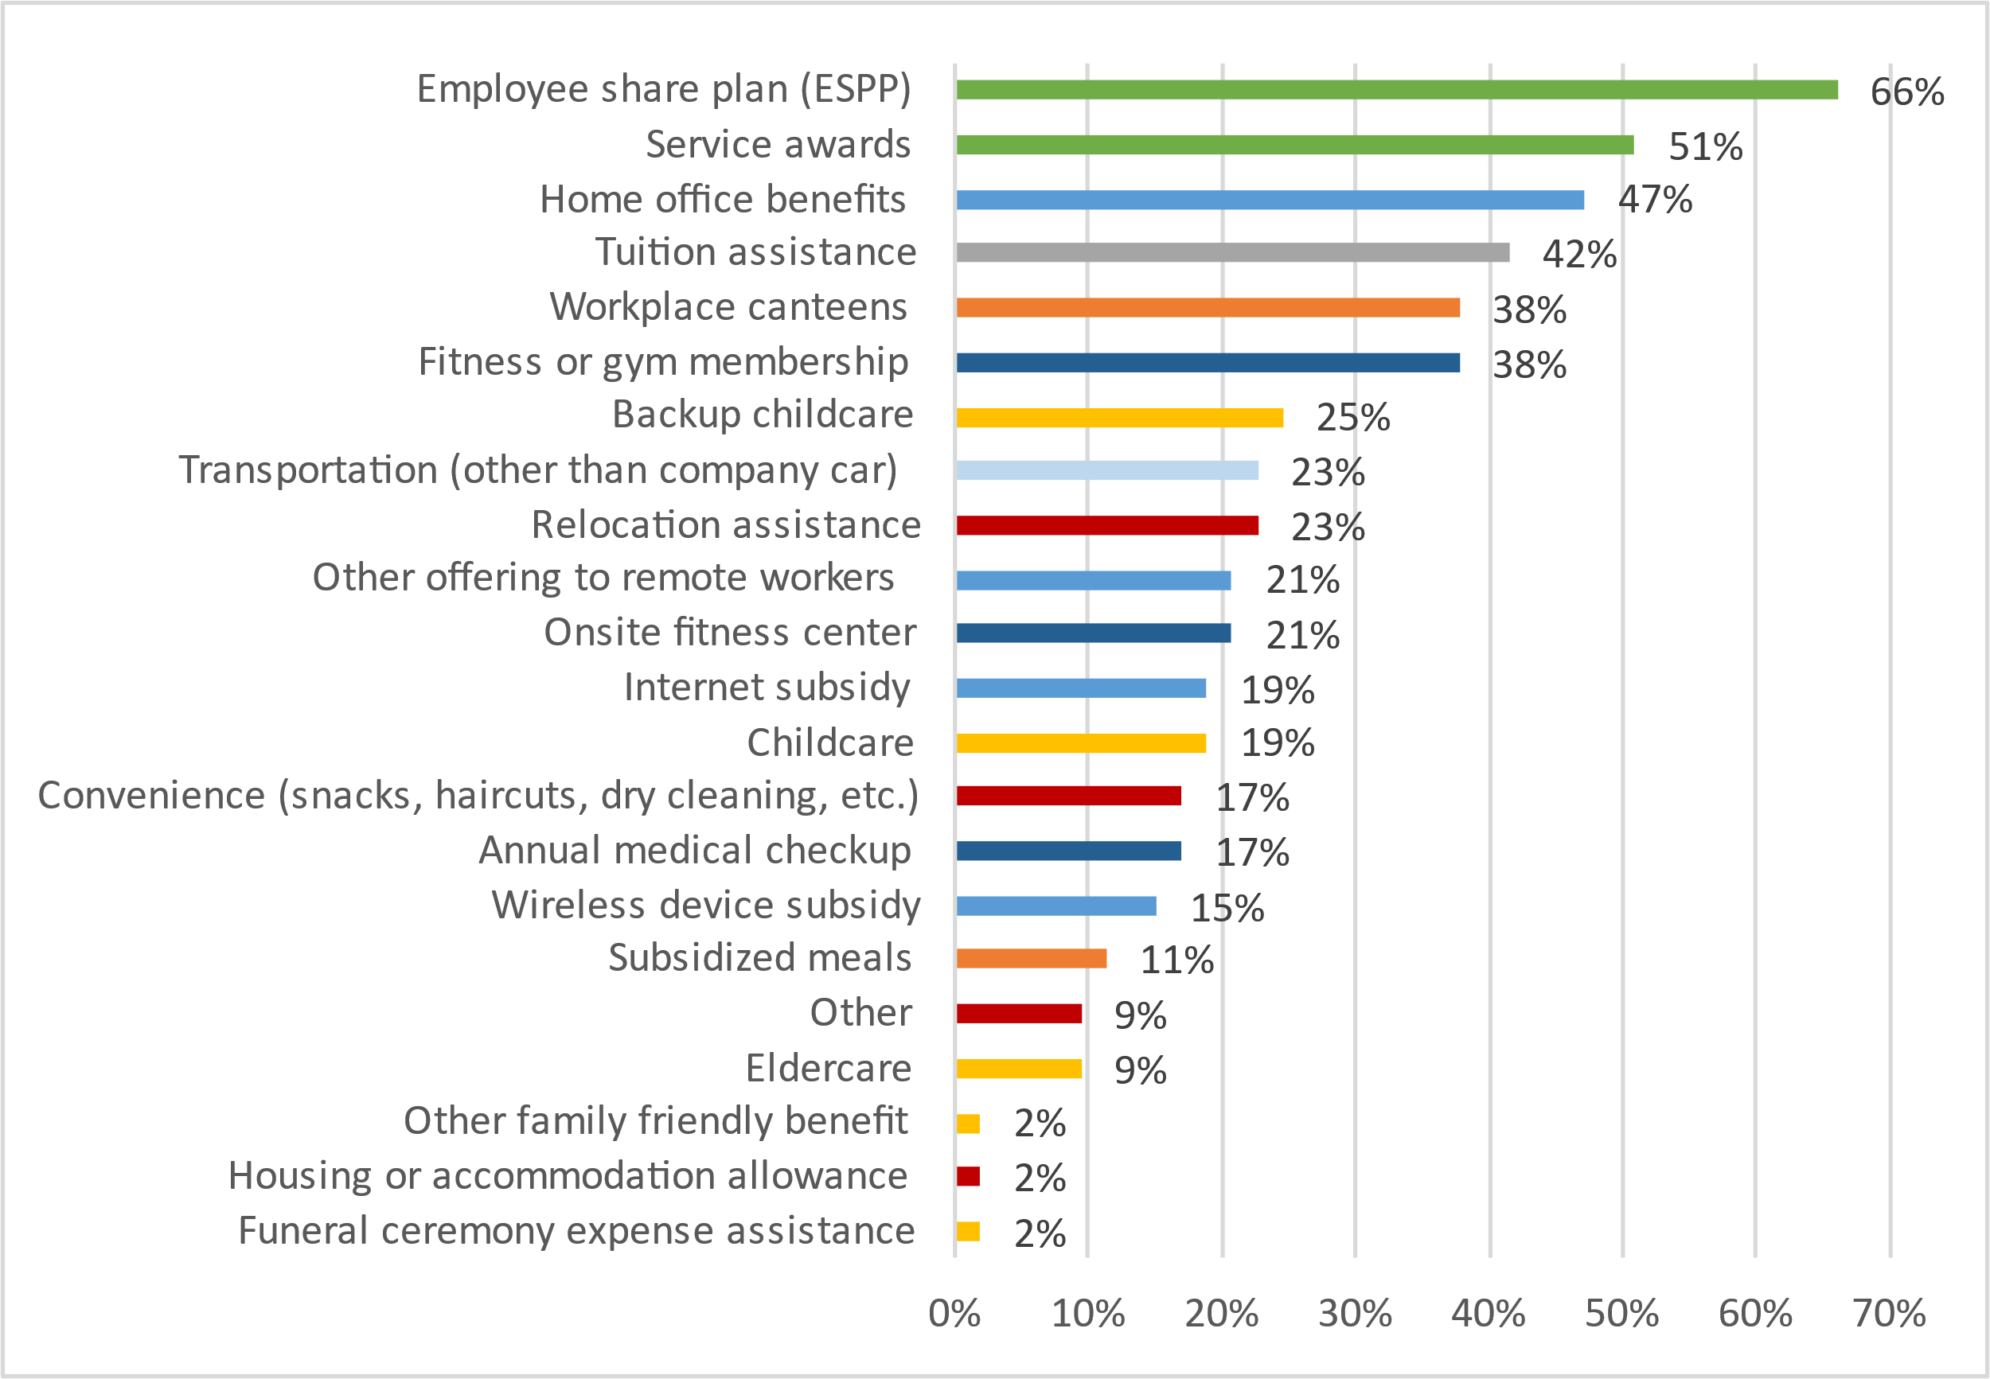
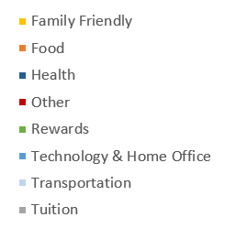
Perks & Allowances – Offering (Excluding EAP) Rewards type perks and allowances are the most popular
Perks & Allowances Category
Are Perks & Allowances included in the flex benefits plan?
N = 53

Slide 69
Perks & Allowances Other perks & allowances provided
Tuition
Of the 22 companies assisting with tuition payments, 86% requires it to be job-related, while 77% requires pre-approval
The average maximum tuition assistance payment is GBP 4,263, with a maximum of GBP 11,169 and a minimum of GBP 740
ESPP
Of the 35 companies providing ESPP, 97% allow employees to purchase shares, while 31% award them to employees for free
Home Office
Of the 25 companies providing the benefit, only 52% provided information on annual maximum benefit. For those who provided (13 companies), the average is GBP 668, with a maximum of GBP 1,825 and a minimum of GBP 110.
Service Awards
56% (15 companies) give an award every 5 years starting on year 5

Slide 70
2021 UK Benchmark Survey
Transportation

Slide 71
Transportation - Benefits Car allowances are the most prevalent transportation benefit, and transportation policies are mainly reviewed on an ad-hoc basis
N = 55
N = 47

Slide 72
Transportation Steps taken towards promoting a greener transportation program
N = 17
N = 14
N = 7
N = 26
N = 29
5 companies offer free electric vehicle charging stations at all locations, and 11 companies offer them at some locations

Slide 73
2021 UK Benchmark Survey
Survey Resources

Slide 74
UK Benchmark Survey Resources Available to SVEF Members Where to Find Them and How They are Used
Resources Available | Use
Summary Presentation Posted on sveforum.org | High-level overview of survey results
Excel File of Aggregate Data Posted on sveforum.org | Detailed analysis using comprehensive data Index can be used to find specific information within the aggregate data
Excel File of Custom Cut Data Files delivered via email | Detailed analysis of companies selected for your custom cut Index can be used to find specific information within the aggregate data
Dashboards Coming soon! | Online view of survey results Comparison of your company and all SVEF members Comparison of your company and selected SVEF members

Slide 76
2021 UK Benchmark Survey
Appendix

Slide 77
Private Medical - Plan Design Most companies have only one medical plan design
N = 57
N = 7

Slide 78
Private Medical - Part-time Employee Eligibility Most companies do not require a minimum number of hours for part-time employees to be eligible
N = 58
N = 41

Slide 79
Private Medical - Deductibles and Maximum Cover Most plans do not have a deductible (excess) or a cap on the amount paid for hospital and/or surgical care
N = 42
N = 42

Slide 80
Private Medical - Outpatient Benefits Most members do include outpatient treatment and services in their plan
N = 58
N = 7

Slide 81
Vision – Financing and Vendors Approaches to financing of the benefit is equally split between self-insured, insured and eye voucher vendors
N = 42
N = 26

Slide 82
Employee Supplemental Life Assurance – Coverage Levels Most companies provide only one
Companies providing additional coverage levels typically do so through a Flex plan
Only two companies offer more than 5 levels of coverage; might want to review utilization and consider if it's necessary
N = 58

Slide 83
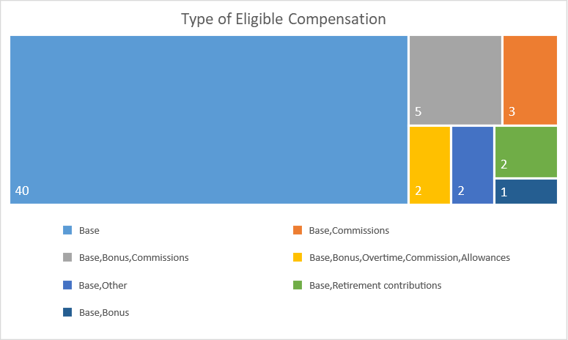
Employee Supplemental Life Assurance – Eligible Compensation 73% use base salary only
N = 55
N = 15

Slide 84
Employee Supplemental Life Assurance - Insurers
The two most popular insurers, Canada Life and Unum, are part of Insurope and Swiss Life’s pooling network, respectively
N = 57

Slide 85
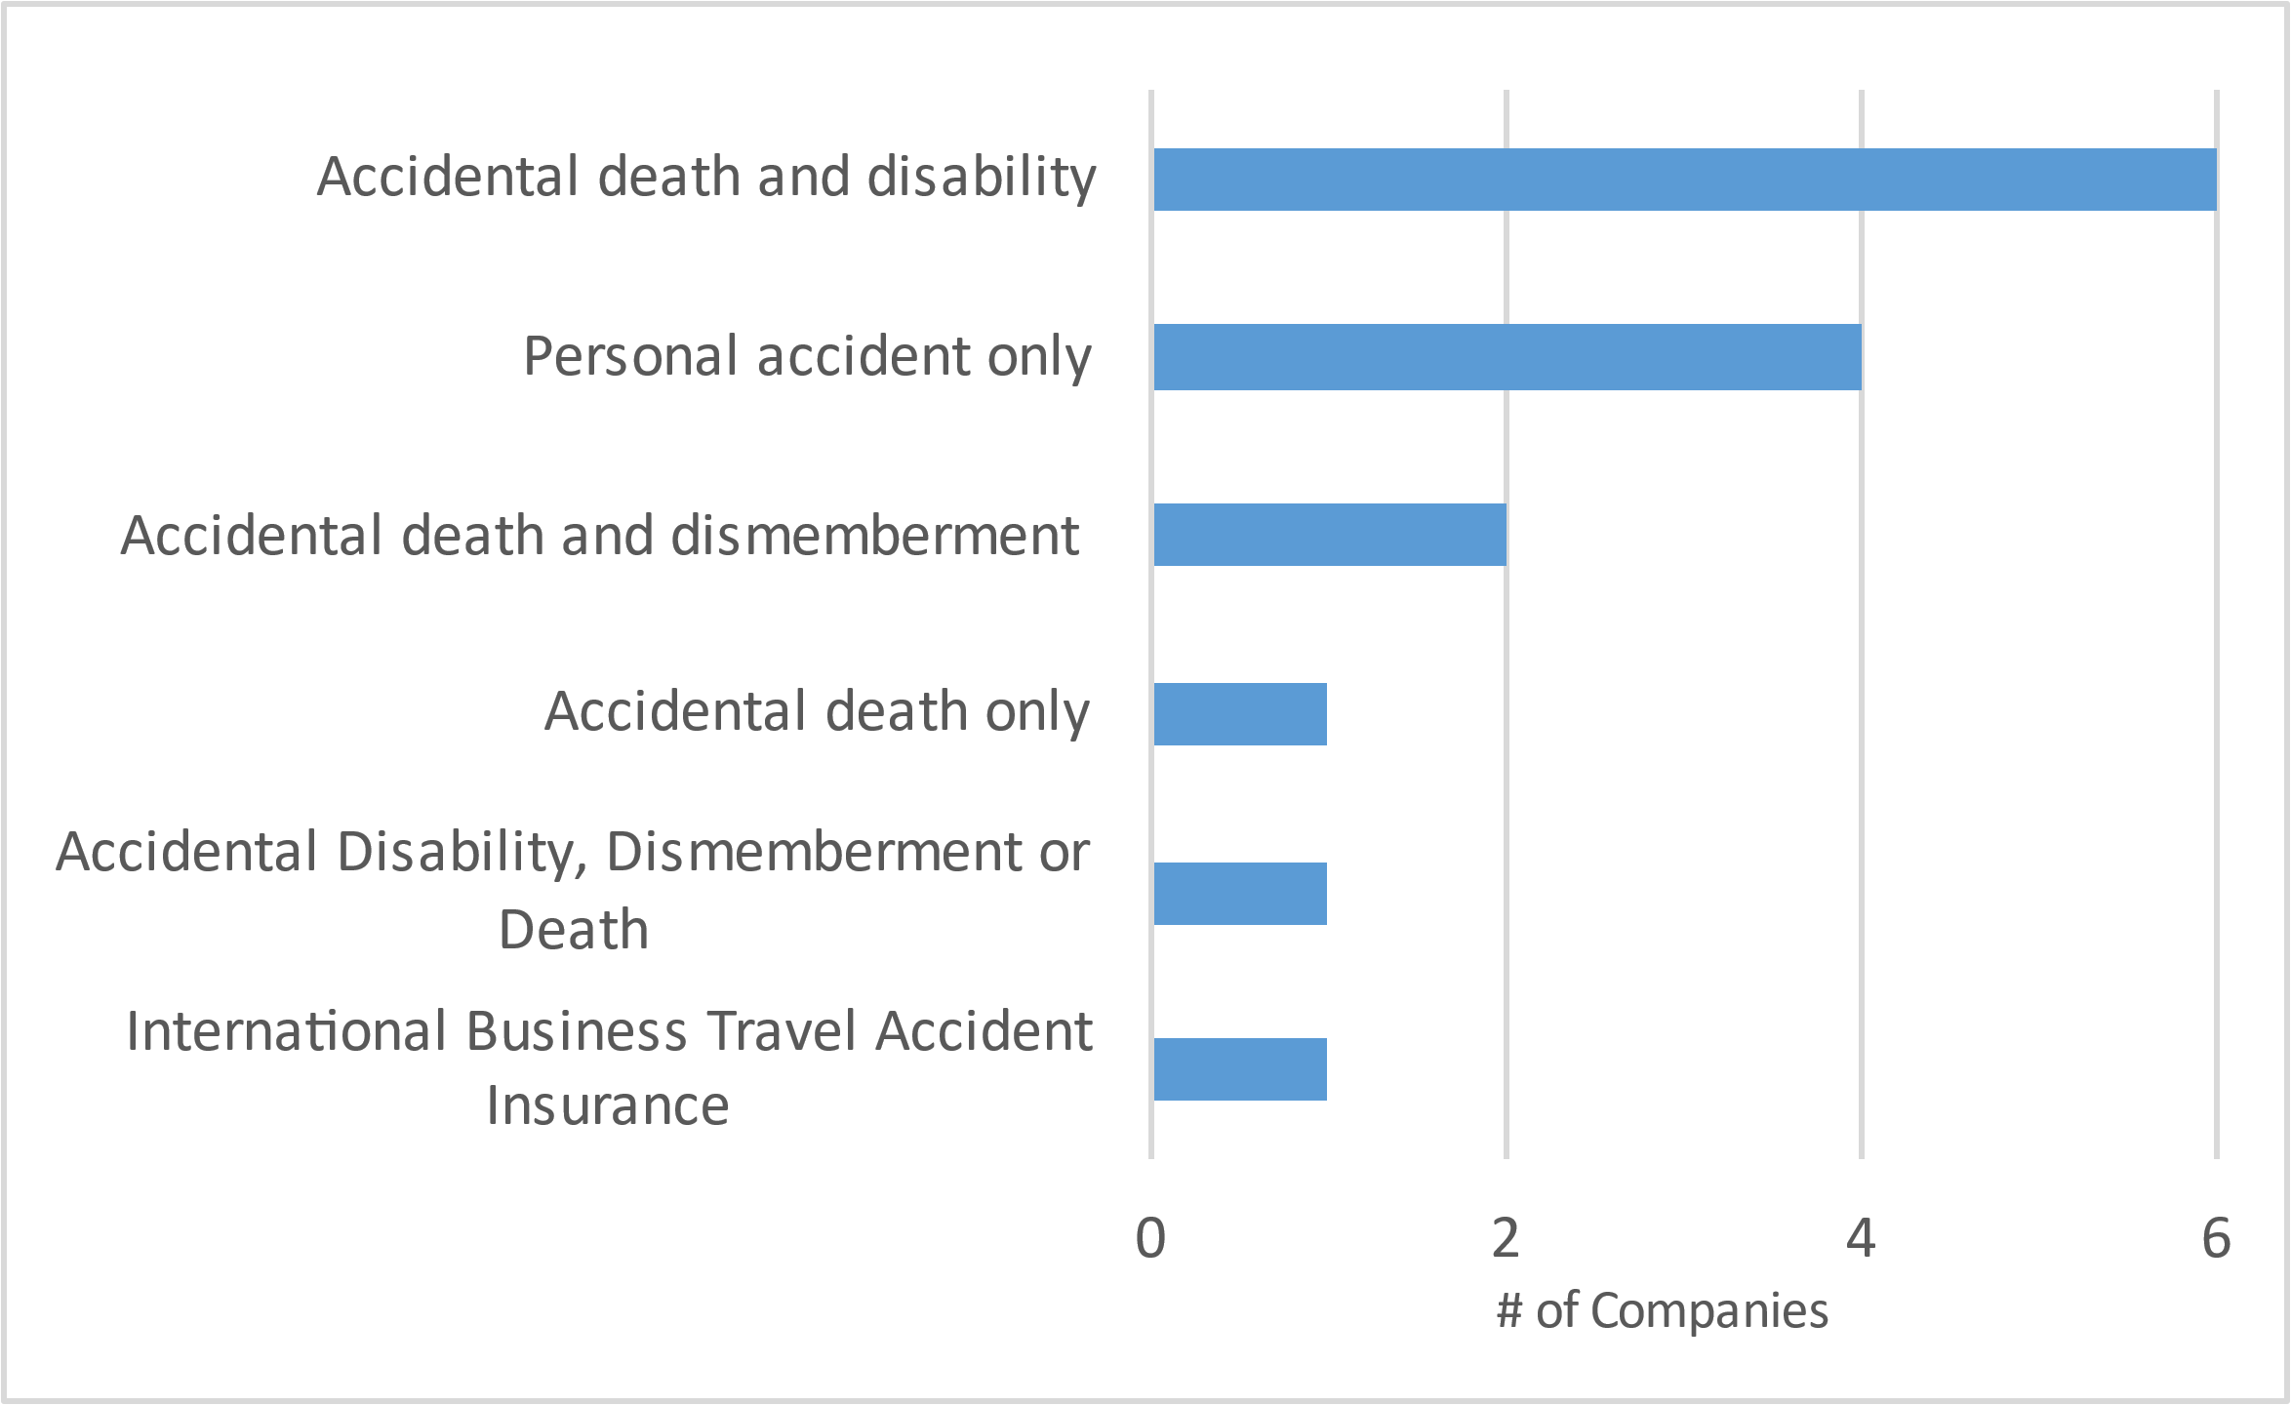
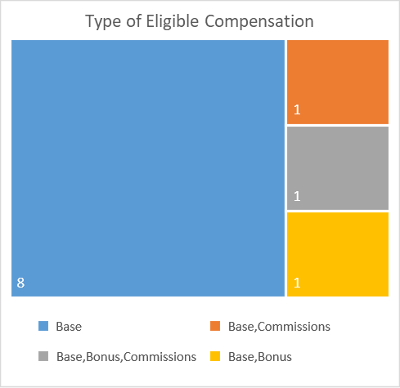
Employee Supplemental Accident Assurance What’s covered & eligible compensation
3 companies provide a fix amount, while most of the others (8) provide a benefit as a multiple of base salary
N = 15
N = 11

Slide 86
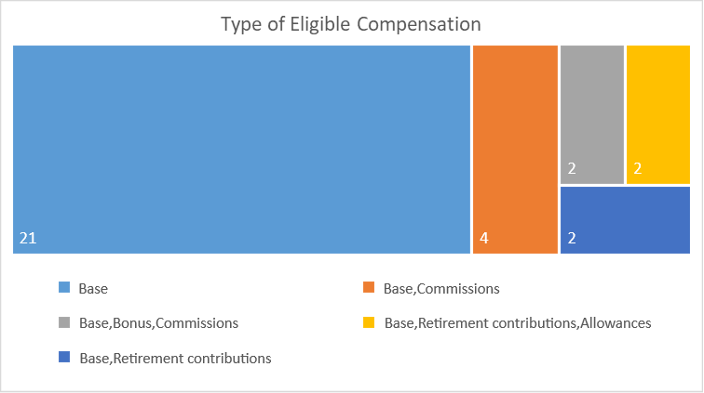
Short Term Disability – Eligible Compensation 68% use base salary only
N = 31
N = 10

Slide 87
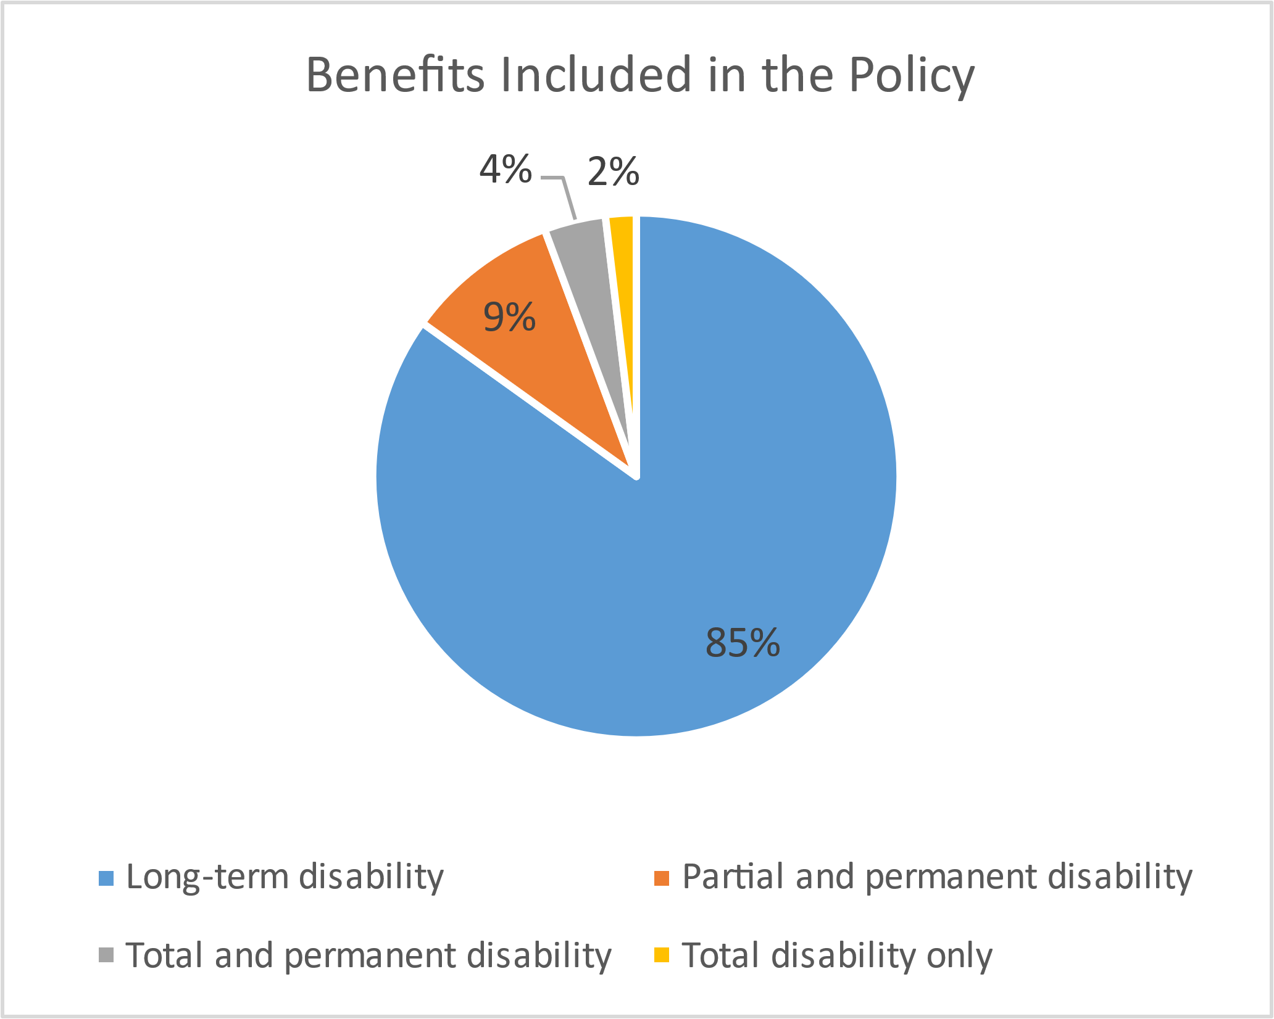
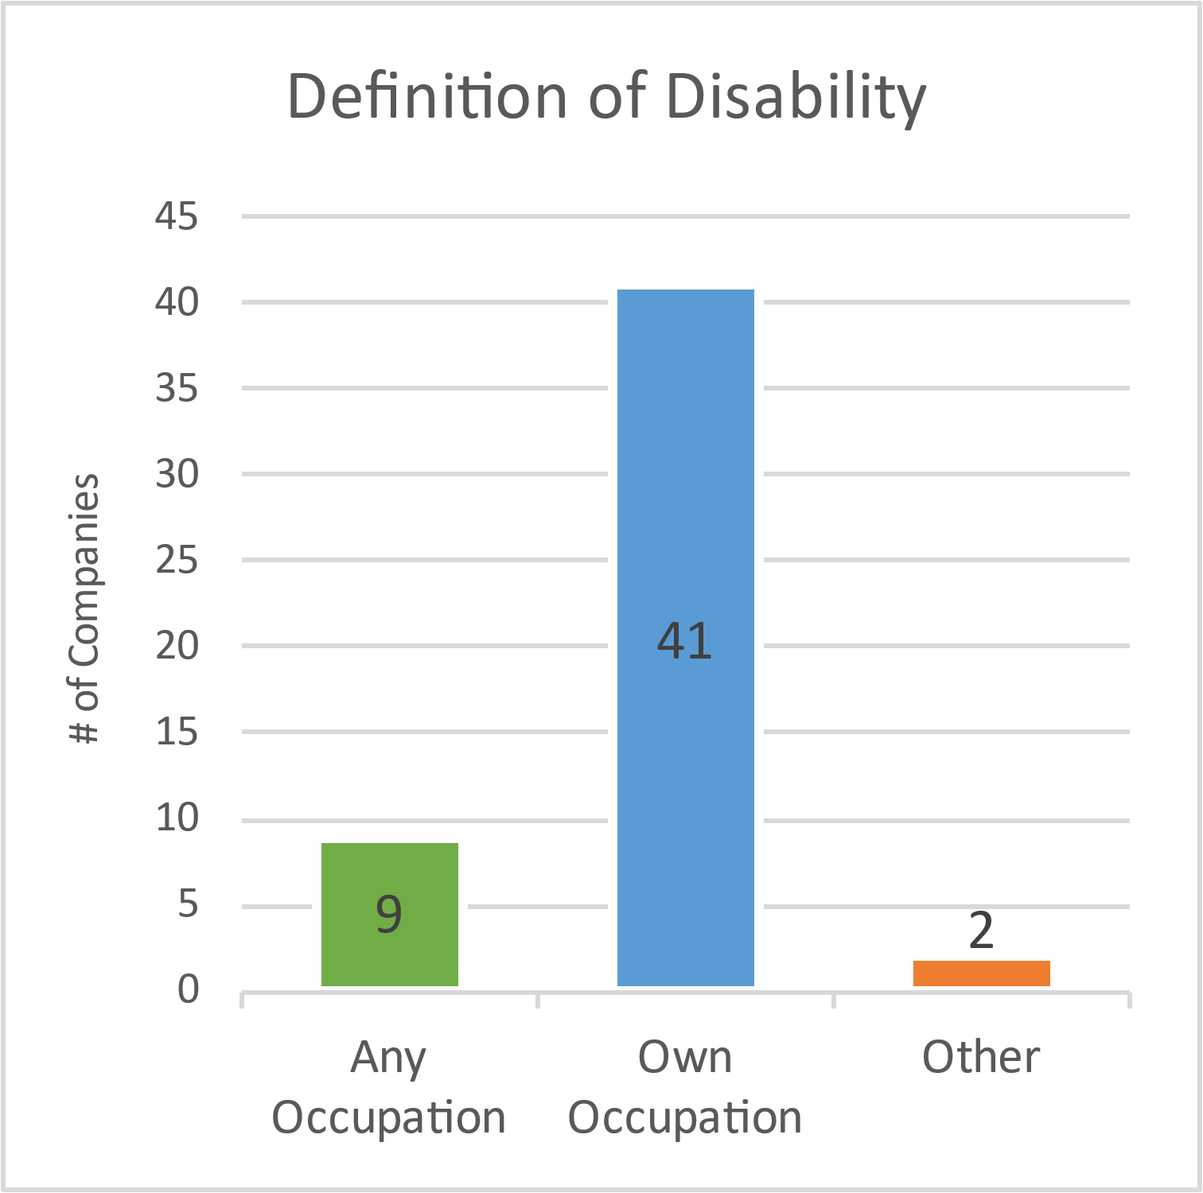
Income Protection Disability benefits included & definition of disability
N = 53
N = 52

Slide 88
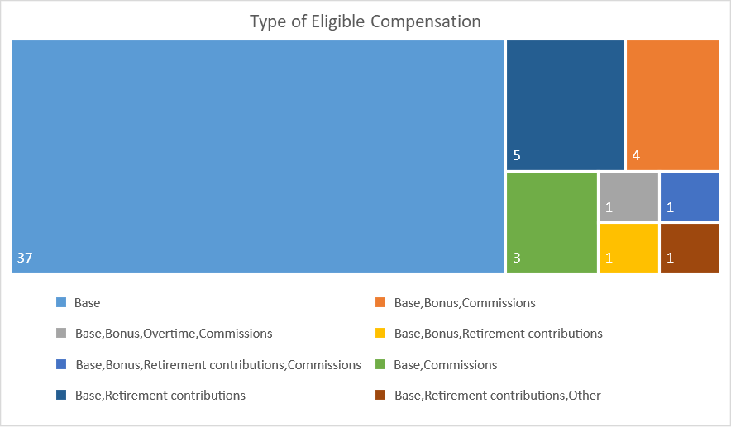
Income Protection – Eligible Compensation 70% use base salary only
N = 53
N = 16

Slide 89
Income Protection – Insurers Used Canada Life and Unum have the largest book of business with SVEF members
The two most popular insurers, Canada Life and Unum, are part of Insurope and Swiss Life’s pooling network, respectively
They were also the most popular insurers for the Life coverage; bundling policies might trigger savings
N = 46

Slide 90
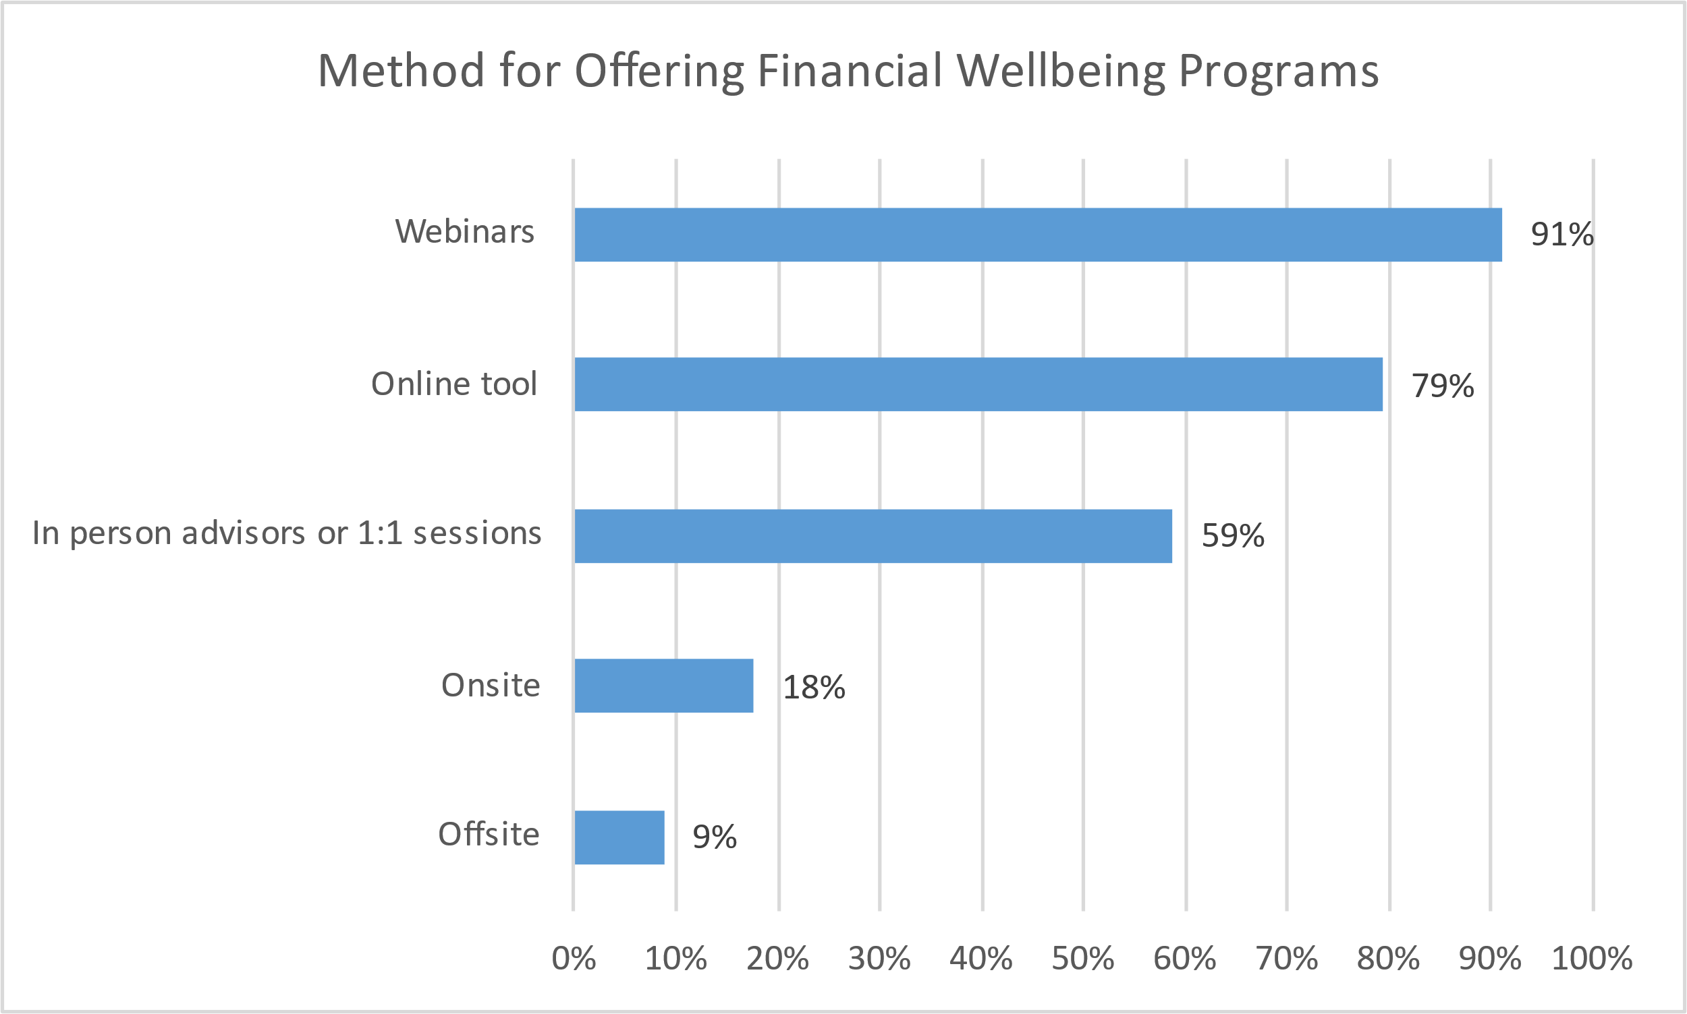
Wellness – Financial Well-Being 60% provide, mostly through webinars and online tools
N = 34

Slide 91
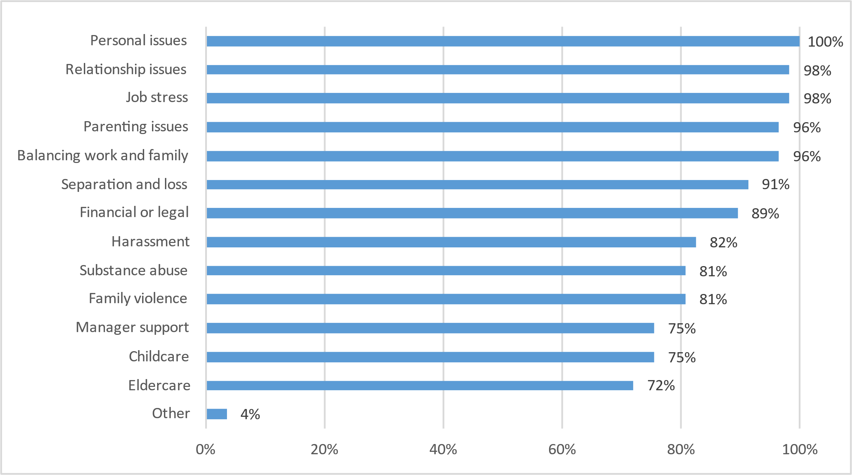
EAP – Covered Issues Most companies provide comprehensive EAP benefits
N = 57

Slide 92
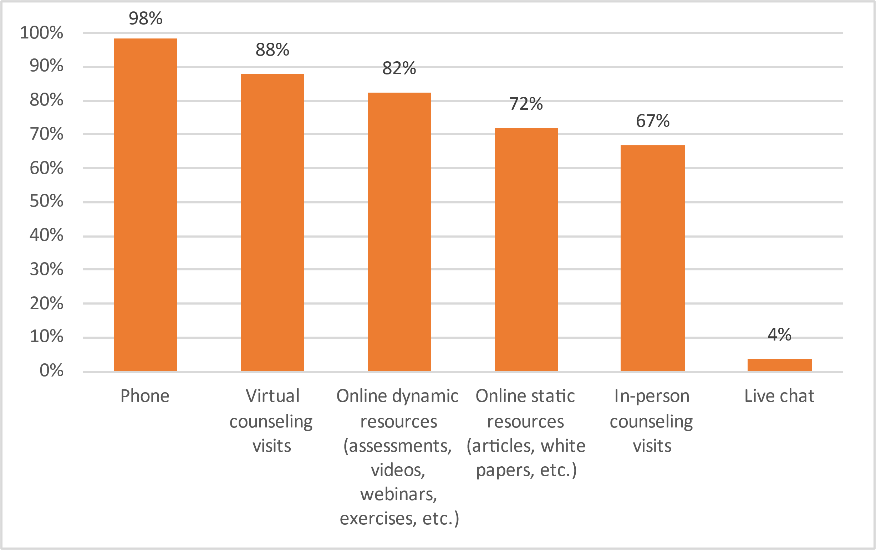
EAP – Methods for Accessing EAP Almost all offer EAP through phone
Personalized online support is prevalent, either through phone or virtual counseling visits
Only 5 companies also offer onsite EAP services, while 1 is considering
N = 57

Slide 93
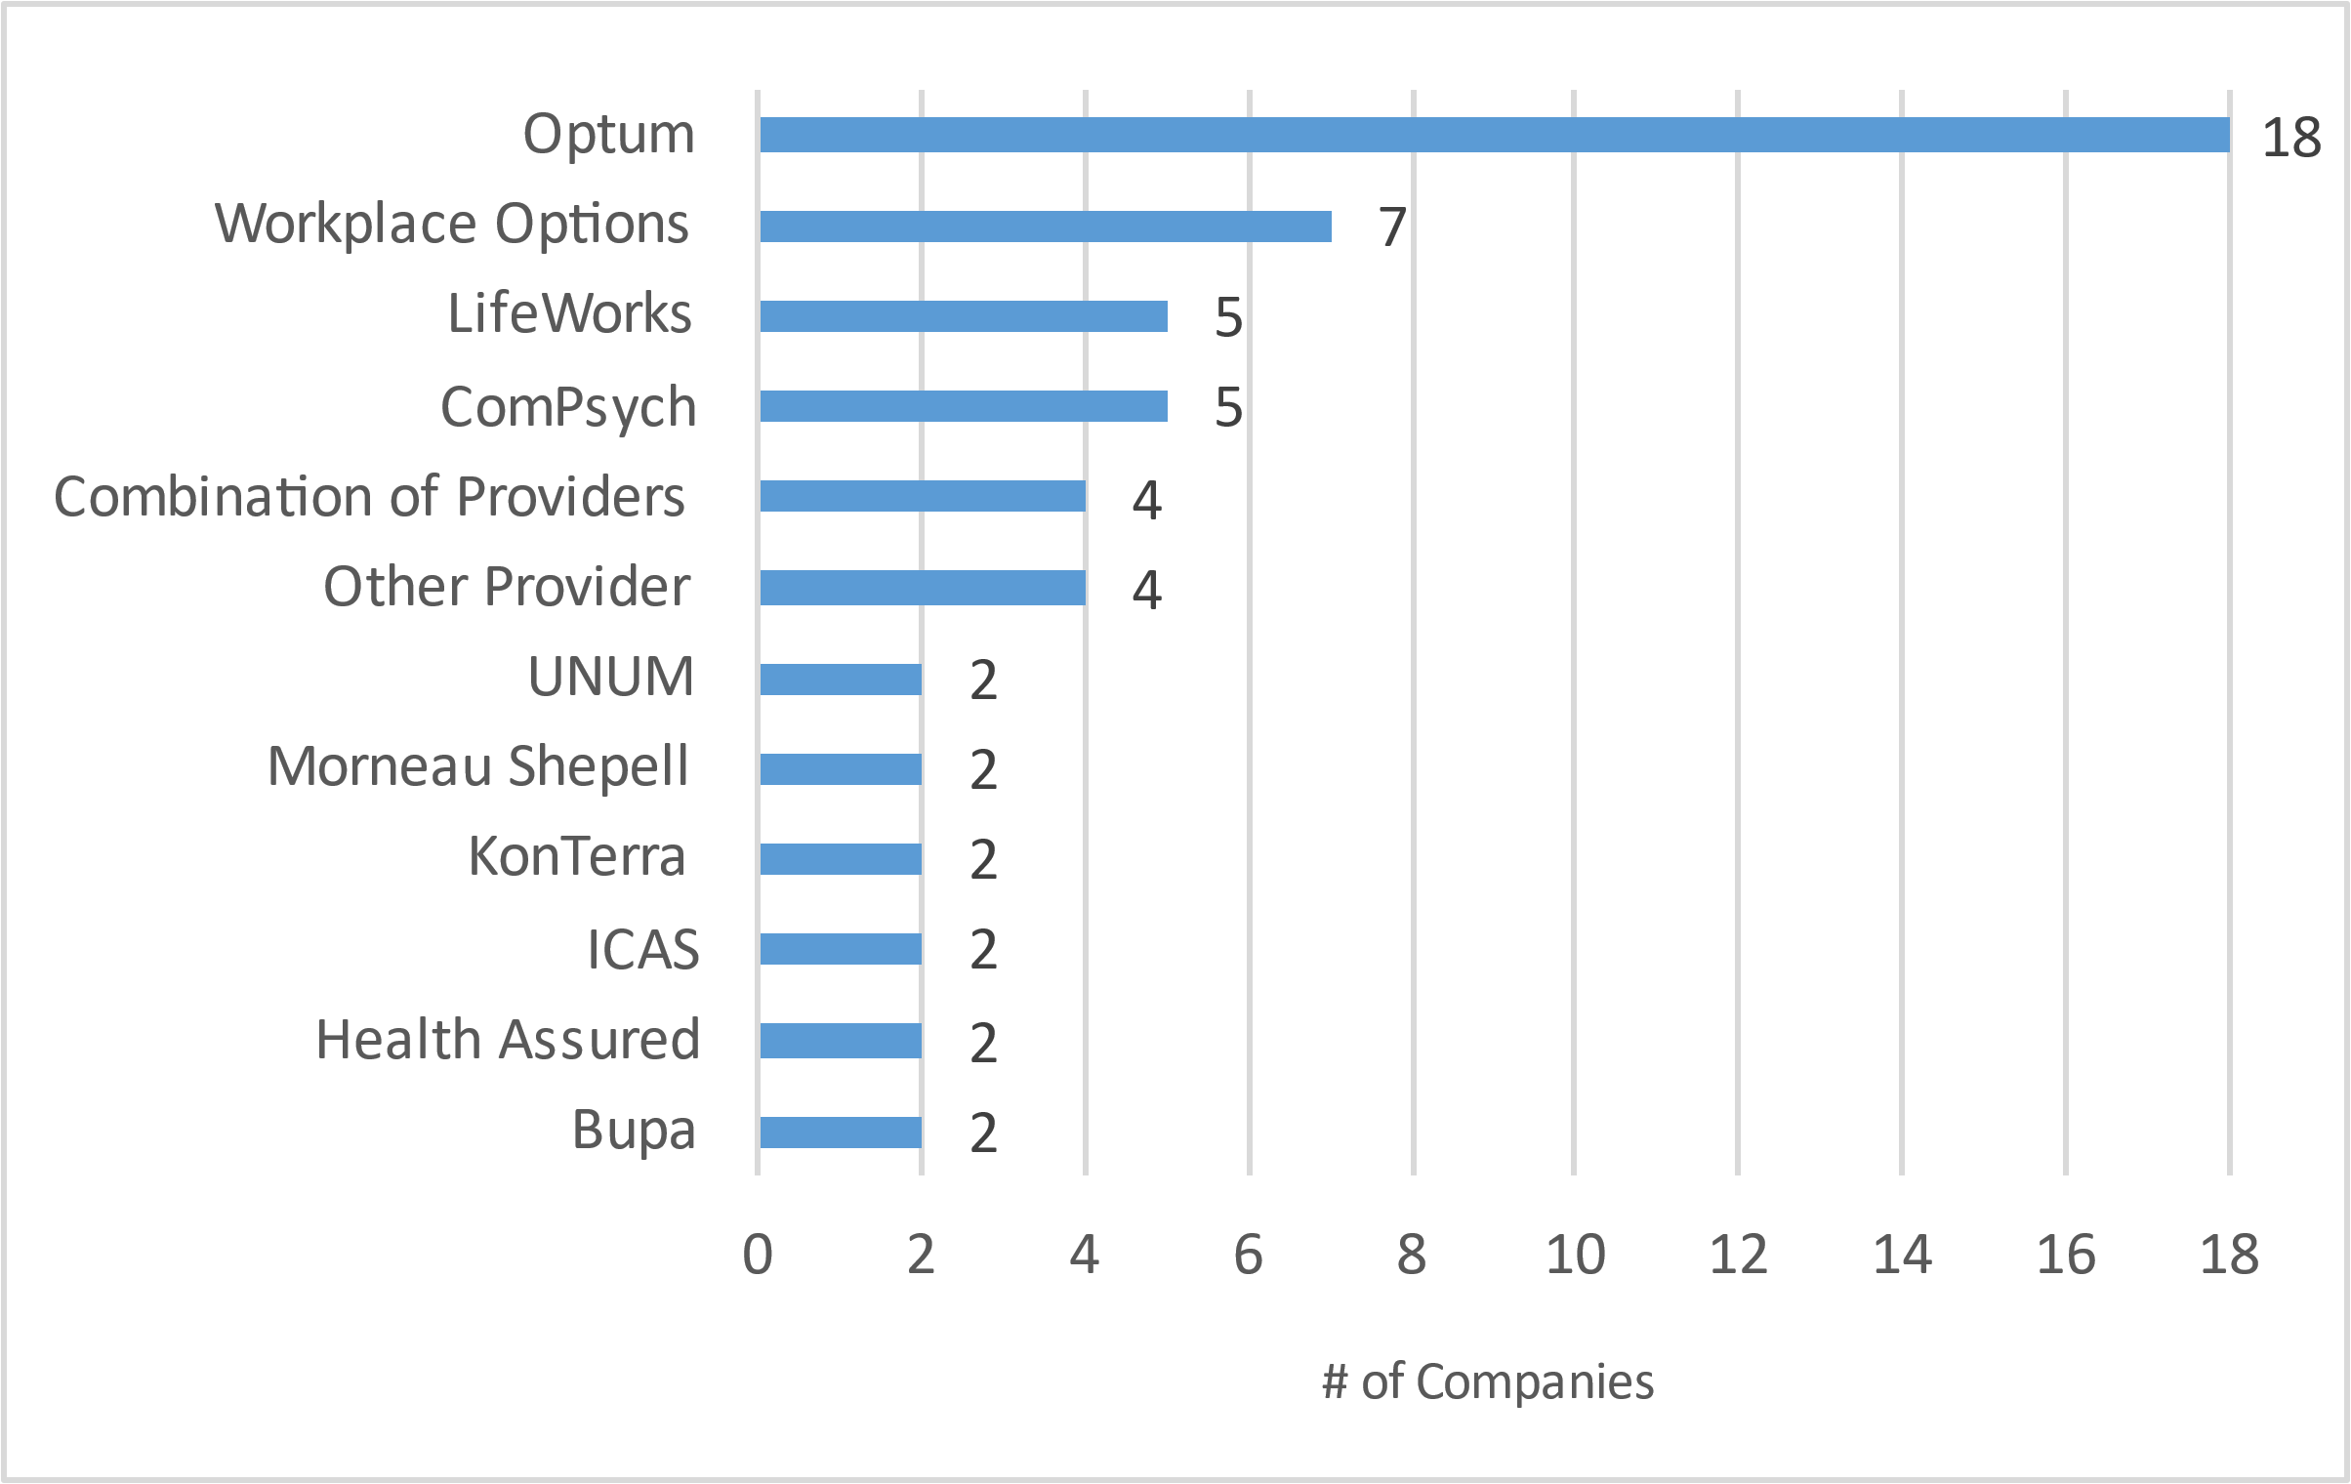
EAP - Providers 33% use Optum
Although there is a wide range of EAP providers, Optum is by far the most popular
When companies leverage a combination of providers, it’s typically one traditional insurer with an EAP provider
N = 55

Slide 94
Annual Leave - Additional Leave for Tenure When granted, companies provide a median of 3.5 additional days leave for tenure for a median maximum leave of 28 days/5.6 weeks
N = 9
N = 8

Slide 95
Perks & Allowances – Service Awards 56% give an award every 5 years starting on year 5
N = 26

Slide 96
Transportation - Car Allowance Amounts Car allowance eligibility and amounts are based on job level and market competitiveness
N=16
N=20
N=21
N=16
N=13
N=19
N = 14

Slide 97
Transportation – Responsible Departments Benefits and HR teams mainly manage the transportation policy
Benefits teams are most commonly listed as managing the transportation policy
N = 53

