Slide 1
SVEF Confidential - Not for Distribution

Slide 2
2022 Canada Benchmark Survey Overview and Agenda
Participating Companies
Company Overview, Demographics, Accomplishments
Supplemental Medical, Dental, and Vision
Supplemental Life, Accident, and Critical Illness
Sickness and Disability
Retirement
Wellbeing
Leaves
Transportation
Perquisites and Allowances
Flexible and Voluntary Benefits
Survey Resources
2

Slide 3
62 Participating Companies Data from all companies are included in presentation
Adobe
Agilent
Airbnb
Alibaba
Amazon
AMD
Apple
Applied Materials
Atlassian
Autodesk
Block
Cadence
Ciena
Cisco
Citrix
Dell
DocuSign
eBay
Electronic Arts
Gen Digital
Google
Hewlett Packard Enterprise
Hitachi Vantara
HP
Intel
Intuit
Juniper Networks
Keysight
Lenovo
LinkedIn
Lumentum
Lyft
Marvell
Meta
Microsoft
NetApp
Netflix
Nutanix
NVIDIA
NXP
Oracle
PayPal
Pinterest
Pure Storage
Qualcomm
Salesforce
Seagate
ServiceNow
Sony Interactive Entertainment
Splunk
Stripe
Synopsys
Take-Two Interactive Software
Tencent
Tesla
Twitter
Veritas
Visa
VMware
Western Digital
Workday
Zendesk

Slide 4
Thank You to Our Survey Team With much appreciation!
Sebastien Auger Microsoft
Kim Coleman Salesforce
Sarah Collins Google
Tim Grace Cisco
Lauren Merluzzi AMD
Gabriela Paiva Rocco Microsoft
Carolina Vertel EA
4

Slide 5
Benefits Summary Percentage of companies offering each benefit
N = 62

Slide 6
2022 Canada Benchmark Survey
Company Overview | Demographics | Accomplishments

Slide 7
Demographics
Total Headcount is 95,773 Employees
49
# of companies with greatest headcount in Ontario
# of companies with greatest headcount in Quebec and British Columbia
6
N = 61

Slide 8
Demographics
Age, Gender, and Work Location
Employee Age (N=56)
High: 49 Years
Low: 30 Years
Average: 39 Years
Most employees are hybrid, splitting their time between working on-site and remotely, or full-time remote
Only a small percentage of employees are working onsite full-time
N = 61

Slide 9
Accomplishments in 2022 Mental Health, Health Plans, Time Off Programs
Mental Health
Expanded benefits, coverage & services
Increased frequency of awareness programs and webinars
Vendor changes
Health Plans
Changed carriers
Added gender affirming care, fertility benefits, virtual care
Enhanced dental and vision plan coverage & limits
Added health care spending account
Time Off
Added / expanded leave programs: parental, family care, COVID-19, bereavement, hardship
Added additional holidays, recharge days
Added sick days
Vendor changes

Slide 10
Demographics
Top Health Risks
Other Conditions
Rheumatoid Arthritis
Dermatology/skin issues
N = 54

Slide 11
2022 Canada Benchmark Survey
Supplemental Medical, Dental, and Vision

Slide 12
Medical Overview
Offer supplemental healthcare coverage (N=62)
98%
Have no eligibility waiting period (N=61)
Have no pre-existing condition waiting period (N=60)
Include dependent coverage (N=61)
SVEF Confidential - Not for Distribution

Slide 13
Medical Dependent Eligibility
5 companies have the same maximum child eligibility age, regardless of student status
All companies providing dependent coverage include spouses and children
98% include common-law partners
N = 60
SVEF Confidential - Not for Distribution

Slide 14
Medical Coverage Included
95% or More | 90-94% | 75-89% | 50-74% | Less than 50%
Chiropractor | Ambulance services | Emergency out-of-country treatments | Vaccination shots | Infertility treatments
Physiotherapist | Massage therapist | Acupuncturist | Prosthetic devices | Neurological disorders
Hearing benefits | Medical supplies | Social worker | Telemedicine | Private hospital room
Psychologist | Naturopath |  | Private duty nursing | Gender affirmation services
 | Semi-private hospital room |  |  | Female egg preservation
 | Osteopath
 | Podiatrist
 | Prescription drugs
 | Speech therapist
N = 61
SVEF Confidential - Not for Distribution

Slide 15
Medical Prescription Drug Coverage
32%
Have dispensing fee caps between $5 and $12 (N=56)
80%
Have a generic substitution clause (N=56)
58%
Require preauthorization for high-cost prescriptions (N=55)
N = 55
SVEF Confidential - Not for Distribution

Slide 16
Medical Cost Sharing
84%
Pay the full cost of employee medical coverage (N=61)
80%
Pay the full cost of dependent medical coverage (N=60)
SVEF Confidential - Not for Distribution

Slide 17
Medical Health Care Spending Account
58%
Provide different employer contributions, typically based on single versus family coverage (N=19)
42%
Provide the same employer contribution to all employees (N=19)
N = 61
SVEF Confidential - Not for Distribution

Slide 18
Medical Insuring and Vendors
SVEF members use seven different medical vendors, but three are commonly used
N = 61
SVEF Confidential - Not for Distribution

Slide 19
Dental All companies provide dental benefits
97%
Have no eligibility waiting period
13%
Offer more than one plan design
100%
Cover spouses and children
94%
Cover common-law partners
N = 55
N = 62
SVEF Confidential - Not for Distribution

Slide 20
Dental - Overview Coverage Included
N = 62
SVEF Confidential - Not for Distribution

Slide 21
Dental Cost Sharing
Dependent Cost Sharing
82%
77%
Pay the full cost
Pay the full cost of employee dental coverage (N=62)
21%
Share the cost with employees
2%
Require employees to pay the full cost
N = 62 (Spouse), N = 58 (Common-law partner), N = 61 (Children)
SVEF Confidential - Not for Distribution

Slide 22
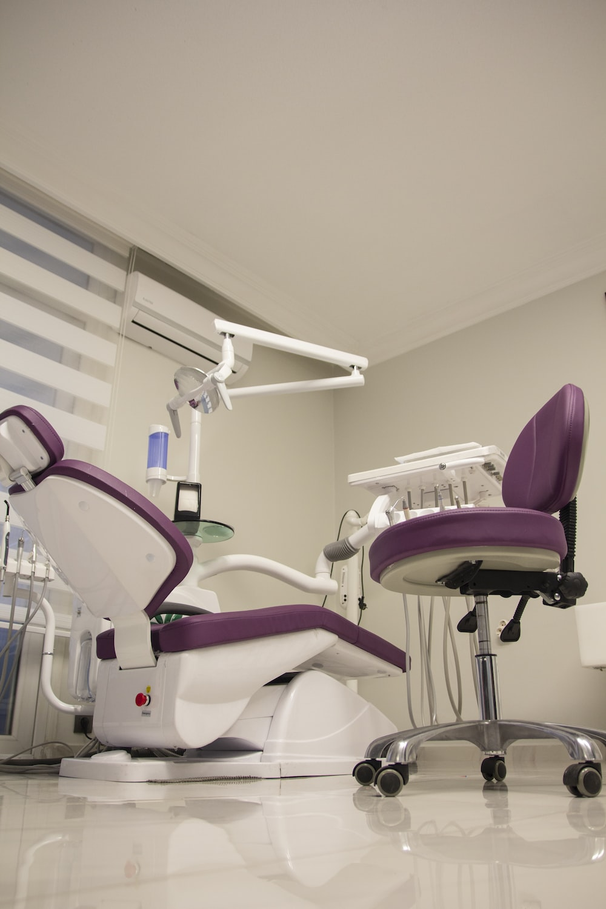
Dental Insuring and Vendors
Companies use the same vendor for medical, dental, and vision
N = 62
SVEF Confidential - Not for Distribution

Slide 23
Vision - Overview 95% of companies offer vision benefits
97%
Have no eligibility waiting period (N=59)
10%
Offer different vision plan designs (N=59)
98%
Include dependent coverage (N=59)
100%
Cover spouses and children (N=58)
95%
Cover common-law partners (N=58)
N = 59
SVEF Confidential - Not for Distribution

Slide 24
Vision Cost Sharing
88%
Pay the full cost of employee vision coverage (N=59)
84%
Pay the full cost of dependent vision coverage (N=58)
SVEF Confidential - Not for Distribution

Slide 25
Vision Insuring and Vendors
Companies use the same vendor for medical, dental, and vision
N = 59
SVEF Confidential - Not for Distribution

Slide 26
2022 Canada Benchmark Survey
Supplemental Life | Accident | Critical Illness

Slide 27
Employee Supplemental Life Insurance Overview
All companies provide supplemental life insurance without a waiting period
56%
Provide the benefit to both employees and eligible dependents
N = 35
SVEF Confidential - Not for Distribution

Slide 28
Employee Supplemental Life Insurance Types of compensation covered
Use multiple of earnings as the benefit formula
98%
N = 59

Slide 29
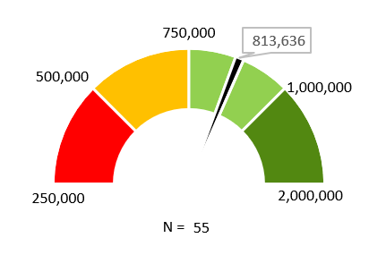
Employee Supplemental Life Insurance Coverage Levels
97%
Cap the life benefit
Maximum Life Benefit (CAD)
N = 61

Slide 30
Supplemental Life Insurance Dependent Life
97%
Provide a different coverage for dependents (n=35)
Most companies provide spouses with $10,000 of coverage and children with $5,000
All but one company provides half the amount of the spouse death benefit in case of a child’s death
SVEF Confidential - Not for Distribution

Slide 31
Supplemental Life Insurance Additional coverage
N = 62
N = 61

Slide 32
Employee Supplemental Life Insurance Insurance
Most companies (94%) pay for the full cost of the policy
Eight different vendors are used, with most using one of three vendors
89%
Insure their life benefit with a carrier (vs. self-insured)
SVEF Confidential - Not for Distribution

Slide 33
Employee Supplemental Accidental Insurance Overview
Provide supplemental accidental insurance without a waiting period
92%
Most companies (93%) provide the benefit to employees only
N = 57
SVEF Confidential - Not for Distribution

Slide 34
Employee Supplemental Accidental Insurance Types of compensation covered
Use multiple of earnings as the benefit formula
98%
N = 50

Slide 35
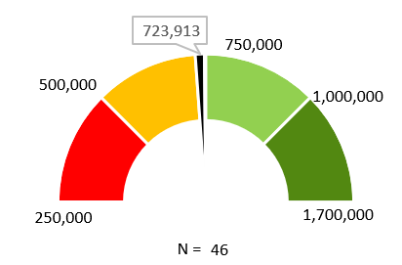
Employee Supplemental Accidental Insurance Coverage Levels
91%
Cap the accidental benefit
Maximum Accidental Benefit (CAD)
N = 54

Slide 36
Supplemental Accidental Insurance Additional coverage
N = 61
N = 60

Slide 37
Supplemental Accidental Insurance Insurance
Most companies (98%) pay for the full cost of the policy
88%
Insure their life benefit with a carrier (vs. self-insured)
Twelve (12) different vendors are used, with most companies using the same vendor as life insurance
N = 48
SVEF Confidential - Not for Distribution

Slide 38
Supplemental Critical Illness Overview
Only 23%
Provide a critical illness benefit, typically a flat amount to employees only and without a waiting period
When provided, critical illness is a company-provided, paid benefit in half the cases, while the rest offer it on a voluntary, employee-paid basis
SVEF Confidential - Not for Distribution

Slide 39
2022 Canada Benchmark Survey
Sickness | Disability

Slide 40
Supplemental Sick Leave Overview
When provided, 98% of companies fully pay for the supplemental sick leave
The majority (83%) does not require proof
Carry over of unused sick days are typically not allowed (only 10% do)
N = 62
SVEF Confidential - Not for Distribution

Slide 41
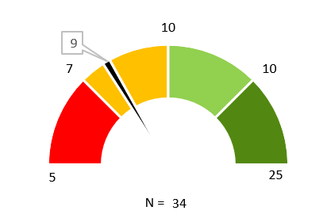
Supplemental Sick Leave Number of supplemental days
Three (3) companies also provide unlimited sick leave
SVEF Confidential - Not for Distribution

Slide 42
Supplemental Short-Term Disability Overview
87%
Provide short-term disability (STD) above statutory requirements
There’s typically (93%) no waiting period
For 89% of companies, the definition of disability is the inability to perform own occupation. 11% use the inability to perform any occupation.
N = 49
SVEF Confidential - Not for Distribution

Slide 43
Supplemental Short-Term Disability Types of compensation covered
N = 52

Slide 44
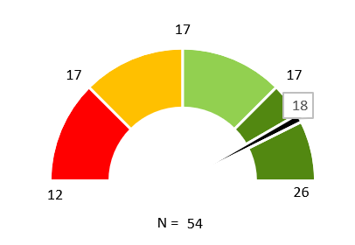
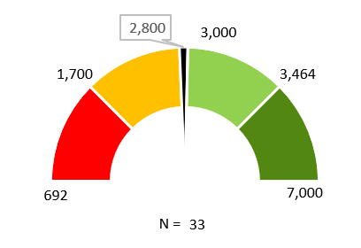
Supplemental Short-Term Disability Duration and Weekly Maximum
61%
Cap the STD benefit
Duration (weeks)
Weekly maximum (CAD)

Slide 45
Supplemental Short-Term Disability Percentage of Pay Provided During the STD Period
Average: 75.8%
Median: 72.5%
Provide the same benefit throughout the entire STD period
69%
N = 36

Slide 46
Supplemental Short-Term Disability Insurance
94%
Most companies pay for the full cost of the STD
About half the companies (48%) insure their STD benefit with a carrier (vs. self-insured)
Nine (9) different vendors are used, with most companies using the same vendor as life insurance
N = 24
SVEF Confidential - Not for Distribution

Slide 47
Supplemental Long-Term and Total Permanent Disability Overview
Only 5%
Provide total permanent disability (TPD), paid as a lump sum payment. One company is considering.
Provide long-term disability (LTD), paid as a regular payment, above statutory requirements
87%
SVEF Confidential - Not for Distribution

Slide 48
Supplemental Long-Term Disability Waiting Period and Definition of Disability
There’s typically (88%) no waiting period
Companies using a combination definition of disability typically use own occupation for 2 years, then transition to any occupation.
N = 53
SVEF Confidential - Not for Distribution

Slide 49
Supplemental Long-Term Disability Elimination Period in Weeks
Average: 18.2 weeks
Median: 17 weeks
When both STD and LTD are provided, the LTD elimination period matches the STD maximum duration period, except in one case
N = 50
SVEF Confidential - Not for Distribution

Slide 50
Supplemental Long-Term Disability Types of compensation covered
N = 52

Slide 51
Supplemental Long-Term Disability Maximum Duration of the LTD Benefit
All but one company providing a specified age that is not retirement age end LTD at 65
Companies providing a specified number of weeks have a maximum duration of 104 weeks
N = 52

Slide 52
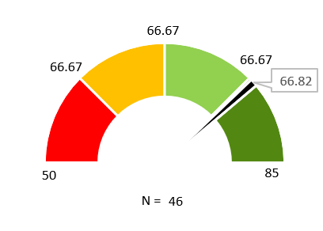
Supplemental Long-Term Disability Percentage of Pay Provided During the LTD Period
Provide the same benefit throughout the entire LTD period
92%

Slide 53
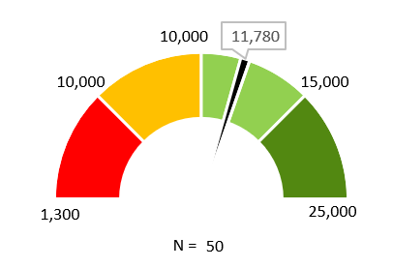
Supplemental Long-Term Disability Monthly Maximum Benefit (CAD)
94%
Cap the LTD benefit

Slide 54
Supplemental Long-Term Disability Insurance
N = 53
N = 46
SVEF Confidential - Not for Distribution

Slide 55
Supplemental Long-Term Disability Vendors
91%
Insure their LTD benefit with a carrier (vs. self-insured)
Like short-term disability, nine (9) different vendors are used, with most companies using the same vendor as life insurance

Slide 56
2022 Canada Benchmark Survey
Retirement

Slide 57
Supplemental Retirement Benefits Overview
92%
Offer a supplemental retirement or savings plan (N=62)
95%
Have no waiting period (N=57)
Do not offer an alternative for higher-paid employees affected by capped retirement benefits (N=56)
96%
N = 57
SVEF Confidential - Not for Distribution

Slide 58
Group Registered Retirement Savings Plan (RRSP) Most companies only contribute if the employee contributes
N = 54
SVEF Confidential - Not for Distribution

Slide 59
2022 Canada Benchmark Survey
Wellbeing

Slide 60
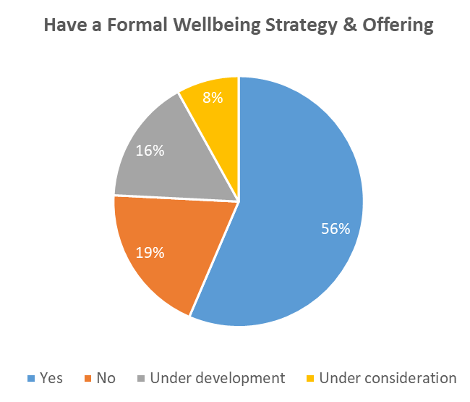
Wellbeing Benefits – Overview Just over half of companies have a formal strategy & offering
Types of Data Used For Strategic Wellbeing Planning & Program Design
Employee Assistance Program
Employee Surveys
Market Practice Information
Focus Group Discussions
Medical Claims
Health Assessments
Occupational Health Data
Risk Policy Claims
86%
80%
57%
37%
37%
20%
N = 62
Of those that do, the majority have a defined vision & strategic plan that is aligned with the business strategy
14%
14%
N = 35

Slide 61
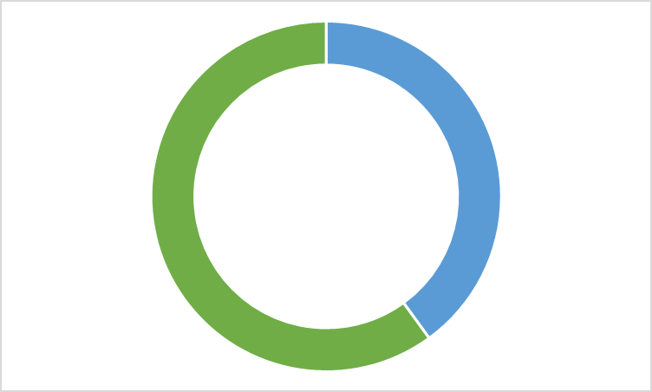
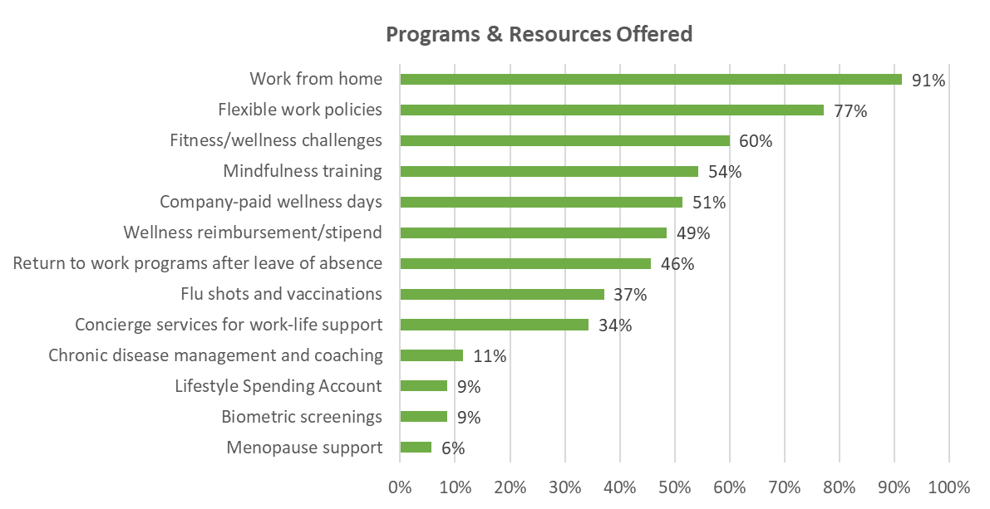
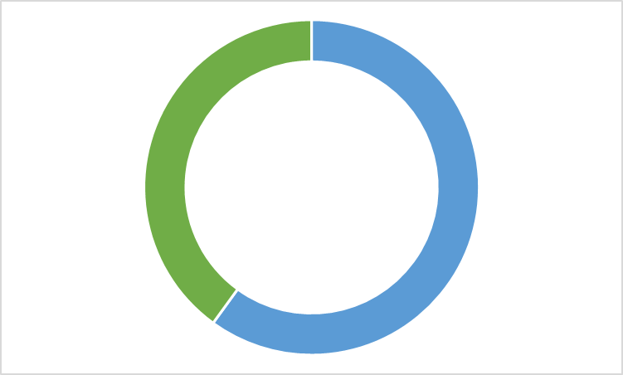
Wellbeing Benefits – Overview What’s offered and who's eligible
Who Can Use the Program (N=35)
40%
Employees Only
60%
Employees & Dependents
100%
Spouse & common-law partner
81%
Children < age 18
76%
Children age 18+
N = 35
24%
Parents
N = 21

Slide 62
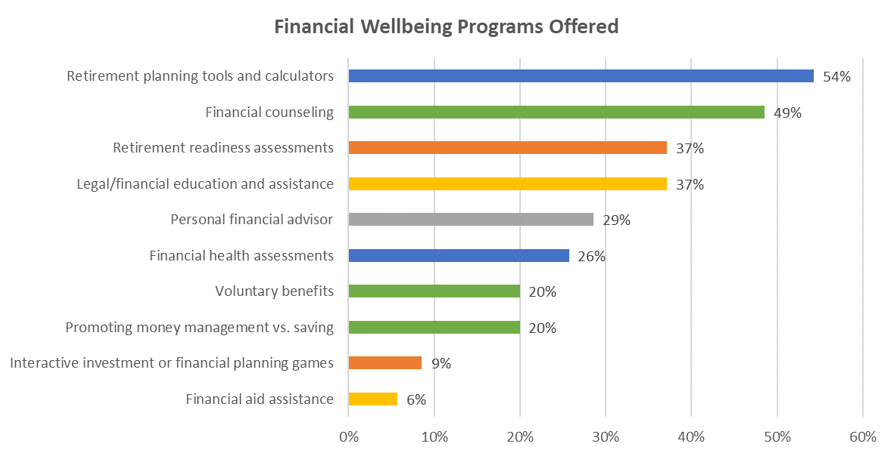
Wellbeing Benefits – Financial Wellbeing Companies providing financial wellbeing benefits offer a variety of programs
N = 35

Slide 63
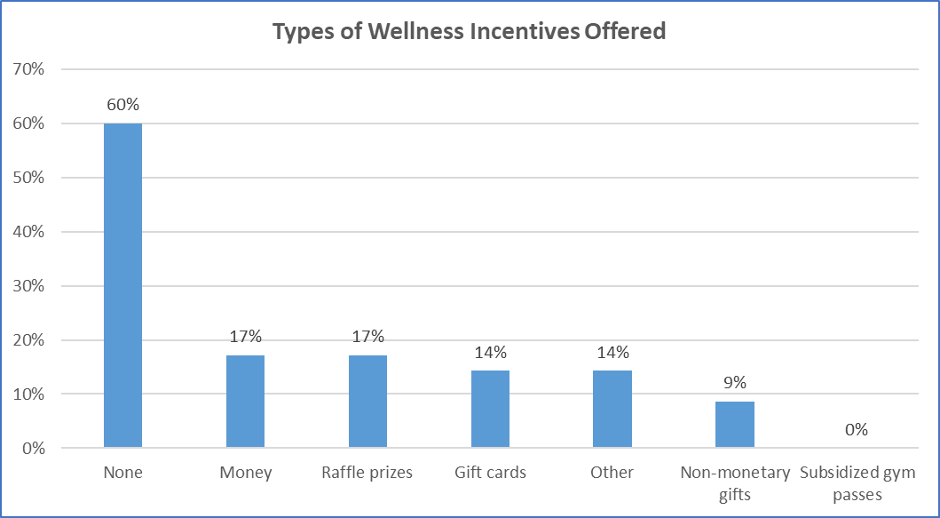
Wellbeing Benefits – Incentives Most companies do not provide them
Other Types of Incentives Offered
T-shirts, blankets, lunchboxes
Wellness points
Wellness vendor
N = 35

Slide 64
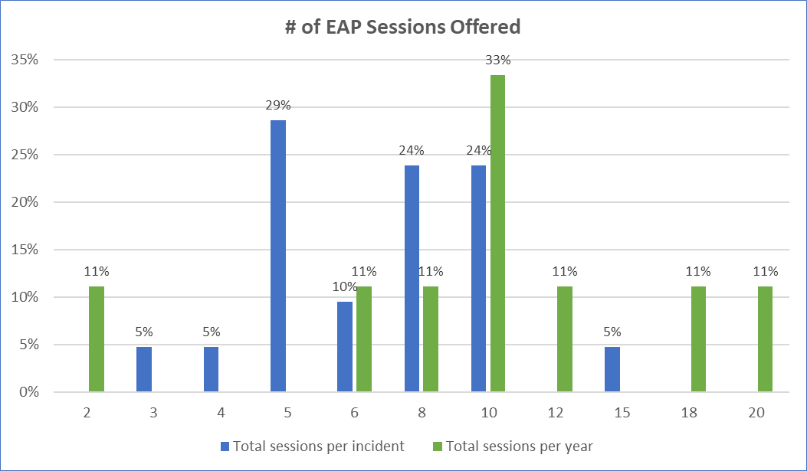
EAP – Overview All except one company provides an EAP
N = 21 per incident; 9 per year

Slide 65
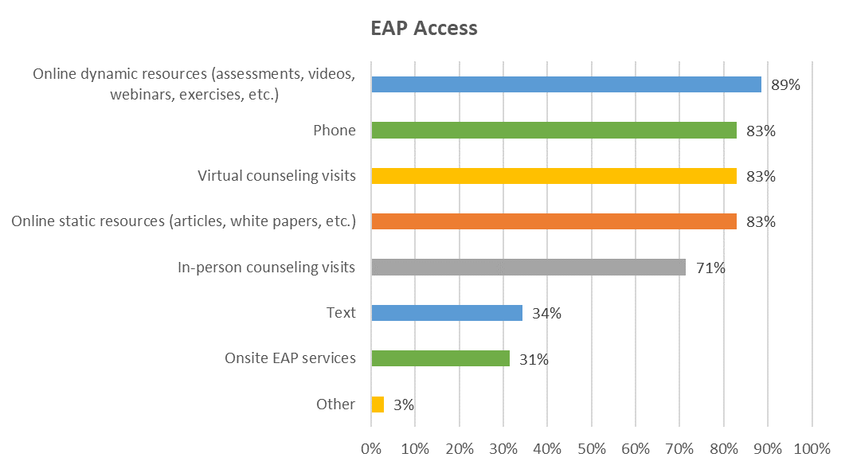
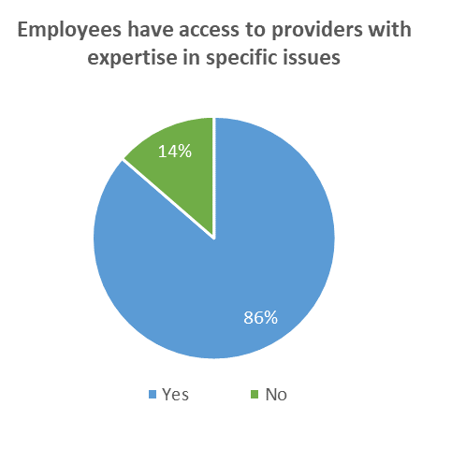
EAP – Access Companies provide many ways to access EAP services
N = 22
N = 35

Slide 66
Wellbeing Benefits – Other Services Mental wellbeing support is also provided outside of EAP & medical plan
Caregiving Support
Mental Health First Aid
Immediate Crisis Hotline/Support
Digital App/Platform/Vendor
N = 35

Slide 67
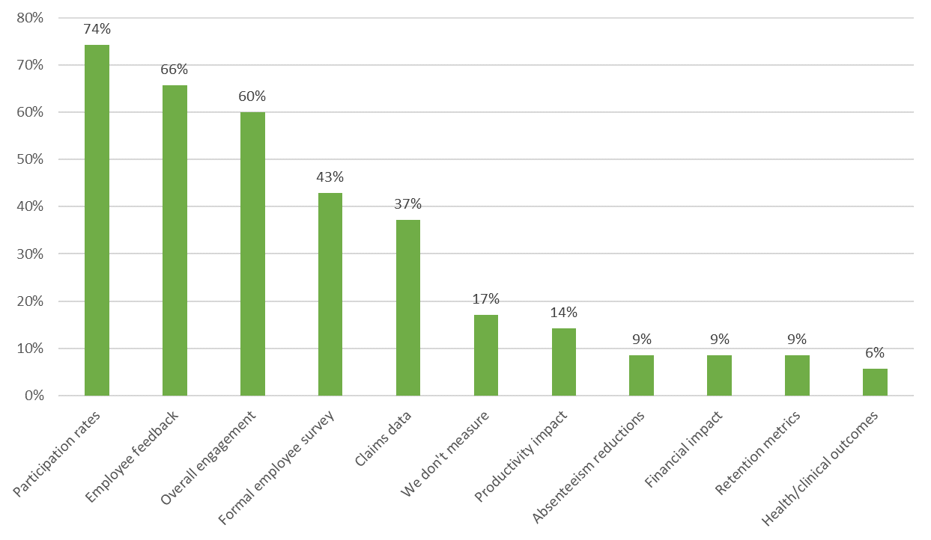
Wellbeing Benefits – Impact Companies measure impact in a variety of ways
N = 35

Slide 68
2022 Canada Benchmark Survey
Leaves

Slide 69
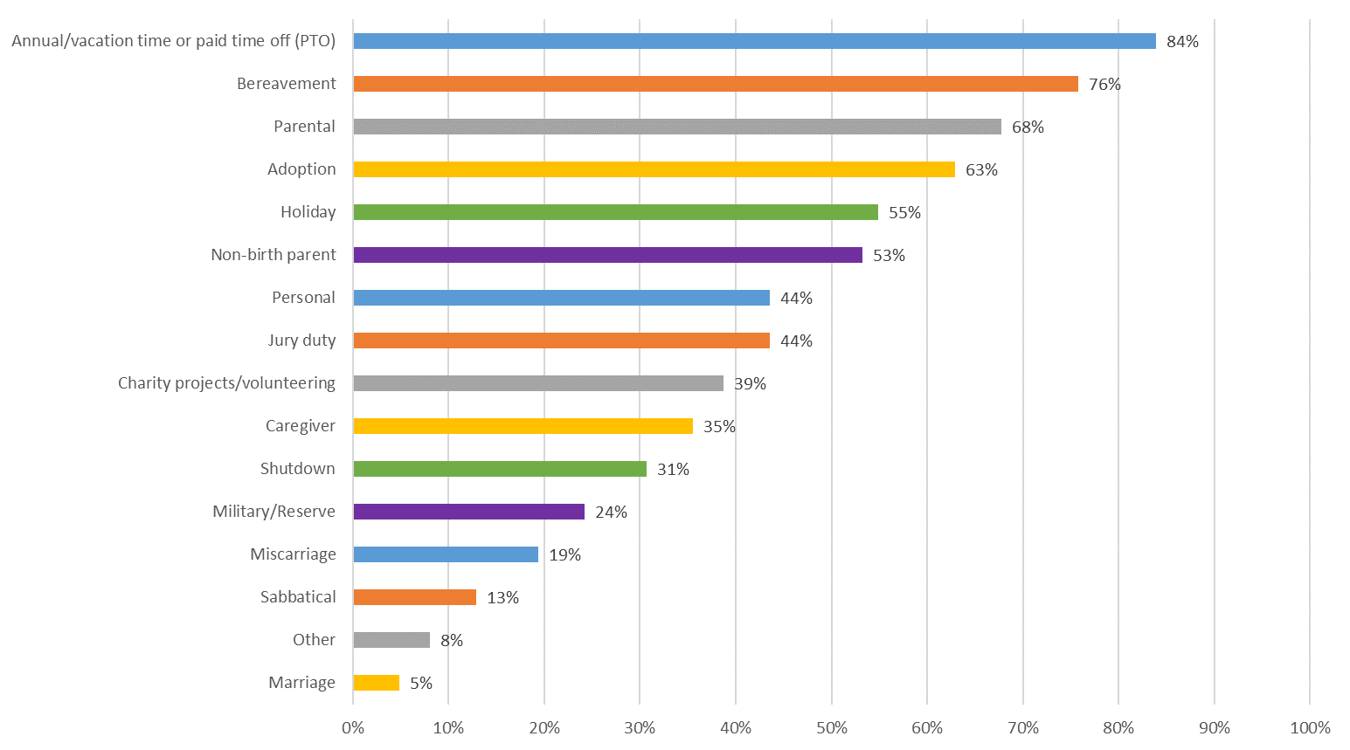
Leaves – Types Offered Above Statutory Requirements Most companies supplement vacation and bereavement leaves
N = 62

Slide 70
Leaves – Proof Requirements Companies require proof for caregiver, jury duty & bereavement leaves
3
Companies require proof for taking bereavement leave
64%
Caregiver (N=22)
68%
Provide the same bereavement leave for all relationships
59%
Jury Duty (N=27)
Companies providing the same amount of bereavement leave for all relationships provide between 3 and 20 days

Slide 71
Leaves Other Differentiating & Unique Policies Offered

Slide 72
2022 Canada Benchmark Survey
Transportation

Slide 73
Transportation
Only 8 companies offer transportation benefits
Transportation Benefits Provided
87% do not offer any transportation benefits
Public transportation
1 company is considering providing transportation benefits
Car allowances
Parking
13% offer transportation benefits
Company cars
N = 62

Slide 74
2022 Canada Benchmark Survey
Perquisites | Allowances

Slide 75
Perquisites & Allowances
Overview of what’s offered
N = 62

Slide 76
Perquisites & Allowances
35 companies offer tuition assistance
Maximum Annual Tuition Assistance (excluding MBAs)
91% require a passing grade to provide tuition assistance (N=35)
N = 30
Maximum Annual Tuition Assistance (including MBAs)
N = 24

Slide 77
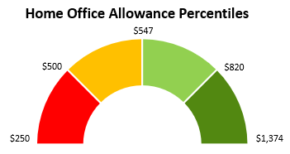
Perquisites & Allowances
About 1/3 offer service awards, home office benefits, and/or internet subsidies
Service Awards Provided (N=19)
Gifts/Experiences
N = 16
Cash
Additional time off
N = 17

Slide 78
2022 Canada Benchmark Survey
Flexible Benefits | Voluntary Benefits

Slide 79
Flexible and Voluntary Benefits
Neither are typically offered
Flexible Benefits
Voluntary Benefits
18%
offer voluntary benefits (N=62)
8% offer flexible benefits (N=62)
Most prevalent voluntary benefits:
Pet insurance
2 companies are considering them
Discount products
Homeowner’s insurance

Slide 80
2022 Canada Benchmark Survey
Survey Resources

Slide 81
Canada Survey Resources Available to SVEF Members Where to Find Them and How They are Used
Resources Available | Use
Summary Presentation Posted on sveforum.org | High-level overview of survey results
Excel File of Aggregate Data Posted on sveforum.org | Detailed analysis using comprehensive data
Excel File of Custom Cut Data Files delivered via email on 16 December | Detailed analysis of companies selected for your custom cut
Dashboards https://knowledgenow.ajgsurveys.com/Login.aspx | Online view of survey results Comparison of your company and all SVEF members Comparison of your company and selected SVEF members

Slide 82
82

Slide 83
svefsurvey@sveforum.org

